Slide 1
How are commercial video games used by teachers to support primary aged pupils’ learning of programming concepts?
Neil Rickus
King’s College, London
Email - neil.rickus@kcl.ac.uk
Twitter / X - @computingchamps
Notes:
PUT ON IMAGES
PLAY - https://www.youtube.com/watch?v=S51ps-5vvIQ

Slide 2
Today’s session
Why, or why not, to use commercial, off-the-shelf (COTS) video games to support primary aged pupils’ learning of programming concepts
Research related to the use of COTS video games when teaching programming in schools
How you use, or might use, COTS video games to support primary aged pupils’ learning of programming concepts
Play COTS video games to determine how they could be used to support primary aged pupils’ learning of programming concepts

Slide 3
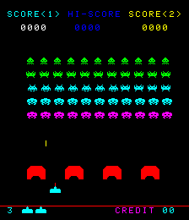
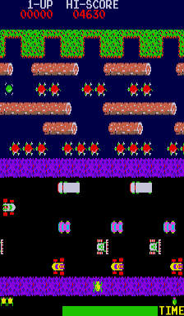
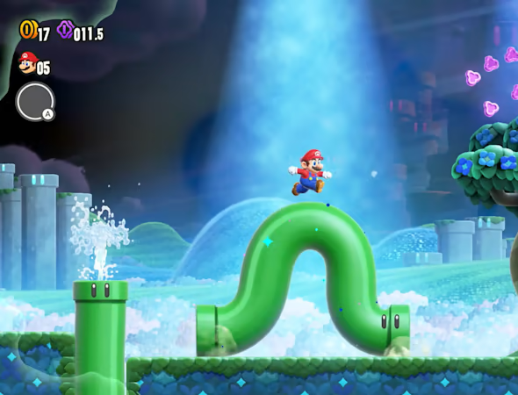
What are COTS video games?
Video games developed for entertainment purposes
•What were your thoughts, feelings or beliefs when viewing the images of the
video games as you entered the session?
Notes:
Images from Moby Games

Slide 4
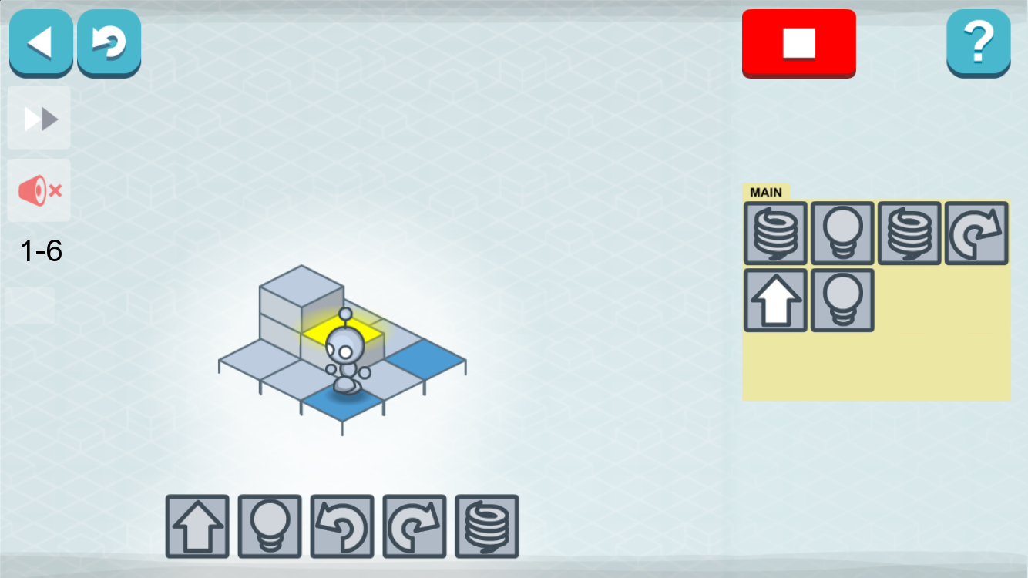
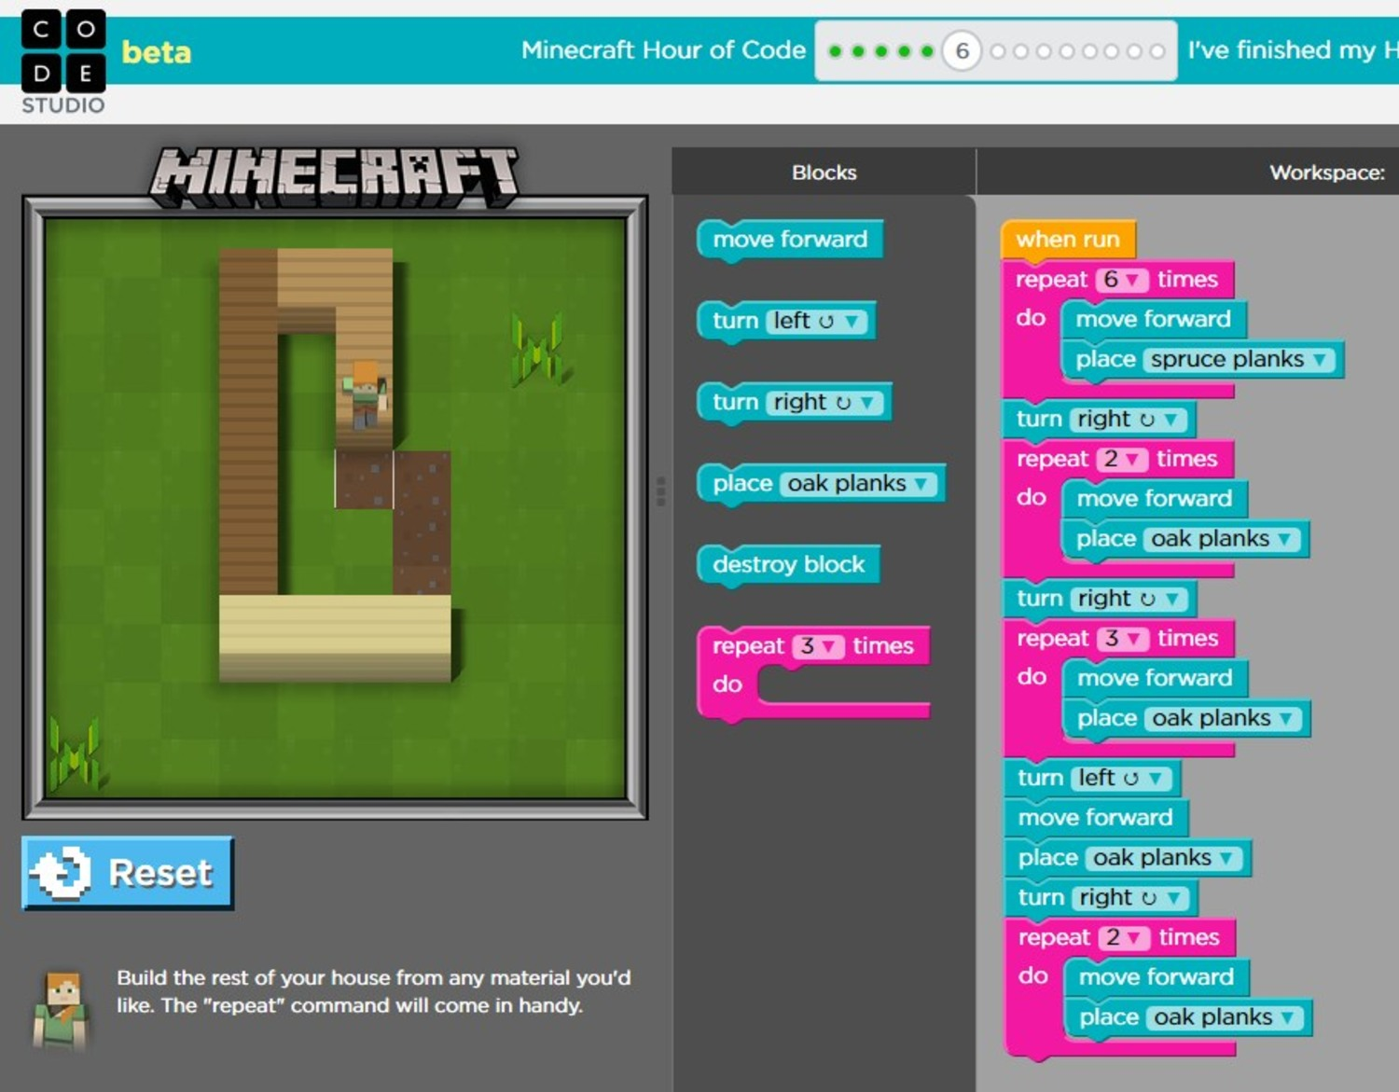
What are COTS video games?
COTS video games are different to:
edutainment games
games specifically developed to teach programming
gamification
games featuring a programming component

Slide 5
What are programming concepts?
English KS2 Computing National Curriculum (DfE, 2013) :
Sequence
Repetition
Selection
Variables
Block-based environment, such as Scratch
Notes:
https://assets.publishing.service.gov.uk/media/5a7c576be5274a1b00423213/PRIMARY_national_curriculum_-_Computing.pdf

Slide 6
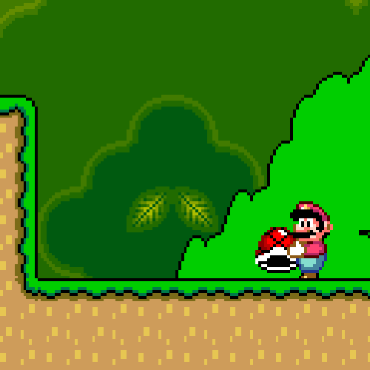
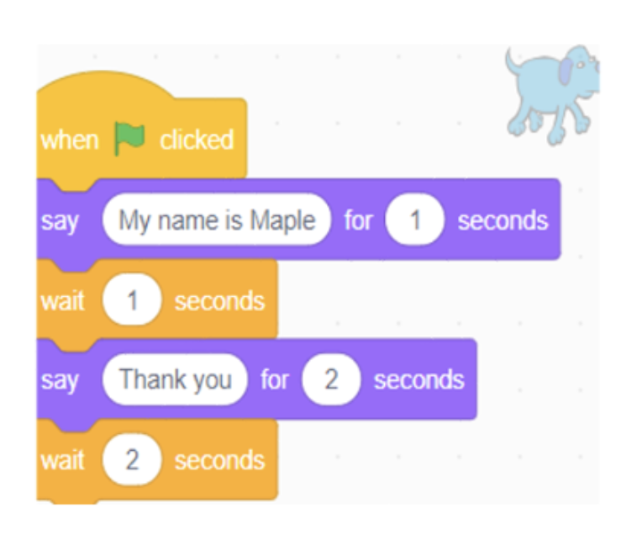
What are programming concepts?
Sequence
Series of instructions carried out in order
Kick shell
Jump
Grab shell

Slide 7
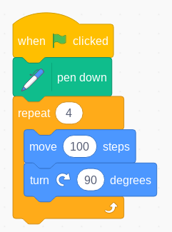
What are programming concepts?
Repetition
Instructions taking place a number of times, or indefinitely
Forever
Move left for 1 second
Turn around
Move right for 1 second
Turn around

Slide 8
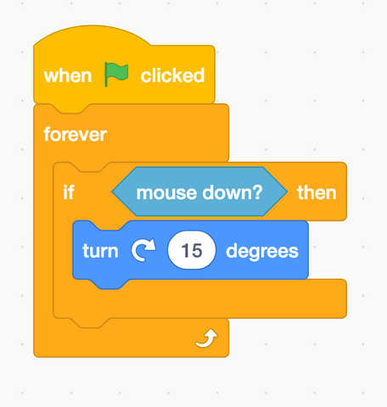
What are programming concepts?
Selection
Carrying out an instruction if something happens (a condition is met)
Forever
If touching waterfall
Play splash sound

Slide 9
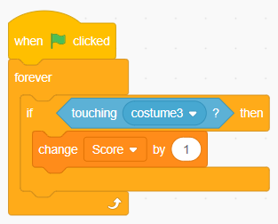
What are programming concepts?
Variables
Store data in the computer’s memory
Forever
If jump button pressed
Change Score by 1

Slide 10
Over to you…
Why might teachers use commercial, off-the-shelf (COTS) video games to support primary aged pupils’ learning of programming concepts?
Why might teachers not use commercial, off-the-shelf (COTS) video games to support primary aged pupils’ learning of programming concepts?
Write your thoughts on Post-it notes (one idea per Post-it note) and stick them on the relevant sheet

Slide 11
Why use COTS video games?
COTS video games deliver benefits in school (Kafai & Burke, 2015)
Increased engagement
Attitudes towards computing
Carefully selected video games have the potential to support pupils learning to program (Zhang & Kaufman, 2014)
Using appropriate pedagogical techniques – e.g. linking concrete elements in the game to abstract programming concepts
•“Games, from pencil and paper to video games, can teach concepts embedded within them” (Curzon et al, 2023, p. 156)
Notes:
Curzon, P., McOwan, P., Donohoe, J., Wright, S., & Marsh, W. (2023). Teaching of Concepts. In S. Sentance, E. Barendsen, C. Schulte, & N. R. Howard (Eds.), Computer Science Education: Perspective on Teaching and Learning in School. Bloomsbury.
Kafai, Y. B., & Burke, Q. (2015). Constructionist Gaming: Understanding the Benefits of Making Games for Learning. Educational Psychologist, 50(4), 313–334. https://doi.org/10.1080/00461520.2015.1124022
Zhang, F., & Kaufman, D. (2014). USING VIDEO GAMES IN COMPUTER SCIENCE EDUCATION. European Scientific Journal, ESJ, 10(22), Article 22. https://doi.org/10.19044/esj.2014.v10n22p%p

Slide 12
Related literature – Rapid review
Identified 12 studies related to school aged children
Three main themes were evident:
Students making their own version of a commercial video game they have played / viewed. n = 6
Parts of a commercial video game used to develop students’ knowledge and understanding of programming concepts. n = 3
Commercial video games of interest to students used as a stimulus to program their own games. n = 3

Slide 13
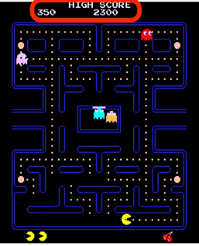
Related literature – Rapid review – Example
Grover et al (2019)
Unplugged activity to introduce variables
Students watch a video of Pac-Man and list, “the different variables they observe, and their ranges” (p. 1137)
Students also discuss how values change
Students then alter values within an educational game
72 students – US grades 6, 7, 8
Scratch projects demonstrated “better performance … especially on coding constructs and the use of operators” (p. 1140)
Notes:
Grover, S., Jackiw, N., & Lundh, P. (2019). Concepts before coding: non-programming interactives to advance learning of introductory programming concepts in middle school. Computer Science Education, 29(2-3), 106–135. https://doi.org/10.1080/08993408.2019.1568955

Slide 14
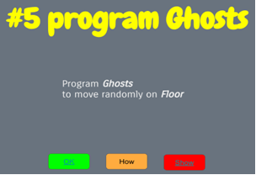
Related literature – Rapid review – Example
Basawapatna et al (2019) – differentiated support for developing own games provided via online tutorials
Research focused on lines of code completed (1,468 Pac-Man games and 767 Frogger games examined)
Notes:
Basawapatna, Ashok, Alexander Repenning, and Mark Savignano. 2019. ‘The Zones of Proximal Flow Tutorial: Designing Computational Thinking Cliffhangers’. In Proceedings of the 50th ACM Technical Symposium on Computer Science Education, 428–34. SIGCSE ’19. New York, NY, USA: Association for Computing Machinery. https://doi.org/10.1145/3287324.3287361.

Slide 15
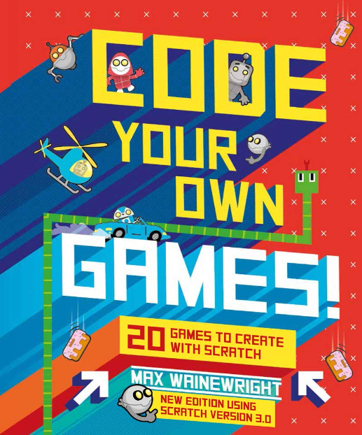
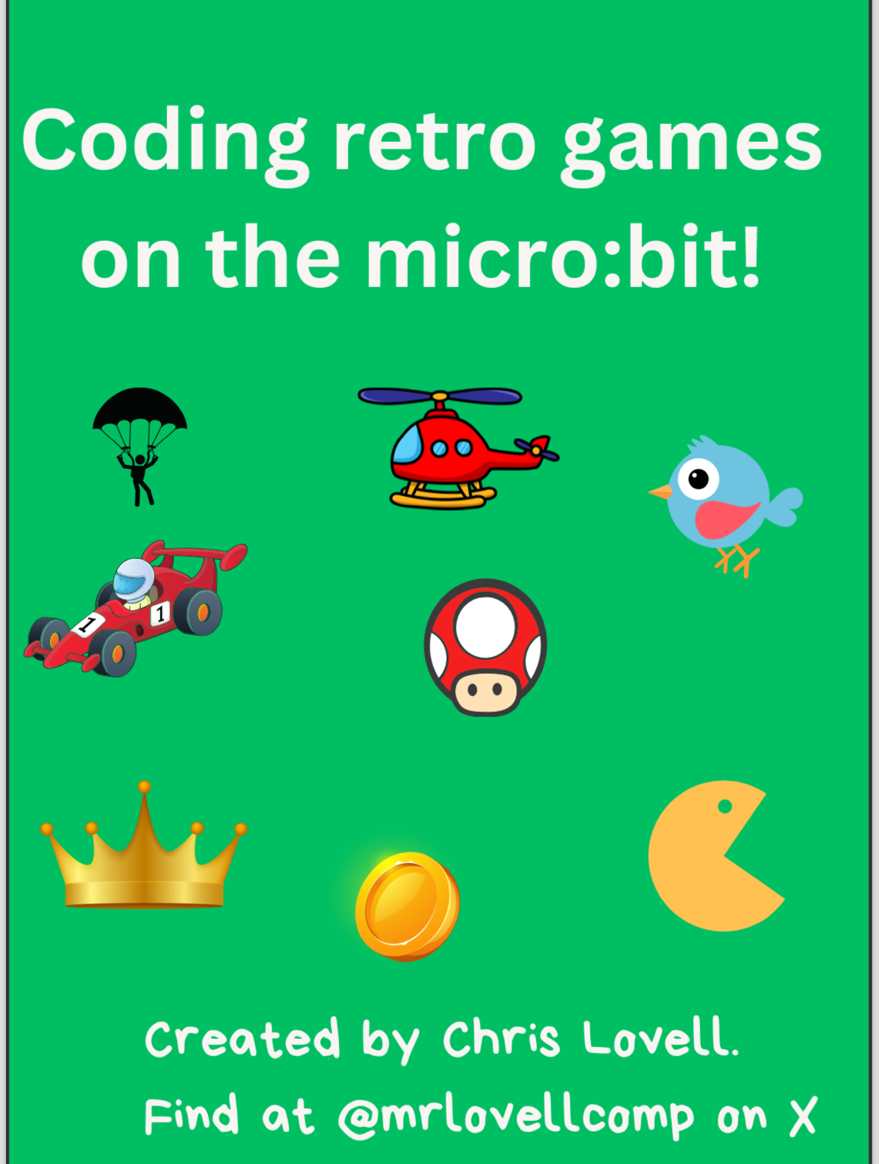
Related literature – Other initiatives

Slide 16
Related literature – Learning using video games
Egenfeldt-Nielsen et al (2020, p. 255-6) – Characteristics of commercial, off the shelf, video games when used in education:
Gee (2007) – 36 ways to learn a video game
Bogost (2007) – Procedural rhetoric
Notes:
Egenfeldt-Nielsen, S., Smith, J. H., & Tosca, S. P. (2020). Understanding video games: The essential introduction (Fourth edition). Routledge, Taylor & Francis Group.
Gee, J. P. (2007). What Video Games Have to Teach Us About Learning and Literacy: Revised and Updated Edition (2nd edition). Palgrave Macmillan.
Bogost, I. (2007). Persuasive Games: The Expressive Power of Videogames. The MIT Press. https://doi.org/10.7551/mitpress/5334.001.0001

Slide 17
Related literature – Absence of research
The pedagogical approaches employed, such as how the COTS video game is incorporated into lessons when used to support primary pupils’ learning of programming concepts
Teachers’ and pupils’ views and opinions on using COTS video games to support primary pupils’ learning of programming concepts; particularly with regards to motivation
89 primary teachers in England / Italy showed the, “motivational power” (Allsop & Jesse, 2015, p. 8) of games was the reason most cited for their use
120 teachers across Europe. Teachers’ main expectation from games was to, “increase motivation of pupils” (Wastiau et al., 2009, p. 73)

Slide 18
How do you use COTS video games?
Let’s find out from each other how we use, or might use, COTS video games to support primary pupils’ learning of programming concepts
What might be useful to know? – e.g. part of game used, how the game is introduced to pupils, programming concept covered
Create a list with the people around you and be prepared to share with the group

Slide 19
How do you use COTS video games?
Spreadsheet link – bit.ly/dsh-jun24
Complete the spreadsheet for how you currently use, or might use, COTS video games to support pupils’ learning of programming concepts
Learning trajectories – e.g. for variables (Rich et al, 2022)
Notes:
Rich, K. M., Franklin, D., Strickland, C., Isaacs, A., & Eatinger, D. (2022). A Learning Trajectory for Variables Based in Computational Thinking Literature: Using Levels of Thinking to Develop Instruction. Computer Science Education, 32(2), 213–234. https://doi.org/10.1080/08993408.2020.1866938

Slide 20
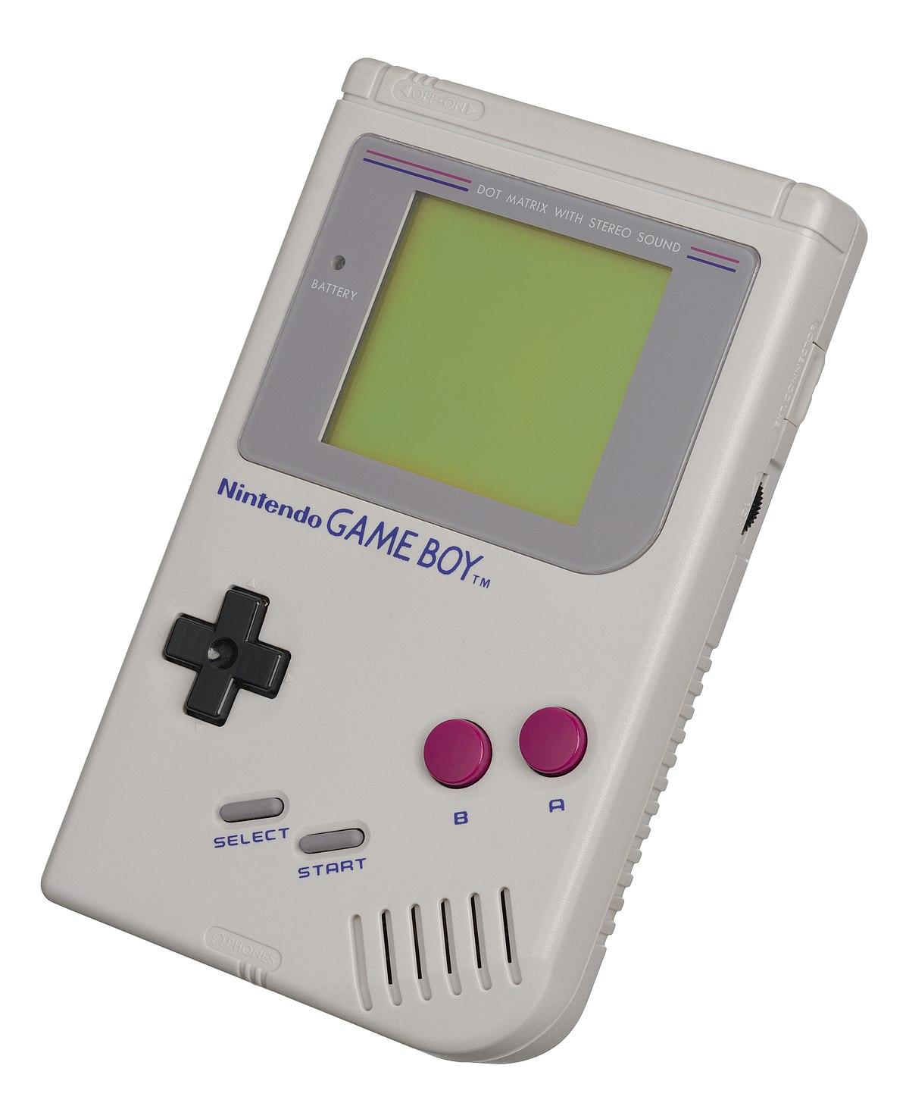
Playing some games
We’re going to add to our spreadsheet by playing some COTS video games - bit.ly/dsh-jun24
You can access some versions of COTS at –linktr.ee/neilrickus
We have some handheld consoles you can use
COTS video games installed on your own devices
Search for other COTS video games you can play online if there’s a title you’re particularly interested in

Slide 21
Possible uses of COTS video games
Spreadsheet review

Slide 22
Research questions
Overall – How are COTS video games used by teachers to support primary aged children’s learning of programming concepts?
RQ1 - How is pedagogical content knowledge (PCK) evident through pedagogical reasoning within participant teachers’ lessons that use COTS video games to support pupils’ learning of programming concepts?
RQ1a - How do participant teachers perceive the motivation for learning provided by COTS video games when they are used to support pupils’ learning of programming concepts?
RQ2 - How do participant pupils perceive the motivation for learning provided by COTS video games when they are used to support their learning of programming concepts?

Slide 23
Research methodology
Qualitative
Exploratory study; gathering of different perspectives
Multiple case studies – five to seven schools where teachers are using COTS video games to support primary aged children’s learning of programming concepts
Schools visited when a lesson using COTS video games is taking place
Discussions with 5-6 pupils following the lesson

Slide 24
Contribution
Description of findings and discussion for each research question
Cross-case analysis
Comparison of teacher and pupil viewpoints
Contribute to pedagogical content knowledge (PCK) for programming
Recommendations for teachers in primary schools
Findings used when developing educational resources
Effectiveness evaluated in the classroom

Slide 25
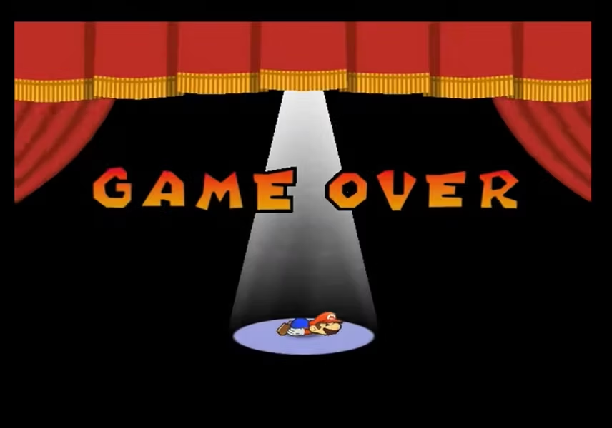
Reflection
What’s your main takeaway from the session today?
Might you be interested in finding out more and / or being involved in the research? – bit.ly/dsh-form
Email – neil.rickus@kcl.ac.uk
X - @computingchamps
Slides – bit.ly/dsh-nr-pres
Notes:
Screenshot from - Paper Mario: The Thousand-Year Door

Slide 26
How are commercial video games used by teachers to support primary aged pupils’ learning of programming concepts?
Neil Rickus
King’s College, London
Email - neil.rickus@kcl.ac.uk
Twitter / X - @computingchamps

Slide 27
Theoretical background – Pedagogical content knowledge (PCK)
Combination of content and pedagogy required to teach a subject effectively and facilitate learning (Shulman, 1986)
Requires knowledge of pupils’ understanding of the subject and the use of appropriate instructional approaches and representations.
Pedagogical reasoning – enables a teacher to translate their PCK into practice (Shulman, 1987). Thinking and decision making behind teaching methods are explained.
Notes:
Shulman, L. S. (1986) Those Who Understand: Knowledge Growth in Teaching. Educational Researcher. [Online] 15 (2), 4–14. [online]. Available from: https://doi.org/10.3102/0013189X015002004
Shulman, L. S. (1987) Knowledge and Teaching:Foundations of the New Reform. Harvard Educational Review. [Online] [online]. Available from: https://www.scinapse.io/papers/2153000380

Slide 28
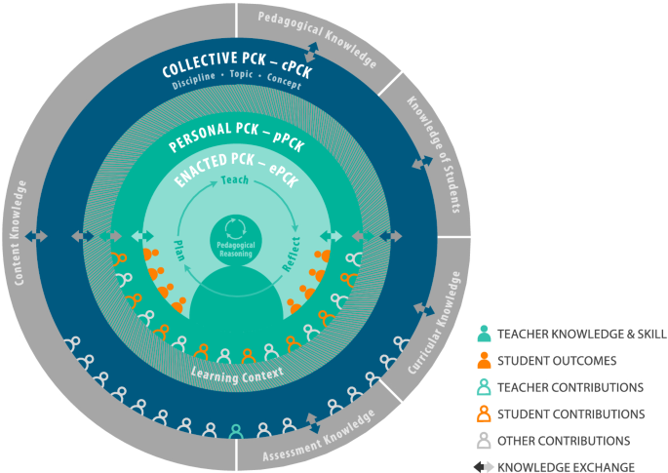
Theoretical background – Pedagogical content knowledge (PCK)
Refined consensus model (RCM) of PCK (Carlson et al, 2019).
Highlights importance of enacted PCK (ePCK).
ePCK is used when teachers plan, teach and reflect on lessons.
Notes:
Carlson, J. et al. (2019) ‘The Refined Consensus Model of Pedagogical Content Knowledge in Science Education’, in Anne Hume et al. (eds.) Repositioning Pedagogical Content Knowledge in Teachers’ Knowledge for Teaching Science. [Online]. Singapore: Springer Nature. pp. 77–94. [online]. Available from: https://doi.org/10.1007/978-981-13-5898-2_2

Slide 29
Theoretical background – Self-determination theory (SDT)
Fulfilling three basic psychological needs leads to individuals being motivated and experiencing wellness – autonomy, competence and relatedness (Deci & Ryan, 1985).
Focus on intrinsic motivation (Ryan & Deci, 2000). Tasks undertaken for the inherent satisfaction it provides.
Increases engagement and academic achievement (Howard et al, 2021).
Playing COTS video games can be intrinsically motivating (Ryan et al, 2006).
Notes:
Deci, E. L. & Ryan, R. M. (1985) Intrinsic Motivation and Self-Determination in Human Behavior. 1985th edition. New York: Springer.
Ryan, R. M. & Deci, E. L. (2000) Intrinsic and Extrinsic Motivations: Classic Definitions and New Directions. Contemporary Educational Psychology 25, 1 (January 2000), 54–67.
Howard, J. L. et al. (2021) Student Motivation and Associated Outcomes: A Meta-Analysis From Self-Determination Theory. Perspectives on Psychological Science. [Online] 16 (6), 1300–1323. [online]. Available from: https://doi.org/10.1177/1745691620966789
Ryan, R.M. et al. (2006) The Motivational Pull of Video Games: A Self-Determination Theory Approach. Motiv Emot 30, 4 (December 2006), 344–360.

Slide 30
Theoretical background – Self-determination theory (SDT)
Cognitive evaluation theory (CET) (Deci & Ryan, 1985) – SDT mini theory. Focuses on social and environmental factors that impact on an individual’s intrinsic motivation.
Autonomy - Having choice, receiving informational feedback and using non-controlling instructions.
Competence - Opportunities to develop skills, being challenged at a suitable level and experiencing positive feedback.
Relatedness less influential (Deci & Ryan, 2000).
Notes:
Deci, E. L. & Ryan, R. M. (1985) Intrinsic Motivation and Self-Determination in Human Behavior. 1985th edition. New York: Springer.
Deci, E. L. & Ryan, R. M. (2000) The ‘What’ and ‘Why’ of Goal Pursuits: Human Needs and the Self-Determination of Behavior. Psychological Inquiry. [Online] 11 (4), 227–268. [online]. Available from: https://doi.org/10.1207/S15327965PLI1104_01

Slide 31
Research methodology
RQ1 - How is pedagogical content knowledge evident through pedagogical reasoning within participant teachers’ lessons that use COTS video games to support pupils’ learning of programming concepts?
Content Representation (CoRe) (Loughran et al, 2014) – teachers articulate ePCK related to the lesson they plan to deliver through responding to specific prompts
Semi-structured interview – provide insight into teachers’ pedagogical reasoning
Video recording of lesson – teacher identifies reasoning for approaches used when they teach and they reflect on how the lesson went
Notes:
Loughran, J. et al. (2004) In search of pedagogical content knowledge in science: Developing ways of articulating and documenting professional practice. Journal of Research in Science Teaching. [Online] 41 (4), 370–391. [online]. Available from: https://onlinelibrary.wiley.com/doi/abs/10.1002/tea.20007

Slide 32
Research methodology
RQ1a - How do participant teachers perceive the motivation for learning provided by COTS video games when they are used to support pupils’ learning of programming concepts?
Semi-structured interview – questions modified from the Intrinsic Motivation Inventory (Ryan, 1982)
Notes:
Ryan, R. M. (1982) Control and information in the intrapersonal sphere: An extension of cognitive evaluation theory. Journal of Personality and Social Psychology. [Online] 43 (3), 450–461.

Slide 33
Research methodology
RQ2 - How do participant pupils perceive the motivation for learning provided by COTS video games when they are used to support their learning of programming concepts?
Group interview – questions modified from the Intrinsic Motivation Inventory. More age-appropriate language.

Slide 34
Analysis
Audio recordings will be made throughout and transcribed
Hybrid approach combining inductive and deductive coding
Thematic analysis, supported by analytic memos

