Slide 1
How should students prepare for exams?
Creating a culture of effective study
Imagine a world where revision is a habit. Where students revise for every exam using a bank of strategies they have practiced. Where they are not only fully confident with these strategies but also know exactly which strategy to choose in different circumstances.
- Howell, H & McGill, R (2022) The Revision Revolution. How to build a culture of effective study in your school. John Catt.
Notes:
This presentation will not conclude with everything that is necessary to achieve this goal, but it hopes to set you on a path towards it.

Slide 2
You’ve heard it all before
Raising attainment with effective revision
This is not the classic session on effective revision techniques because we can cover that very quickly:
Do more of:
Single past paper questions.
Flashcards using the Leitner system.
Making new material from older material.
Do less of:
Reading books, notes, revision guides and knowledge organisers.
Using highlighters.
Working with friends.
Notes:
Dunlosky J. et al (2013) Improving Students’ Learning With Effective Learning Techniques: Promising Directions From Cognitive and Educational Psychology.

Slide 3
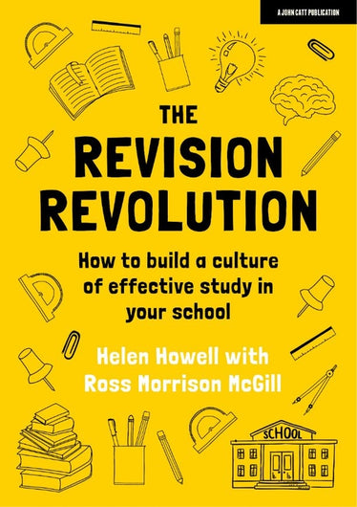
Introducing the Revision Revolution
Raising attainment with effective revision
Why do we need a revolution?
Why are we talking about revision in July?
This is the time when we plan for the new academic year.
Revision is a culture, not just preparation for exams.
At the core, the revision revolution is not about what to revise, it is about how and why.
The goal: can we make revision accessible to all, enjoyable, even irresistible?
Notes:
This presentation is based on the book:
Howell, H & McGill, R (2022) The Revision Revolution. How to build a culture of effective study in your school. John Catt.
Why do we need a revolution?
Page 13, para 2: Not every student is afforded the same advantages in life.
Page 13, para 3: It is important to show students not just what to revise but also how and why.
Revision should not be an activity at the end of a course, it should be infused in the day-to-day intent and implementation.
Craig & Dave didn’t finish the course early to have an extended revision period in year 11, our schemes of learning went to the very end to give more time to embed learning throughout.

Slide 4
Why don’t students revise?
Raising attainment with effective revision
Have you asked them?
Maybe they don’t know how.
Maybe it’s too daunting.
Maybe they’ve given up: If they lack the skills > lack the confidence > fail to prepare for tests > sense of hopelessness.
A culture of revision is not built by “too little, too late”.
Notes:
Page 14, para 2: Too many students revise ineffectively or not at all.
Page 15, para 3: The traditional approach to revision – sessions laid on once or twice a week for Year 11 simply won’t cut it. They are a “too little, too late” intervention. Students are dragged to them, and teachers are dragged into running them and no one gains much.
Teachers often say to us, “My students won’t use Smart Revise outside the classroom”. That’s because there is no culture of revision established in the school. It’s not habitual. Students don’t see the benefit and it isn’t helping them here and now. Teachers are too quick to give up, blame the students for the lack of motivation and incorrectly conclude that the techniques are ineffective.

Slide 5
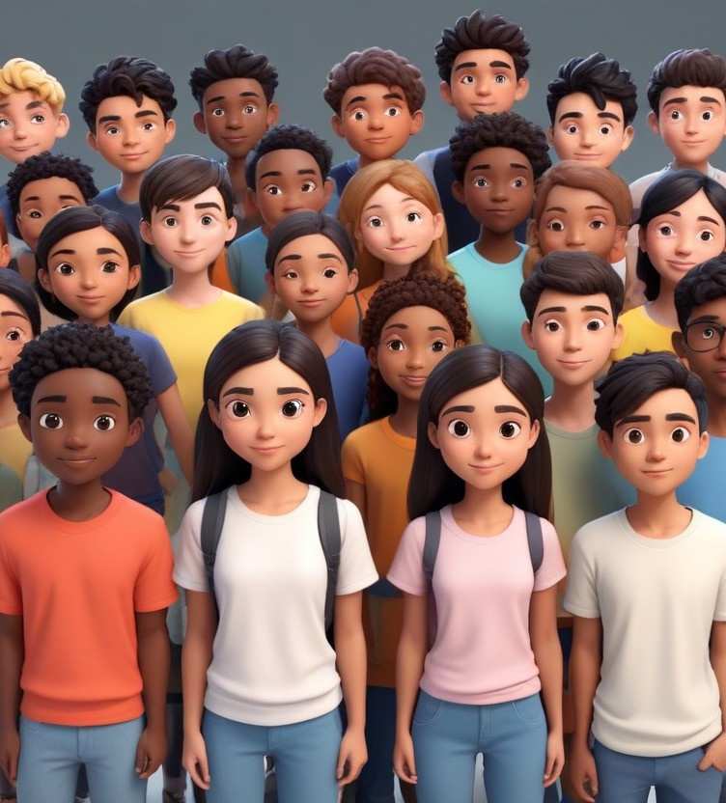
The achievement gap
Raising attainment with effective revision
Failing to establish a culture of revision risks widening the attainment gap.
Differentiation was one of the worst strategies to ever be implemented in education.
Not to be confused with scaffolding and interventions.
Notes:
Page 16, para 1: By neglecting to teach the “how” of revision, we risk widening the achievement gap. Low-attaining students lack the knowledge and skills to work out revision for themselves, whereas high achievers may find relatively effective ways to revise without teacher intervention.
Page 16, para 3: The achievement gap is sometimes compounded in schools by the misguided belief that “less able” or lower-set students need easier activities or, even worse, an easier curriculum. This widens the gap further because while the most behind students only ever complete basic work, their peers are sprinting ahead through exposure to complex texts, vocabulary and challenge.

Slide 6
The solution
Raising attainment with effective revision
Building a revision culture is more than a few tips on how to revise.
It is a gradual process that permeates all lessons.
The aim of the revision revolution is to create autonomous learners who are able to effect their own improvements.
Notes:
Page 17, para 3: The revision revolution goes beyond this presentation as it should permeate lessons, assemblies, parents’ evenings, staff meetings, tutor time and governors.
Page 17, para 4: The aim should be to create a world in which every student knows not just what to revise but how.

Slide 7
Our journey
Raising attainment with effective revision
Step 1: Retrieval practice homework
Step 2: Recap plenaries
Step 3: Starter / Do now activity
Step 4: End of topic tests
Step 5: Monthly reviews
Step 6: Practice exam technique
Step 7: Identify priorities for intervention
Step 8: Data driven parents’ evenings
Step 9: Give students and examiner’s eye
Step 10: Baseline assessments
Step 11: Online mock exams
Step 12: Catch up planning
Notes:
We identified problems in our own classroom, created solutions and later realised this is what the research had been saying! Although we had different starting points to popular authors, we ended up in the same place.
Our journey is a meld of lived experience, Rosenshine’s principles, cognitive science and the Revision revolution.

Slide 8
Retrieval practice
Raising attainment with effective revision
Step 1: Retrieval practice homework
Step 2: Recap plenaries
Step 3: Starter / Do now activity
Step 4: End of topic tests
Step 5: Monthly reviews
Step 6: Practice exam technique
Step 7: Identify priorities for intervention
Step 8: Data driven parents’ evenings
Step 9: Give students and examiner’s eye
Step 10: Baseline assessments
Step 11: Online mock exams
Step 12: Catch up planning
Recalling previously studied information from memory: focus on factual knowledge first and higher-order ideas afterwards.
Little and often with a road to mastery.
Interleaving is the support mechanism for spacing.
Hundreds or thousands?
The risk of AI.
Notes:
Based on the Forgetting Curve: Murre, J. & Dros, J. (2015) Replication and Analysis of Ebbinghaus’ Forgetting Curve, https://www.ncbi.nlm.nih.gov/pmc/articles/PMC4492928
Setting homework based on a previous topic rather than the current one is likely to be more effective for long-term memory.
Page 45: Little and often is better than cramming. Forgetting is good as it allows important knowledge to enter long-term memory. Leave a gap before revising the same information. Fill the gap with knowledge from other topics. Interleaving is the support mechanism for spacing. It also reveals connections between ideas that might not be obvious.
Page 74, para 3: For mastery, it’s about practicing something not until students get it right, but until it’s difficult to get it wrong.
It is better that students memorise the answers to hundreds of questions, not face thousands of them. The goal is knowledge retention, not assessment.
AI generated quizzes need checking carefully. They often stray from the specification, and become summative rather than formative assessments.

Slide 9
Classroom climate
Raising attainment with effective revision
When the teacher asks questions, they are assessing. When students ask questions, they are learning.
In teacher-led class discussions, train students to ask questions instead of simply answering them.
Say something that starts with one of these words and ends with a question mark:
How, when, why, what…?
Notes:
Page 46: Elaboration: use of how, when, why, what and linking ideas to everyday experiences.
If students are engaging with “The Journey” they are already regularly answering plenty of questions to check their understanding. Use class discussions as an opportunity to get the students to ask questions instead. This deepens their understanding by making links.
This is a big culture shift, and students will be shy until they know what is expected of them. We want to develop inquisitive minds because that is when they get the “ah-ha moments”.

Slide 10
Vocabulary
Raising attainment with effective revision
Step 1: Retrieval practice homework
Step 2: Recap plenaries
Step 3: Starter / Do now activity
Step 4: End of topic tests
Step 5: Monthly reviews
Step 6: Practice exam technique
Step 7: Identify priorities for intervention
Step 8: Data driven parents’ evenings
Step 9: Give students and examiner’s eye
Step 10: Baseline assessments
Step 11: Online mock exams
Step 12: Catch up planning
Making more use of flashcards as an every-day part of teaching, not just preparing for exams.
Identifying, not just using computing terms:
Tier 1: words used frequently in speech.
Tier 2: words occur in text & exam papers.
Tier 3: subject-specific terminology.
Notes:
Use monthly reviews, baseline assessments and catch-up planning to engage with key words.
Introduce students to command words (state, describe, explain, discuss) and assessment objectives (knowledge, understanding, application, evaluation) and don’t assume they will know what these mean.
Page 33: explicitly teach both tier 2 & 3 words.

Slide 11
Vocabulary
Raising attainment with effective revision
An iteration in a function uses a stepper to consider each element of an array of integers passed as a parameter; using an operator in the condition to then assign and return the bester variable.
You could give this paragraph to students and get them to ask questions about it until the understand what it means.
What does this code do?
Notes:
Make the “language of computer science” part of the lesson but be mindful that students need to explicitly learn what these words mean.
Getting the students to identify words within blocks of code, or in illustrations helps with dual coding.
This code delivers the highest number from a set of whole numbers.

Slide 12
Vocabulary
Raising attainment with effective revision
1
2
3
4
5
An iteration in a function uses a stepper to consider each element of an array of integers passed as a parameter; using an operator in the condition to then assign and return the bester variable.
6
7
8
9
10
11
12
13
def max(data):
max = 0
for item in data:
if item > max:
max = item
return max
Use the subject-specific vocabulary just as a teacher of MFL would talk to the class in the foreign language.
Notes:
Although the description of the code deliberately used lots of subject-specific terminology to illustrate the point, note that the actual algorithm is a simple one that Year 11 students should be able to write in exams.
What other words could they label in this code as a dual coding exercise?

Slide 13
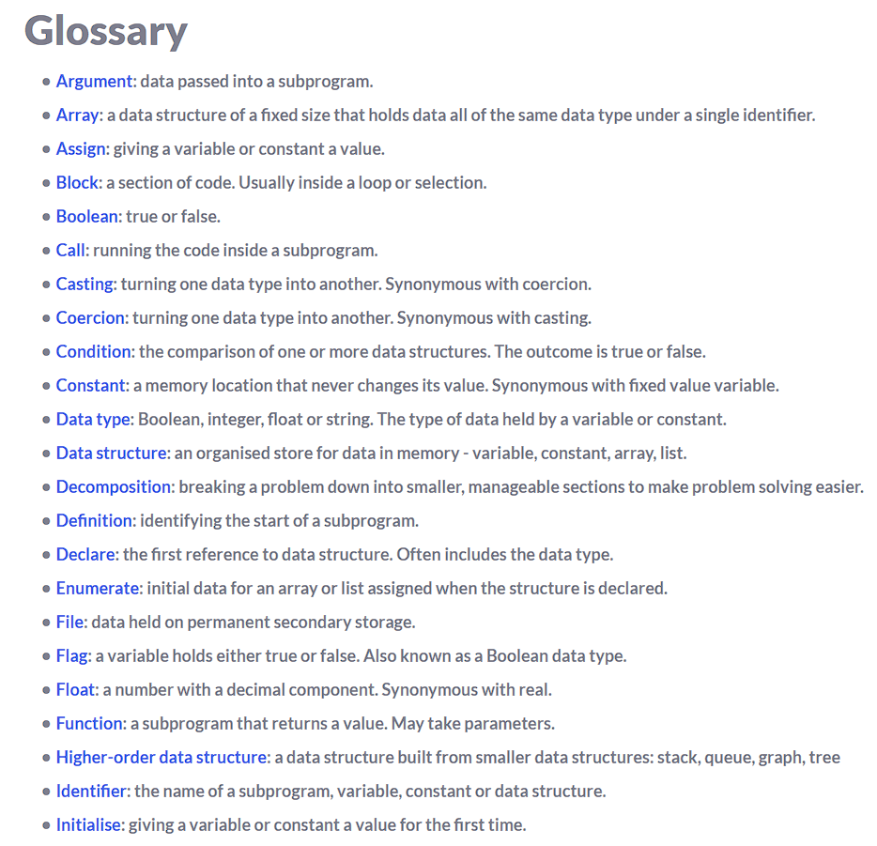
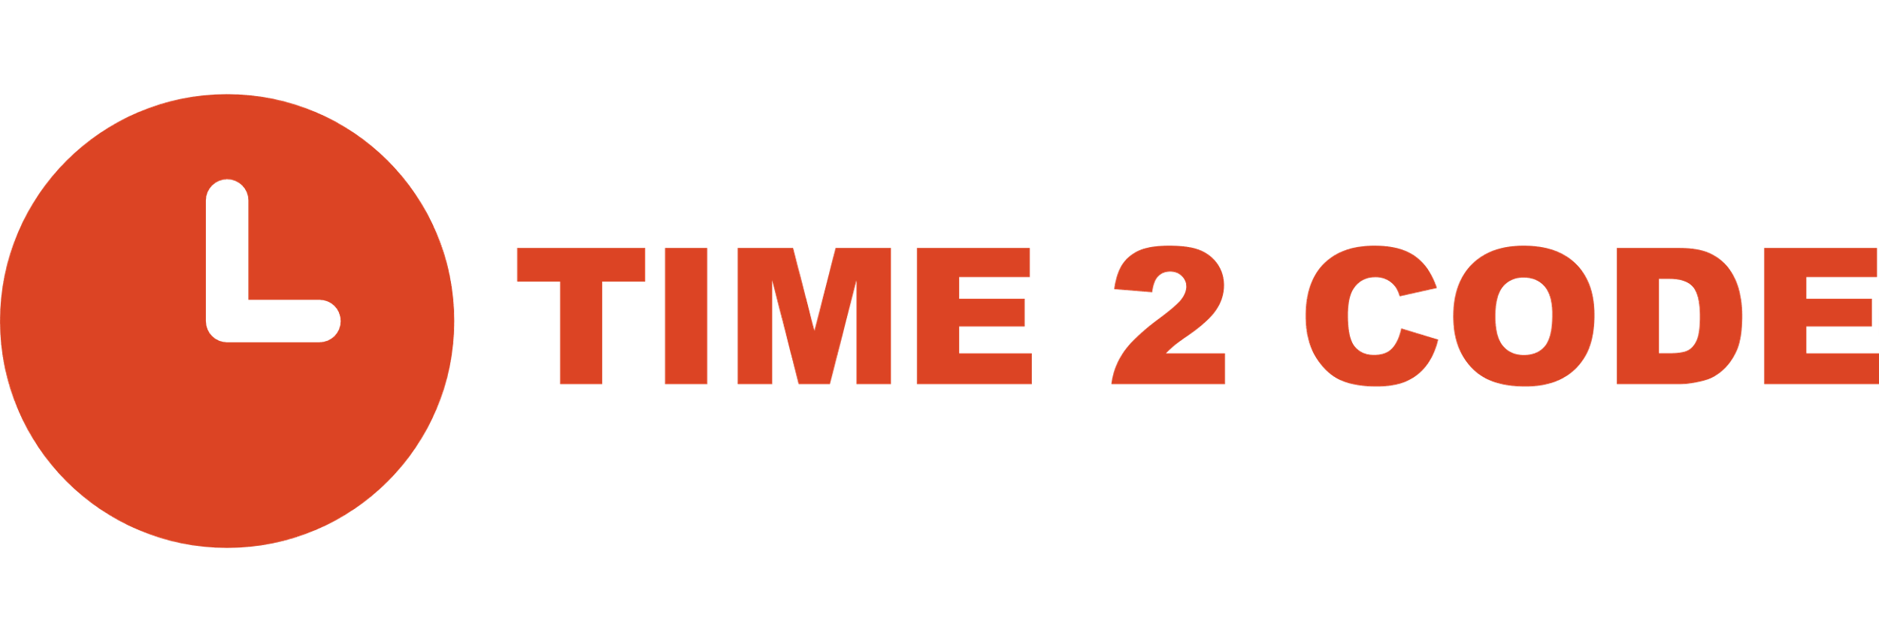
Raising attainment with effective revision
Notes:
Time2Code includes all the words associated with programming for GCSE: https://time2code.today/about/subject-specific-terminology

Slide 14
Building a culture
Raising attainment with effective revision
Step 1: Retrieval practice homework
Step 2: Recap plenaries
Step 3: Starter / Do now activity
Step 4: End of topic tests
Step 5: Monthly reviews
Step 6: Practice exam technique
Step 7: Identify priorities for intervention
Step 8: Data driven parents’ evenings
Step 9: Give students and examiner’s eye
Step 10: Baseline assessments
Step 11: Online mock exams
Step 12: Catch up planning
“Weighing the pig doesn’t make it fatter”.
Except that it does!
The “Hawthorne effect” describes how people change their performance in response to being observed.
This isn’t the point we are making; it was simply the belief of my Headteacher, but it serves to question whether regular assessment can improve learning.
Notes:
Regular assessment is a good thing, not for summative data collection, but for formative purposes. It allows students to understand their own strengths and weaknesses.
Peer assessment and engaging with mark schemes is very important. Do this throughout the course, after the very first topic, not at the end of the course.

Slide 15
Marking & feedback
Raising attainment with effective revision
Be careful about the number of extended answer questions you set – they may reveal too many gaps in knowledge at once.
Alex Quigley’s wedding cake:
The biggest layer is self-assessment. (where the most effort should be exerted)
The middle layer is peer-assessment.
The smallest layer is teacher-assessment.
The decoration is AI-assessment.
Notes:
Page 102, para 3: Feedback should be thought of as a wedding cake.
https://alexquigley.co.uk/questioning-feedback-top-ten-strategies/
https://alexquigley.co.uk/the-problem-with-past-papers/
Peer assessment has a positive effect size of +0.54: Hattie, J. (2023). Visible learning: The sequel. Routledge.

Slide 16
Where next?
Raising attainment with effective revision
Empowering students to take responsibility for their own journey through flightpaths, goals, achievements and incentives.
Advance mode question builder to build from 1- to 8-mark questions & scaffolding longer answer questions.
Frayer models and what, why, webs.
Notes:
Page 59: Mixed retrieval builds on factual recall to more challenging how and why questions.

Slide 17
Frayer models
Raising attainment with effective revision
Definition
The arithmetic logic unit.
A component inside the processor.
Characteristics
Performs logic, calculations and bit-shifts.
Requires a register to hold results and a control unit to synchronise data coming in and out.
Concept
ALU
Examples
Logic: if a > b ✓
Calculation: c = a + b ✓
Bit shift: 0010 ✓
0100
Non-examples
Works on decimal numbers. ✗
A processor. ✗
Embedded system. ✗
Notes:
Frayer D, Frederick W, Klausmeier H. (1969) A schema for testing the level of cognitive mastery. Wisconsin Center for Education Research.
Page 59: building from recall quizzes to higher-order questioning.

Slide 18
What Why Web
Raising attainment with effective revision
Holds the address of the
next instruction
Holds the result
from the ALU
Program counter
Accumulator
Registers
MAR
Memory Address Register
MDR
Memory Data Register
Holds the memory address to
read or write data from/to
Holds the data read from or to be written to the memory
Notes:
Harvard, B. (2019) Building a web of knowledge: https://theeffortfuleducator.com/2019/09/18/building-a-web-of-knowledge

Slide 19
The take-aways
Raising attainment with effective revision
Revision is not an activity; it is a culture.
Make more use of retrieval practice.
Use flashcards as a teaching tool.
Make more use of vocabulary.
Use more self and peer assessment.
Beware of the lure of AI.
Notes:
Revision should be more about how you deliver lessons throughout the course rather than the purpose of a lesson at the end of the course.
Retrieval practice for homework and the start of EVERY lesson – but do something with the data, it is not a throwaway activity.
Flashcards put vocabulary at the heart of the lesson and are a good way of compiling data about the strengths and weaknesses of the class.
Self and peer assessment have a positive effect size and can increase attainment by a whole grade (Hattie, 2008/2023).
AI is making a big impact on education now, and can be a time-saver for teachers, but also realise this does not raise attainment by itself. Students engaging with mark schemes themselves yields better outcomes.

