Slide 1
Pedagogical approaches for teaching programming using Scratch

Slide 2
Concepts and constructs
Worked examples
Code reading and comprehension
Designing
Supportive frameworks

Slide 3
Knowledge building (Ofsed 2022)
Two types of knowledge needs to taught in Computing:
Declarative knowledge
‘Know that’ - concepts
Procedural knowledge
‘Know how’ - methods and processes
Declarative - Computer science is the knowledge of computers and computation. It includes concepts such as data, system architecture, algorithms and programming.
Procedural - Mental model of programming and the implementation of constructs from algorithm to code

Slide 4
What are the main concepts we need to understand in programming?
Concepts
Notes:
Looking for the following answers
Flow of control
How computers run programs from top to bottom
The big three sequence, selection and repetition
Input - process - output and storage

Slide 5
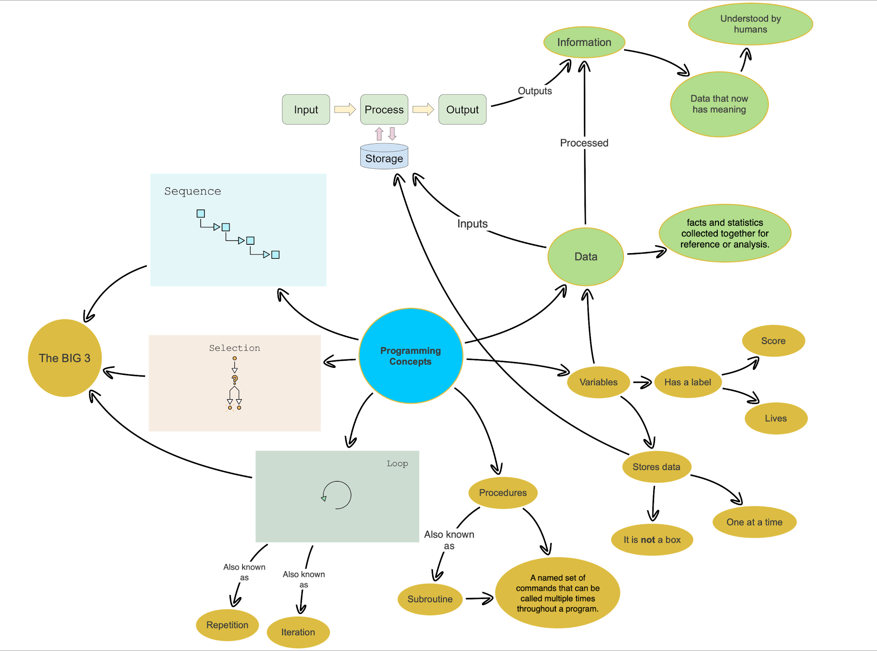
Concepts
Notes:
The mind map could help us to understand these main concepts.

Slide 6
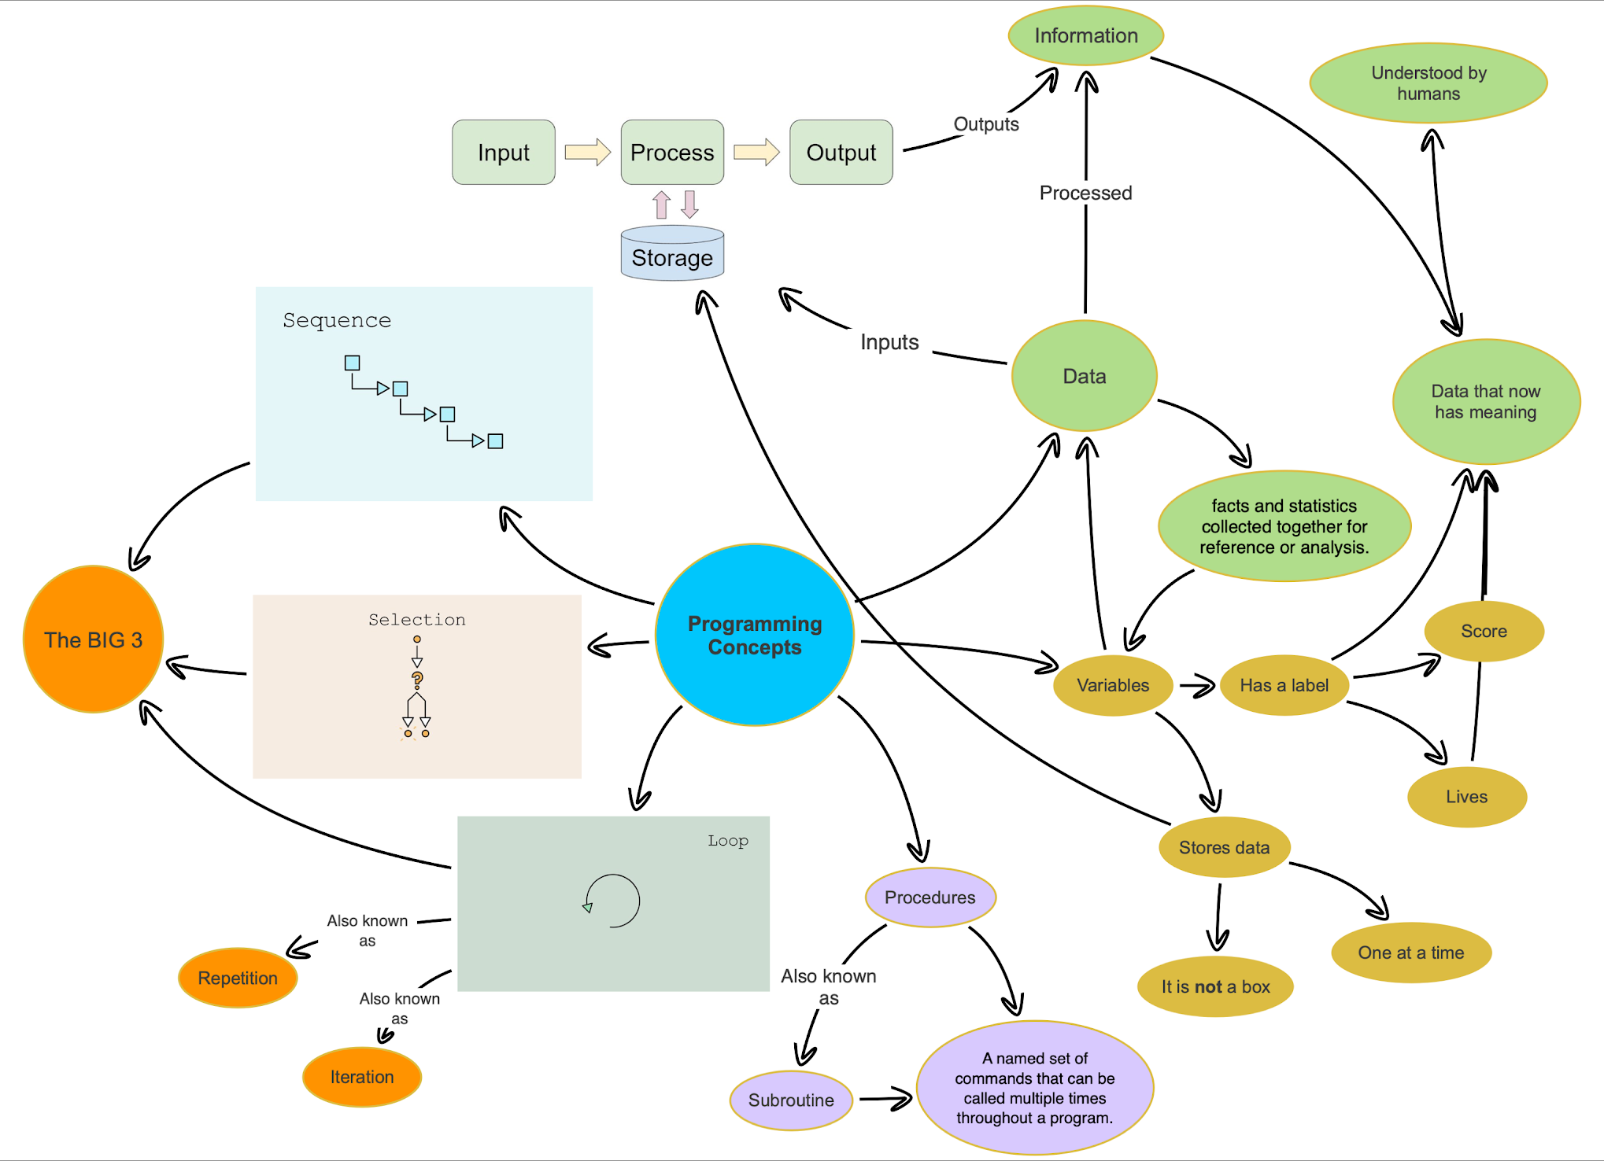
Concepts
Notes:
The mind map could help us to understand these main concepts.

Slide 7
Constructs
Notes:
Concepts of programming then become constructs
We need to ensure that the novice programmers (chn) understand the concepts first.
Then can use these concepts to as constructs for both the algorithms and code

Slide 8
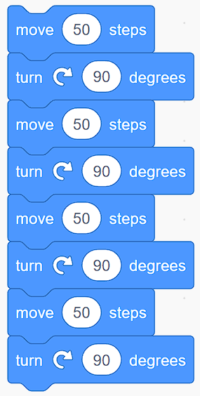
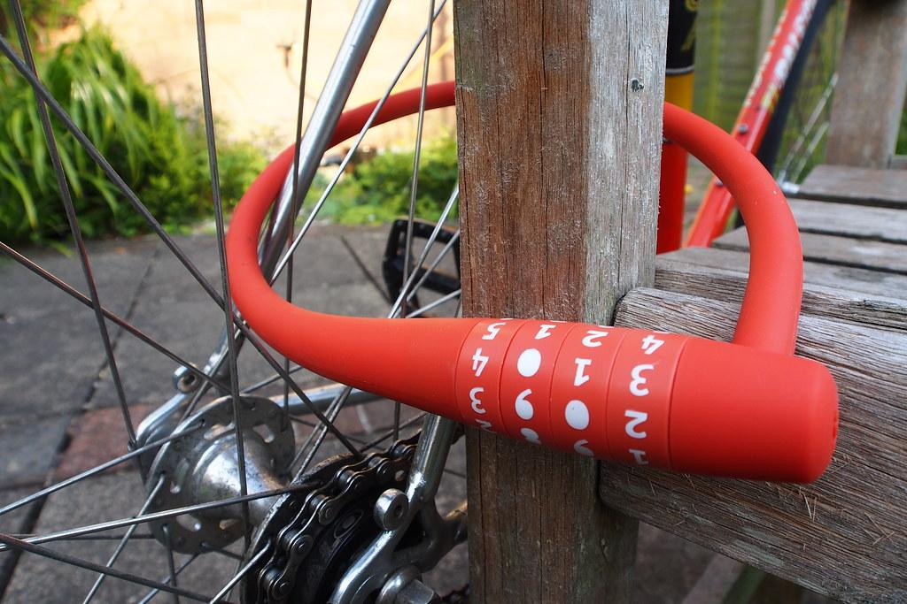
Semantic Waves in Sequence construct (Karl Maton)
Mastery
Novice
LO:- To use a sequence construct in our code
Sequence code can be used to draw a square.
Technical language (abstract & complex)
These blocks are in a sequence
The computer runs a sequence from the top down
Sequence code can often be combined with the other constructs of programming such as repetition and selection
When we stack the blocks we create a sequence
Sometimes there are patterns in our sequences. This can often indicate the need for a loop.
A sequence means one thing after another. These are often called algorithms
Repacking linking back to abstract
Identify the use of sequence code in a full program.
Unpacking making concrete
It’s like playing the notes on piano they need to be played in order to make music
We often use sequences in route based, animation and conversation programming
Sequences often need to be done in order. In maths we call this permutations
We often use sequences of instructions at the start of a program to initialise it.
Sometime the order doesn’t matter. In maths we call this combinations
To make sequences we need to snap the program blocks together
Everyday concept & language
“It’s like a…”
It’s like building Lego
Algorithms are sequences of step by step instructions to do something.
Over time
Notes:
Semantic waves really helps to teach abstract concepts
Helps the learners to develop their understanding vocabulary and how to apply
Can be used to evaluate learning activity.
At the bottom of the curve they are working with concepts that they have secure understanding of. However we can stay there we need to move back up the curve repacking as we go.

Slide 9
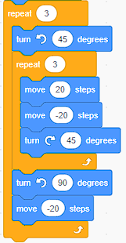
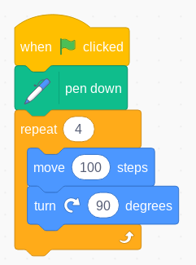
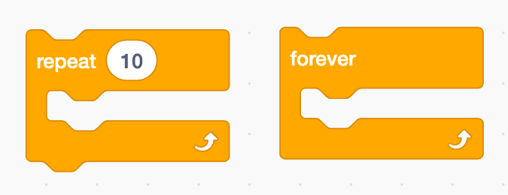
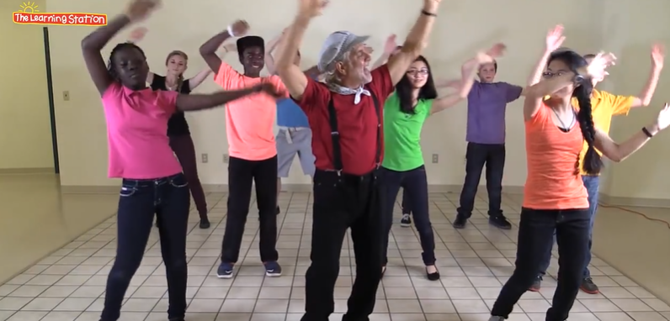
Semantic Waves in Repetition construct (Karl Maton)
Mastery
Novice
LO:- To use a count controlled repetition construct in our code
The count controlled loop can be used to draw regular shapes.
Technical language (abstract & complex)
Repetitions can be counted
A loop can be stopped after a set amount of times.
Repetition can be forever
Things can be repeated forever like days of the week
Repacking linking back to abstract
Unpacking making concrete
Identify the a loop in a program
Different tasks require different kinds of repetition
We can use a loop command in a program to repeat an instruction
Everyday concept & language
“It’s like a…”
Dance moves
Brushing teeth
Loop means the same as repetition
Over time
Notes:
Semantic waves really helps to teach abstract concepts
Helps the learners to develop their understanding vocabulary and how to apply
Can be used to evaluate learning activity.
At the bottom of the curve they are working with concepts that they have secure understanding of. However we can stay there we need to move back up the curve repacking as we go.

Slide 10
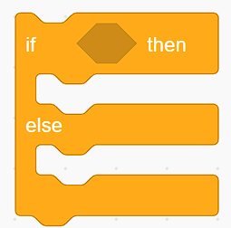
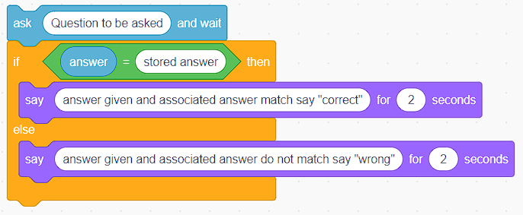
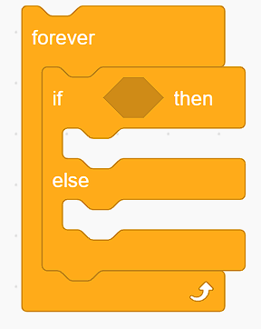
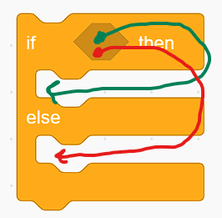
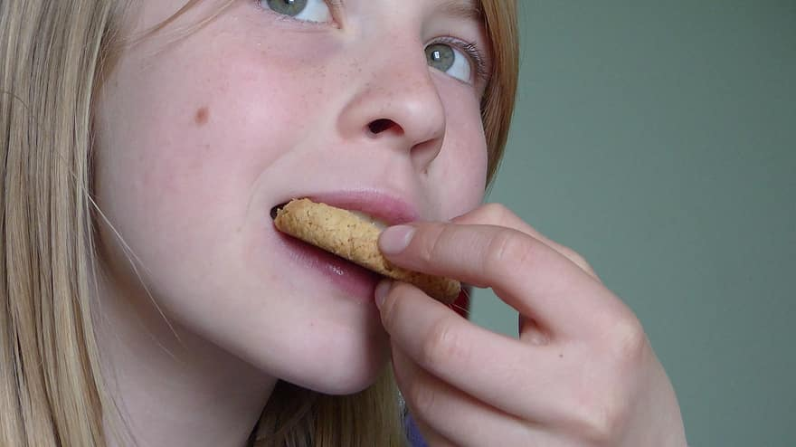
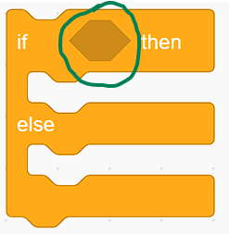
Semantic Waves in Selection construct (Karl Maton)
Mastery
Novice
LO:- To use If then else selection construct in our code
The If then else block can be used to make a quiz game
Technical language (abstract & complex)
A condition can be true or false
This is called selection
If the condition is true then do action. Else the condition is false and do other action
We can use the If then else block to check the answer for a quiz game.
Sometimes we need to combine this with loops so we can keep checking the condition
A condition can be yes or no (true or false)
To make the questions for the computer to check we use the operators
Repacking linking back to abstract
Questions can have yes or no answers (branching tree database)
Identify the if then else block in a program
Unpacking making concrete
It’s a yes or no question and depending on the answer you do different things.
We use the if then else block to change the flow of control in a program
It’s like a fork in the road or path
When the block is run the computer checks the condition of the question if it’s true it runs the first part. If false it run the else part
Is it raining? Yes put umbrella up. Else it’s not raining.
Everyday concept & language
“It’s like a…”
Are you hungry? Yes then eat a biscuit. Else I am not hungry
The yes or no question goes in the diamond shaped slot.
Over time
Notes:
Semantic waves really helps to teach abstract concepts
Helps the learners to develop their understanding vocabulary and how to apply
Can be used to evaluate learning activity.
At the bottom of the curve they are working with concepts that they have secure understanding of. However we can stay there we need to move back up the curve repacking as we go.

Slide 11
Algorithm
Programming
Computational thinking
Coding
Concepts and constructs
Notes:
This diagram shows the connections between algorithm, programming and coding.
Algorithms are developed from solving problems using computational thinking
Programming are developed from algorithm being written as code in a language that can be processed by a computer
Programming is the process of implementing algorithms as code and includes the design, development and testing of algorithms.
All of this is surrounded by the computational thinking.
Alternative conception - not all algorithms become programs.

Slide 12
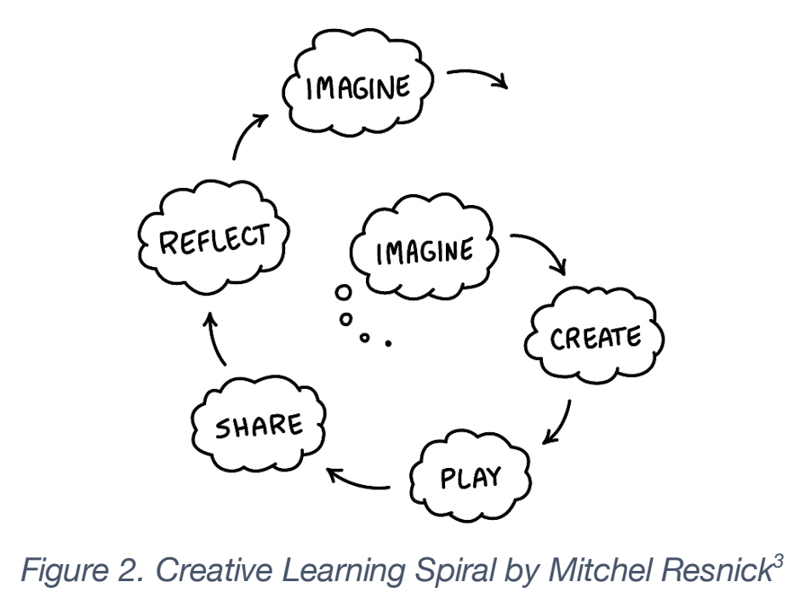
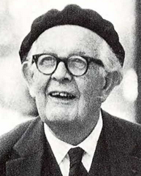
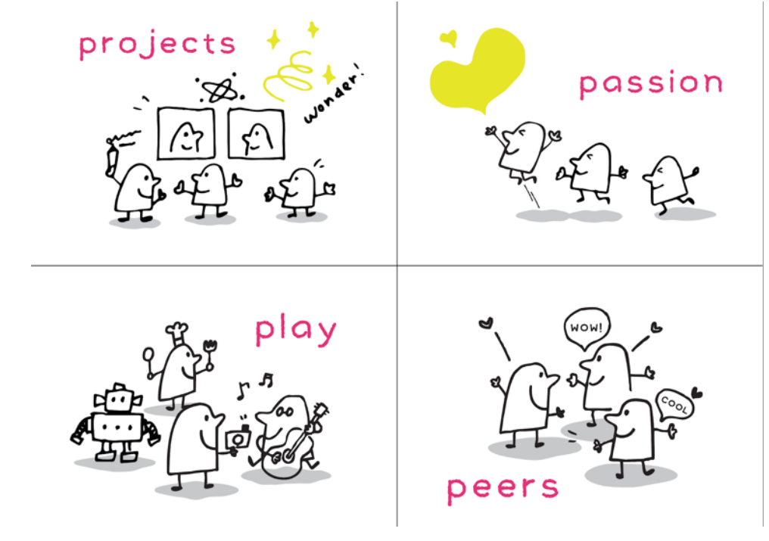
“Children learn best when they
are actively engaged in constructing something that has personal meaning to them”
Piaget
Notes:
The creative learning spiral significantly related to
the cognitive development theories of Piaget and the constructionist theories of Papert. In
his “Creative Learning Spiral” there are five different stages: “Imagine”, “Create”, “Play”,
“Share” and “Reflect”. It is defined as an infinite cycle that builds up at each iteration:
Resnick
explains how creating “projects” is essential for the Creative Learning Spiral and highlights
some of the examples in the Scratch community where users create projects constantly that
help them develop their skills and creativity. As Piaget said: “Children learn best when they
are actively engaged in constructing something that has personal meaning to them”, that is
why “passion” is fundamental for the creative process. “Peers” refers to the collaboration and
sharing of projects with others. As Resnick states: “Creativity is a social process”. Finally, the
last core is “Play”. Playful experimentation is key in order to successfully thrive in the creative
process.

Slide 13
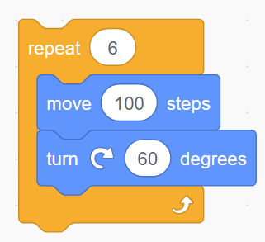
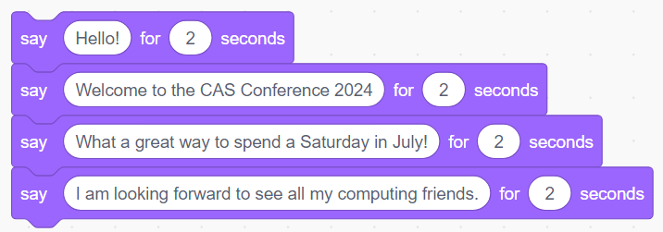
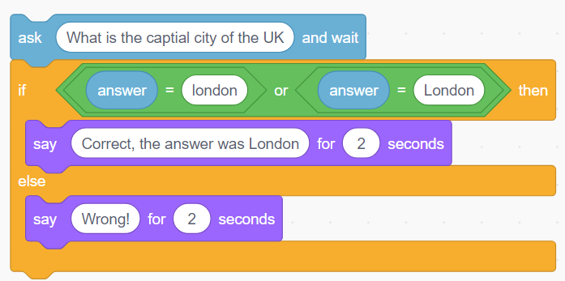
Sequence, repetition or selection?
A
C
B
Notes:
Check for understanding activity
What are each of these constructs of code? What concepts do the also cover
A- Is sequence code - concept is sequences
B - is selection code - concept is branching decision (yes/no, true/false)

Slide 14
Concepts and constructs
Worked examples
Code reading and comprehension
Designing
Supportive frameworks

Slide 15
Worked example
Goal:- To design and write a program that draws a regular 2D shape
Recall:-
Concept: Sequence and Repetition
Secure knowledge and skills

Slide 16
Computational Thinking Resources
Specific skills that should be defined, taught and assessed
Notes:
Computational thinking - concepts and approaches to help scaffold thinking like a computer scientist and solve problems.

Slide 17
Retrieval prior knowledge
Notes:
Cross curricular links to Maths
Retrival from existing schemas
Question could be what is the property of shape thinking about two dimensional shapes? This is retrieval from maths this can help the children to develop the algorithms

Slide 18
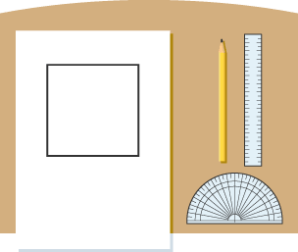
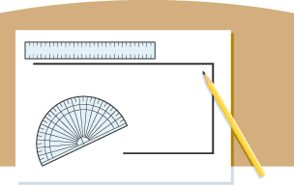
Square drawing algorithm
draw a 5 cm line
turn left 90 degrees
draw a 5 cm line
turn left 90 degrees
draw a 5 cm line
turn left 90 degrees
draw a 5 cm line
Computational Thinking and algorithm design
Notes:
This is the implementation of the design for the algorithm that will be implemented as a code. You can see that it's deterministic and contains step-by-step instructions to complete the task. We also got the unplugged process of this algorithm tested by the children.

Slide 19
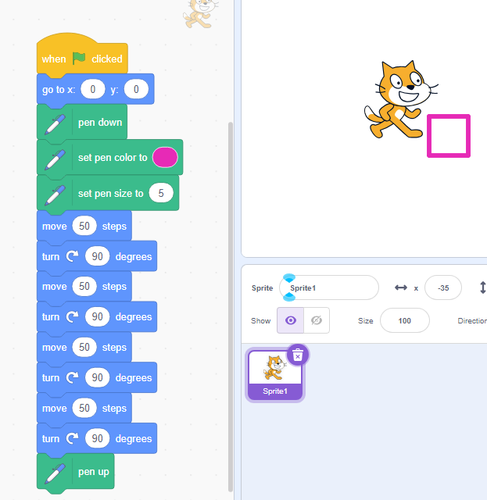
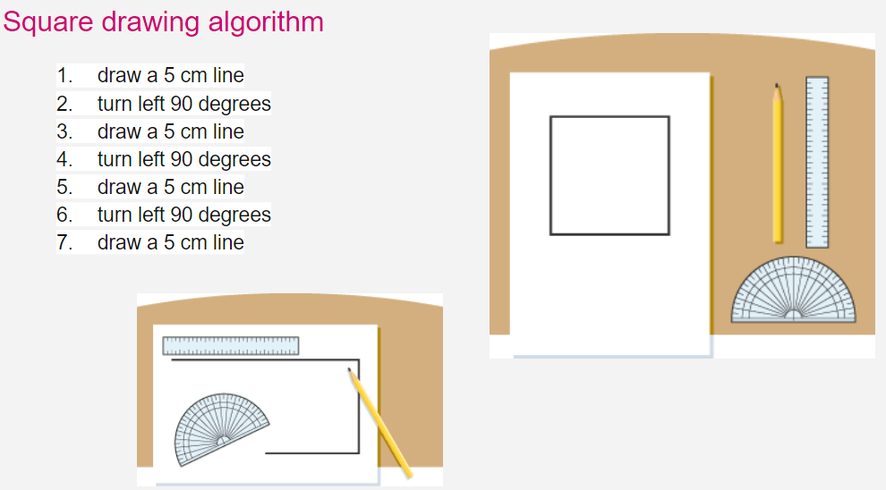
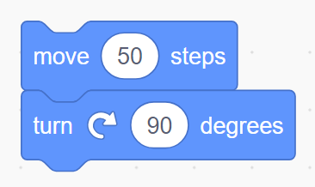
Programming is a 2 step process
Use computational thinking to analyse the problem and design a solution, including creating an algorithm
Implement these ideas in a programming language on a computer: coding.
Programming
Algorithm design
To Code
Mental model of programming
Notes:
We can see how programs are developed through that process of algorithm being implemented as code and how this then becomes the program. You can see the screenshots below of the algorithm and the step-by-step instructions and how they can be implemented as King blocks in scratch the finish program contains the algorithm, the coating blocks and the running of the program which could be evaluated for its objective.

Slide 20
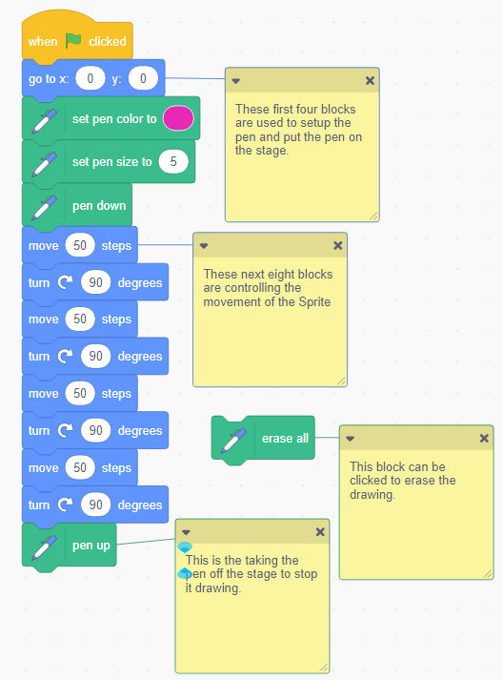
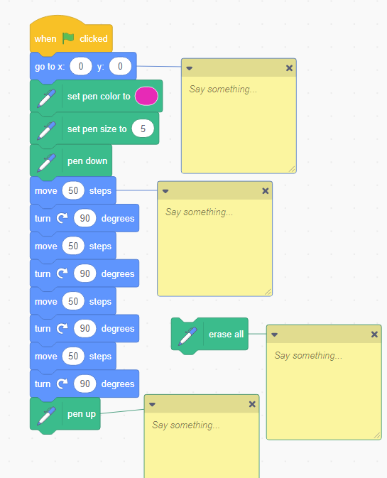
Subgoal labels (passive) to chunk the information
Subgoal labels (active) completed by the pupil
Worked examples
Mental model of programming
Notes:
The use of worked examples can be supported by using labelled subgoals. Subgoals are useful steps in solving complex problems and act as functional components of the problem’s solution.^{[footnote 125]} Labels are added to each subgoal to explain its purpose. This scaffold helps novices to tackle the component parts of a much larger problem. Subgoals can also help pupils see past the surface-level features in problems and transfer this knowledge to new problems. This is because the subgoals focus on abstract knowledge and not the surface features of the problem.
You can see two parts on the slide we can see passive so that's comments on the program explaining what the different parts do and then you can see active which is when the children have to write about how the program works or it could be that they Implement the algorithm and annotate it to the code space.
This is part of the assessment of the code we can use this method called sub gold labelling. This enables the teacher to either post questions that the children have to answer forms part of the peer review or self review of the program whether children can annotate how the code worksOr which elements of the code achieve different bits this can also be used as a place to post questions related to the investigation stage of the program such as the prim approach.

Slide 21
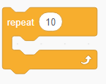
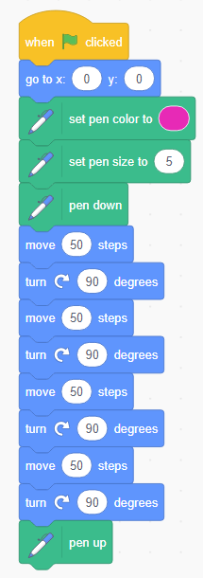
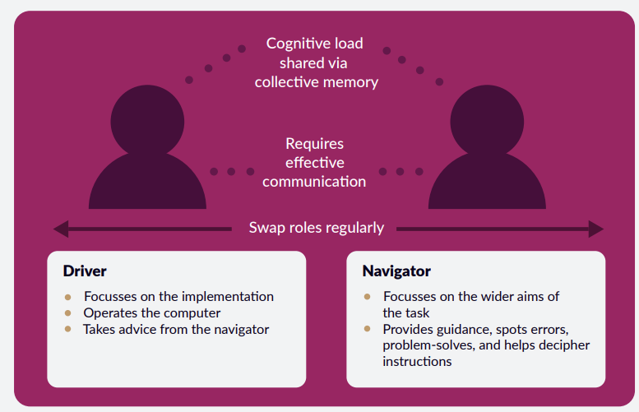
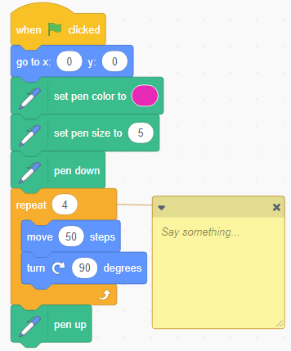
Pair programming is an approach where two people work together to write a program or solve a problem whilst sharing a single computer. Pair programming is routinely used in the software industry and soon came to education as the observed benefits became clear.
https://raspberrypi-education.s3-eu-west-1.amazonaws.com/Quick+Reads/Pedagogy+Quick+Read+3+-+Pair+Programming.pdf
Mental model of programming
Notes:
Here we can see the progression from sequence to repetition and how this can change the program and the flow of control we are able to add the repeat block to the code as there is a pattern in the program and algorithm.
Here we can also see paired programming as an approach to support and scaffold the program implementation from algorithm to code. The pad programming method helps to reduce cognitive load during the programming stages however it does require good working relationship between the children and it's important that they regularly switch roles so that they both get an understanding of how the program works and is coded. This helps them to developTheir notional understanding of the program and how computer execute this code

Slide 22
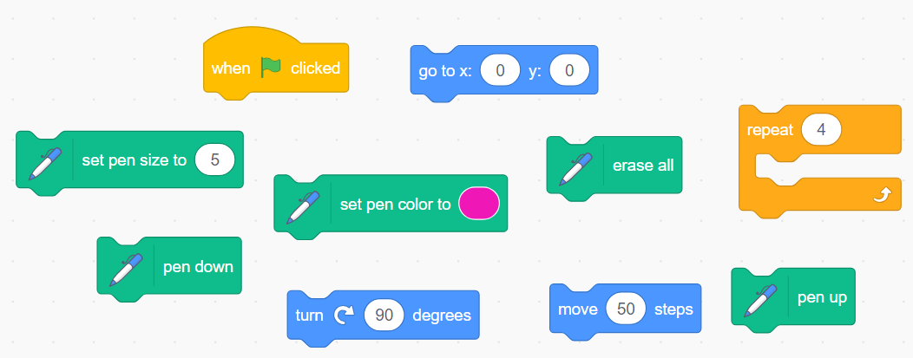
Parsons problems scaffolding approach
Precursor to writing code.
Helps to develop program comprehension.
Helps to reduce cognitive load.
Learners rearrange code into the correct sequence.
Parsons Problem Drawbacks
Can encourage pupils to think there is only one solution to a problem
Mental model of programming
Notes:
Another good method for supporting and scaffolding novice programmers in scratch is the use of Parsons problems. These enable the children to have a reduced instructions set. Say that they only have the blocks of code that they need and these can be snapped together. Another method here is the use of faded Parsons problems faded Parsons problems is when some of the blocks are already connected and some are separated to further develop or adapt you can also, have un related or tror distractor blocks in here.

Slide 23
Concepts and constructs
Worked examples
Code reading and comprehension
Designing
Supportive frameworks

Slide 24
Code reading and comprehension
The national curriculum expects pupils to ‘use logical reasoning to predict the behaviour of simple programs’.
Read code before writing code
Two types of code comprehension
Predict what happens when run, what is the output or outcome.
Be able to explain line by line (block by block) and the overall purpose of code.
Misconceptions
Building programming knowledge
Mental model
Notes:
It is very important that children are able to read code before they write code. This is very similar to how children learn learn to read. This method is called code comprehension and it Fosters the understanding of the program and builds schemas around the notional machine.

Slide 25
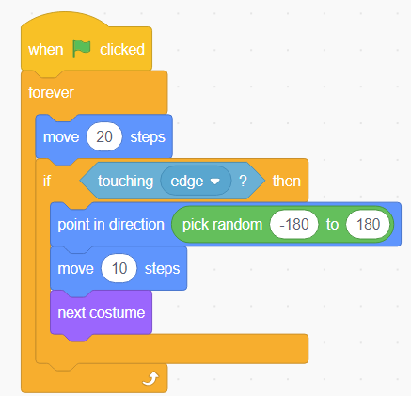
Can you predict what the ball will do when it is run?
Why has a forever loop been used in this program?
https://scratch.mit.edu/projects/1034507944
Misconceptions
Notes:
Here at this stage we would ask the children can you predict what the ball will do when it's his run? Have again? Have a go see what you can predict what will happen when this ball program is run why is it in a forever loop? Suggested answer the ball when the green flag is clicked it will move 20 steps forever but if it touches the edge of the screen then it will point in direction choosing a random direction to point in between -180° and 180° move 10 steps and then changes costume it will then carry on moving 20 steps until it touches the edge of the screen again where it will choose and other random direction move 10 steps and change costume again and move 10 steps

Slide 26
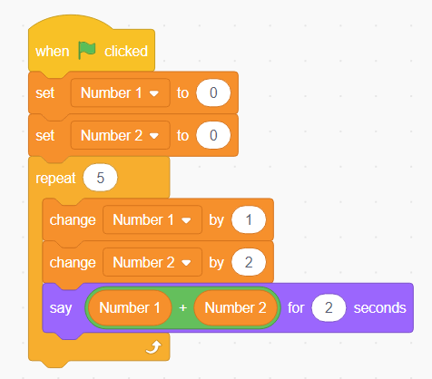
Tracing the variables in this program
Number 1 | Number 2 | Say
1 | 2 | 3
2 | 4 | 6
3 | 6 | 9
4 | 8 | 12
5 | 10 | 15
Misconceptions

Slide 27
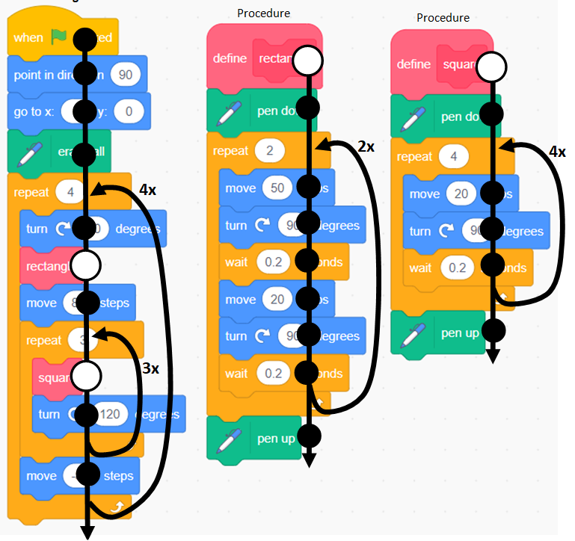
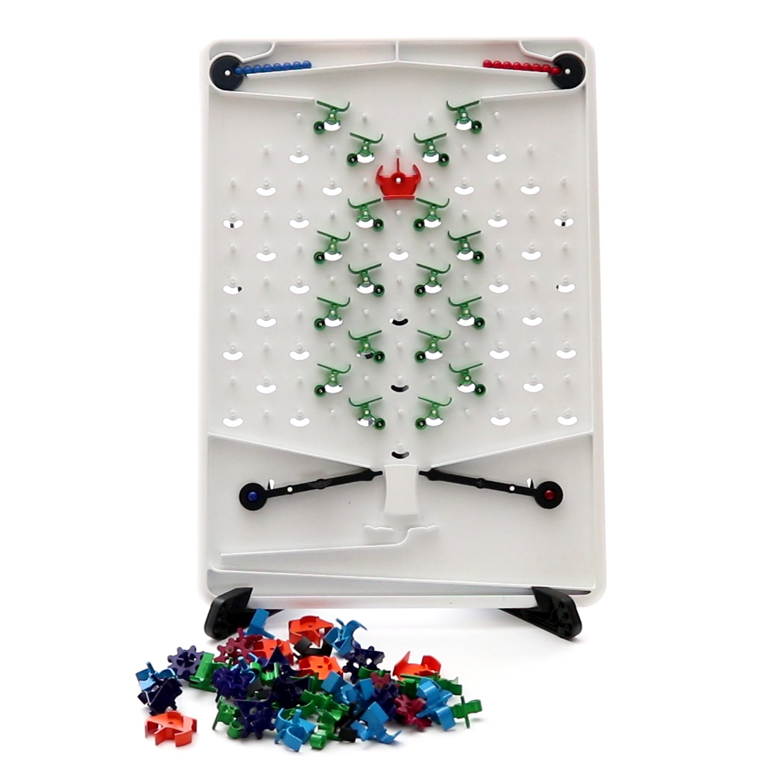
Flow of Control - Tracing flow of control from
Phil Bagge
https://youtu.be/VSVqypPB8S8?si=qEQq5MwgdAuZjwBe&t=195
Mental model
Notes:
This helps children to build the schema around the concepts of programming and the notional machine.
Understand how the flow works
Show the video clip of the Turing Tumble for flow of control.
There is web-based simulator for this

Slide 28
Interpreting the Block Model to Scratch programming.
Macro (M) | Reading the Scratch blocks in a complete program. | What is the algorithm of the program and how it links to the complete Scratch program | Why was the program created and why does it solve the problem.
Relationships (R) | What Scratch blocks been put together in the program and why? | What is the flow of the Scratch program when it runs | Why does the program achieve its goal?
Blocks (B) | Identify the Scratch blocks that are in sequence, repetition and selection. | What will happen when these Scratch blocks are run together? | Why does that happen? Why are the Scratch blocks in that order?
Atoms (A) | The individual Scratch blocks that make the complete program. | How the individual Scratch blocks work when they are run. | Why do we need these Scratch blocks?
 | Text surface (T) | Program execution (E) | Function (F)
 | Structure of the program |  | Relevance of the program
Mental model
Notes:
The Block Model is an educational model for describing how students come to understand a program as they read it 1. It is expressed as a table that covers three dimensions in four levels. Each cell represents one aspect of understanding.
The three dimensions are the text surface (the actual text of the program), the program execution (the order in which the program commands happen, and how data is manipulated), and goals (what the program is meant to do). Text surface and program execution are further grouped into structure (the actual expression of code) and function (its intended purpose).
The levels are atoms (individual elements of the language, i.e. keywords and statements), blocks (groupings of code lines that work together, i.e. a loop that sums all the values in a collection), relations (the connections between the bocks), and macro (the overall program).

Slide 29
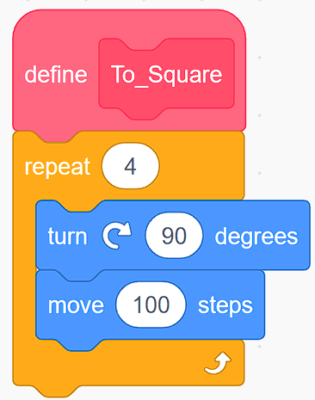
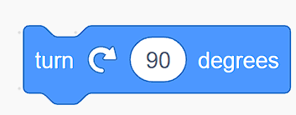
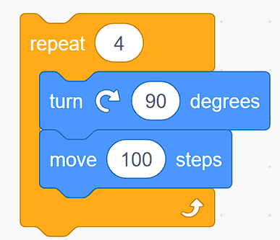
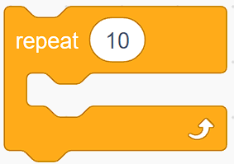
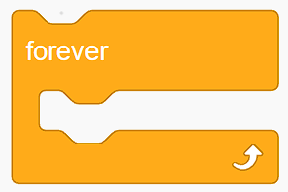
Using the Block model for code comprehension
Macro (M) | At the start of the program there is a setup of a pen, then the program enters a count controlled loop. During each iteration of the loop the sprite moves 100 steps and turns 90 degrees, this continues until the loop has iterated the number of times in the count. The pen is the set to up. | Pen down Loop 4 times Move forward 100 steps Turn right 90 degrees Pen up | Create a program that will draw a square with a length of 100 steps.
Relationships (R)
Blocks (B) | What is the main constructs of this program? Sequence, repetition or selection.
Atoms (A)
 | Text surface (T) | Program execution (E) | Function (F)
 | Structure of the program |  | Relevance of the program
What will this To_Square function do?
What’s the relationship?
What happens when this code is run?
What does the repeat 10 do in this C block?
What’s the function of this C block in this program?
M
Notes:
On this slide we can see how we can use the block model to help break down and develop understanding of the program as both whole and its individual parts.

Slide 30
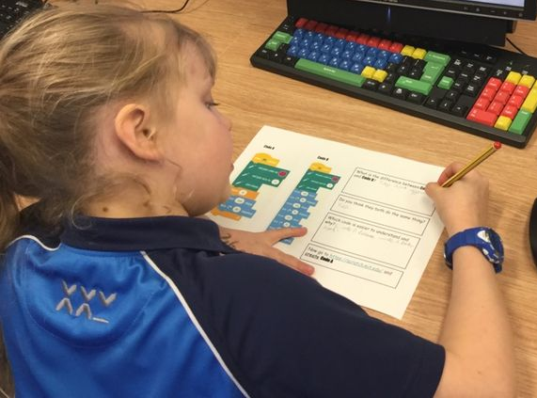
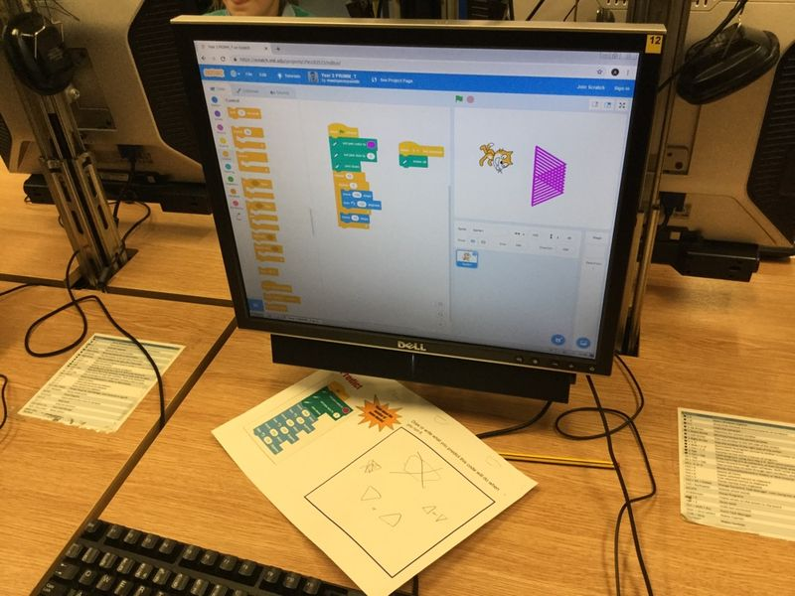
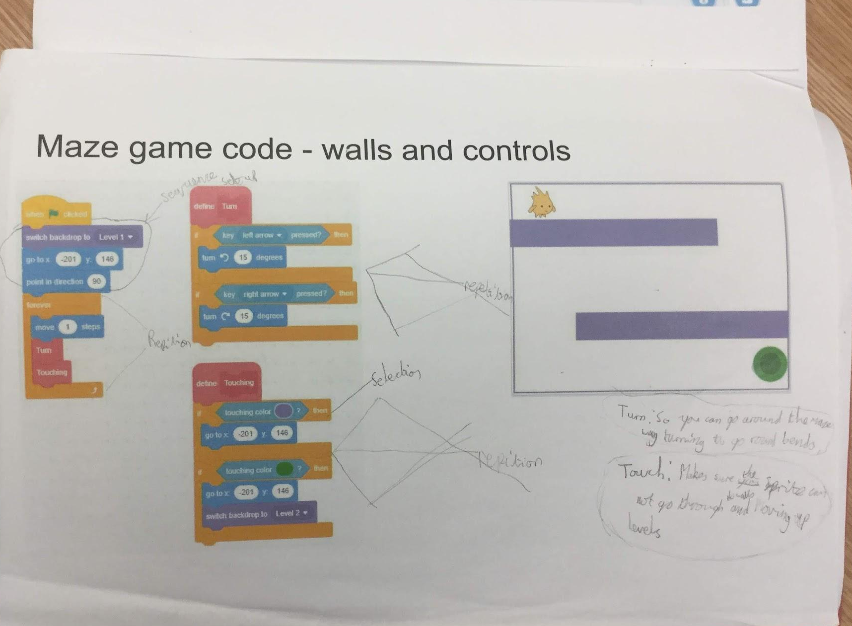
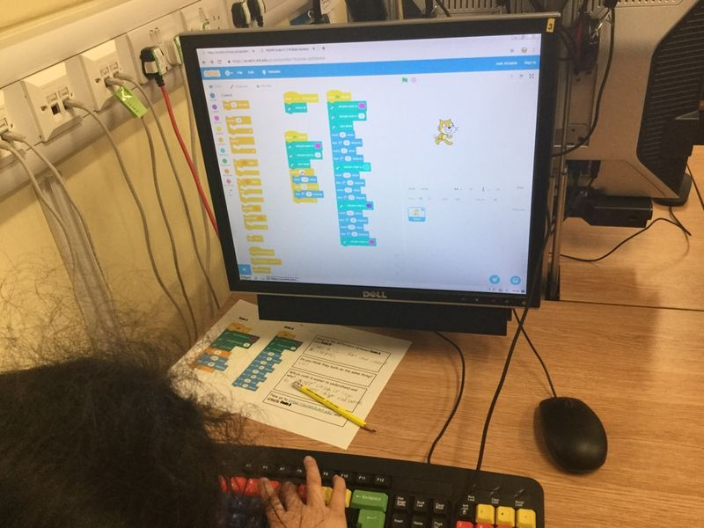
Building programming knowledge
Notes:
This is code comprehension in practice.
The children can use annotation and PRIMM process.
This will help the children to understand the code and support their writing

Slide 31
Concepts and constructs
Worked examples
Code reading and comprehension
Designing
Supportive frameworks

Slide 32
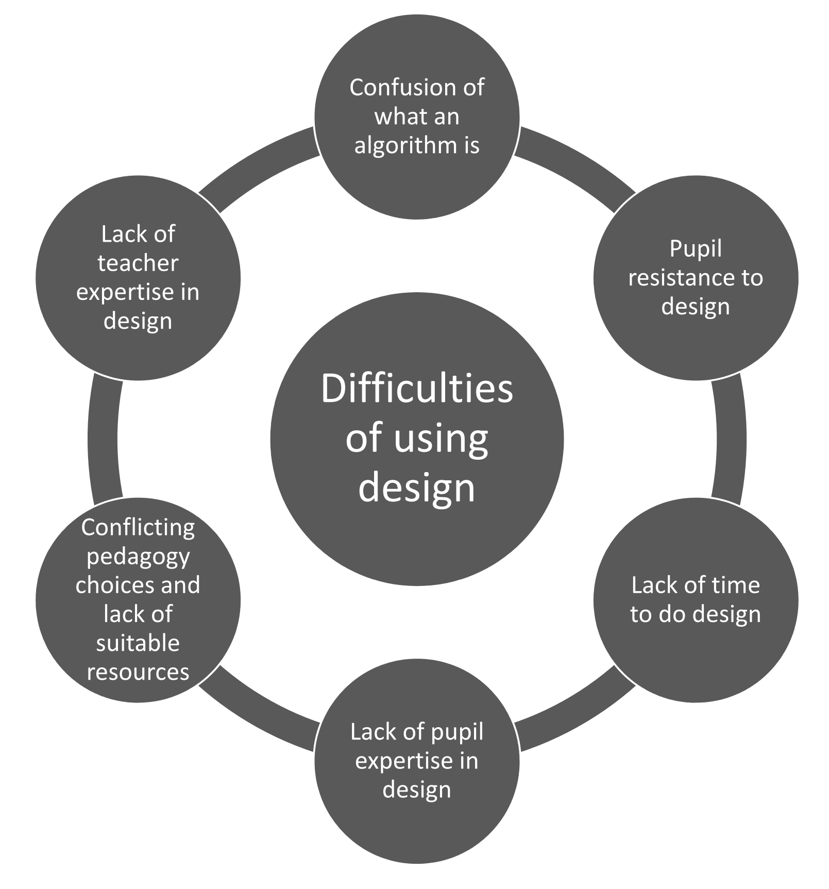
design, write and debug programs that accomplish specific goals, including controlling or simulating physical systems; solve problems by decomposing them into smaller parts
NC Computing, DfE, 2013
The following slides are from the work of Dr Jane Waite and her primary teachers’ design toolkit
Jane Waite, 2019
Computational thinking and problem-solving
Building programming knowledge

Slide 33
Design formats
Thought
only design
Physical enactment design
With or
without manipulatives
Recorded or
not recorded
Verbal design
Recorded or
not recorded
Drawn design
Written design
Implied design
Sketch
Labels or annotations added to drawn formats
Code
List
Digital image or sound files
Labelled diagram
Storyboard
Notes or lists
Program settings
Concept map
Informal Pseudo code
Flowchart
Other
Other
Jane Waite, 2019
Computational thinking and problem-solving
Notes:
Jane OK lets move onto another concept.
The design format is the media in which the design exists-such as written notes, a drawn labelled diagram, etc. For a single component, such as the algorithm design, there may be more than one format for an activity, for example,the algorithm may be physically enacted and recorded as well as verbally explained (but not recorded). One design format may include representations of more than one design component. For example,a drawn storyboard might include the art work design, the algorithm design and the object and data design
Formats are often suggested in research, in passing, but are rarely named or singled out as being worthy of study. But there are so many ways that students can depict their design, much more research is needed to discover which formats are most useful for different genre of projects, e.g in discussions with teachers they have suggested a storyboard is useful for an animation, and a concept map for a game - what do you think and what do you use?

Slide 34
Design components - pupil facing
Object and data design
What are the names of the objects
that you need?
Artwork and sounds design
What do the objects look and sound like?
Algorithm design
What do the objects do?
Jane Waite, 2019
Computational thinking and problem-solving
Notes:
Components that can be used to develop the elements of programming.

Slide 35
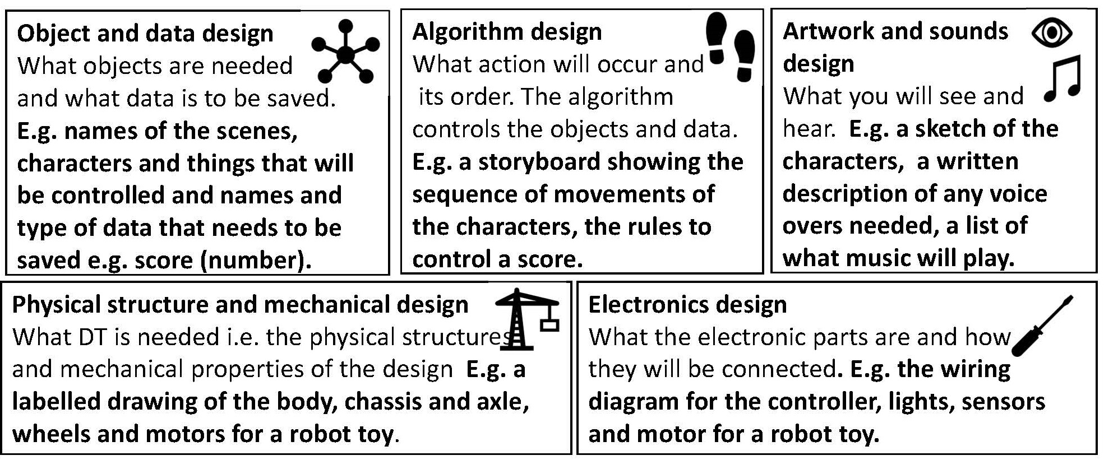
Design components - teacher facing
Jane Waite, 2019
Computational thinking and problem-solving
Notes:
Jane
So lets start with design components
This is is the main building block that we are going to consider when describing a design. When designing an activity, several design components are developed. For most activities, for a primary programming activity, there will be three design components of: • the object and data design, • the algorithm design, • the artwork and sound design.
And if you do a physical computing project a couple of others.
The components are derived from the basics of design as used by developers in IT and taught to undergraduates following guidance by the “greats” such as Knuth, of data structures, algorithms, UX design but the terms have been simplified based on earlier study feedback from teachers. But in England we are perhaps Algorithmic-centric, maybe overlooking the other components.
So Matt, how did this concept manifest in your work?

Slide 36
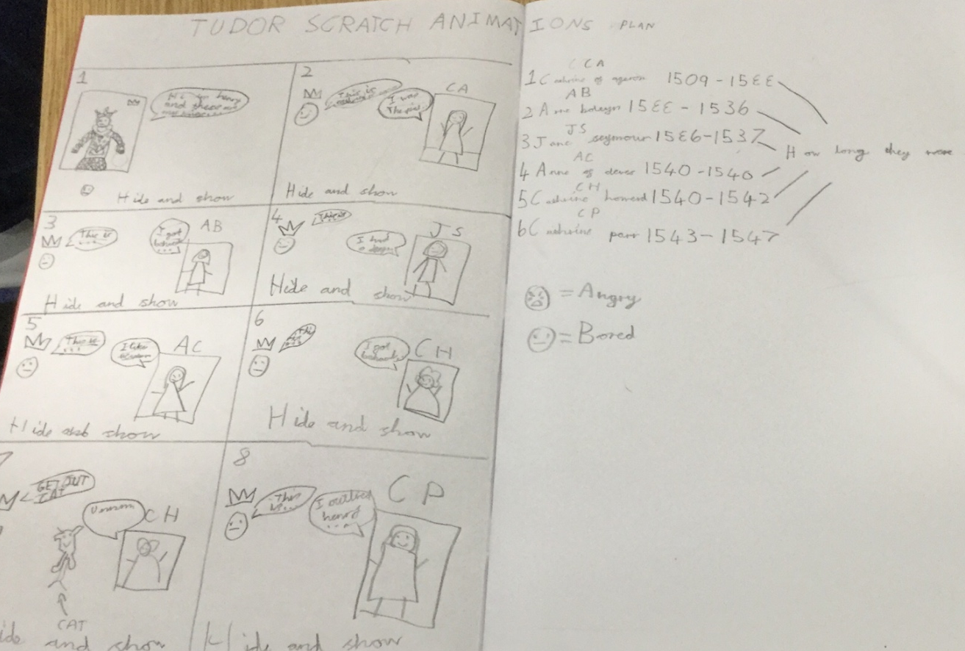
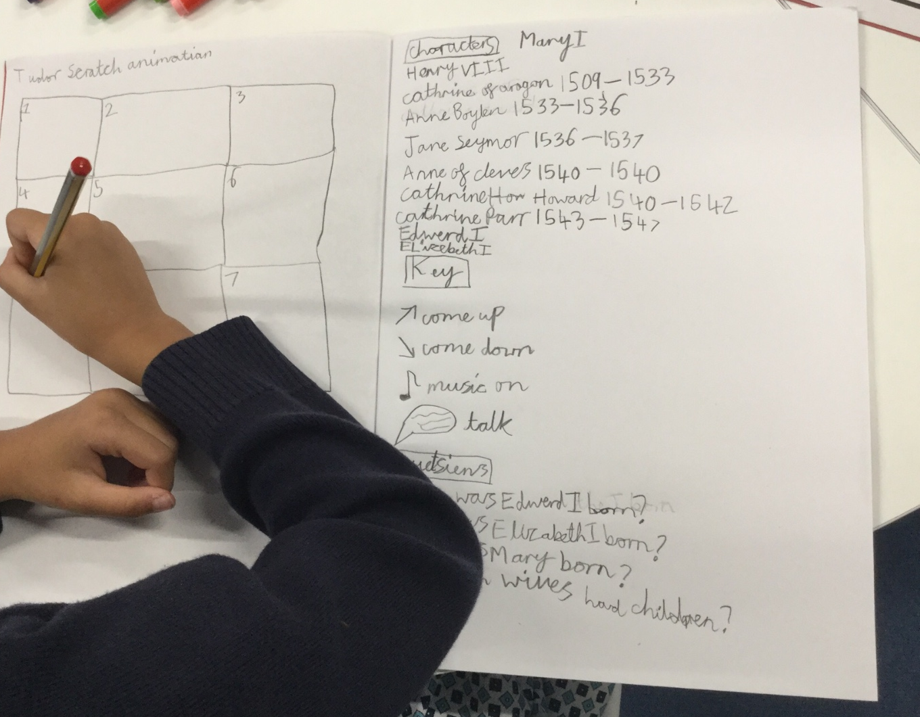
Design components in action
Object design
Algorithm design
Object design
Computational thinking and problem-solving

Slide 37
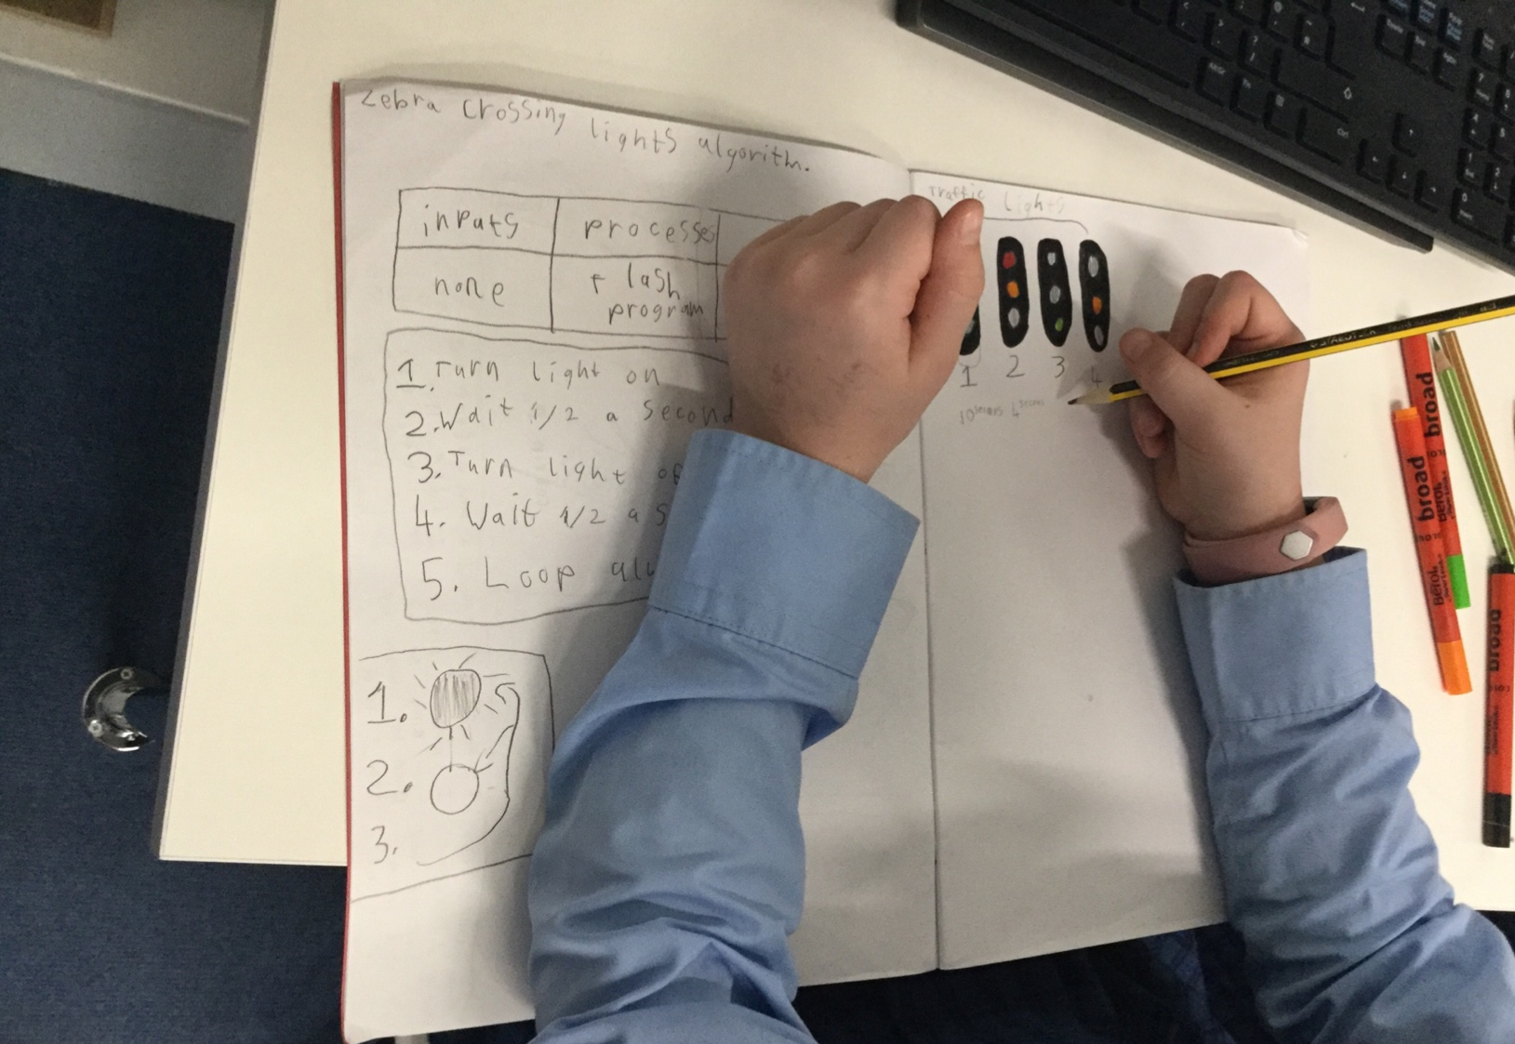
Components
component
state/costume design
Digital component design
Ragging components for complexity
Algorithm design

Slide 38
Components Artwork
Artwork and algorithm design
Computational thinking and problem-solving

Slide 39
Design formats
Storyboard
Computational thinking and problem-solving
Notes:
Jane,
So matt what design formats did you find you used in your teaching and did you find some where more useful than others for certain types of projects and did certain children prefer certain formats.
Matt

Slide 40
Computational thinking and problem-solving

Slide 41
The four levels of programming planning
Ideas Level | Draw a square shape using a loop. A pictorial representation is very useful for many projects.
Design Level (algorithm & objects) Language a human will understand, code agnostic | One character to draw the shapes (objects). Use clear to remove previous drawing (initialisation) Start drawing Do 4 times walk 4 steps quarter turn to the right Stop drawing (algorithm)
Code Level
Running the code, evaluation and refinement | I needed to put a wait block in so I could see it as it drew on screen. What did we learn, change, adapt when we ran the code?
Building programming knowledge
based on the work of Waite, Maton, Curzon and Tuttiett (2019)
Notes:
Professional Development Leader:
We can present these steps into a four level model of Task -> Design -> Code -> Running and evaluation, as above.
This is a useful framework for working with pupils in writing their code.
In many primary classrooms, the move to ‘code level’ is almost immediate, and children have not thought through what and how they will implement a programming challenge before starting to code.
Ask participants to reflect on their own practice and share into the text chat.
Link for research paper - https://www.researchgate.net/publication/335527816_Unplugged_Computing_and_Semantic_Waves_Analysing_Crazy_Characters
This model is sometimes known as the ‘four levels of abstraction’
Participants:
- Share thoughts on their own practice into the text chat.

Slide 42
Concepts and constructs
Worked examples
Code reading and comprehension
Designing
Supportive frameworks

Slide 43
Strategies for scaffolding in learning programming.
Code reading
Live coding
Worked high quality examples
Scaffolds and supports the understand of code
Learners must read code before they can write code
Builds understanding of the concepts and constructs of sequence, selection and repetition.
Teacher or learner demonstrates the implementation of design to programming
As they are doing this they talk through their decision making aloud.
Metacognitive - Use-Modify-Create (TIPP&SEE)
Learners look at code snippets and examples of each concept
Looking different problems or goals and multiple solutions to these.
PRIMM (predict, run, investigate, modify, make)
Use stage - learners explore a completed programming project.
Have activities and questioning linked to it
Modify stage - learners begin to change the existing program. Have activities linked to it
Create stage - Create their own project using the concepts and techniques they have used in the preceding phases.
Combines the code reading and the
Use-Modify-Create
Carefully ordered sequence of instructional phases that introduce a programming concepts or set of concepts
More information at
https://blog.teachcomputing.org/using-primm-to-structure-programming-lessons/
Adapted from Jane Waite and Shuchi Grover 2020

Slide 44
Scaffolding, use by example approach
Students are given example code or product to use
Now the students are ask to make small modifications the code
Finally, students create a new product using the concepts and techniques from the previous stages
Moving through this progression, it is important to maintain a level of challenge and pace that supports growth while limiting anxiety. Conversely, boredom will set in if challenges don’t keep pace with growing skills
Transition back and forth from users to modifiers to creators.
Lee et al, 2011

Slide 45
I do
Direct instruction / explicit modelling
Use
We do
Modify
Guided practice / scaffolding
You do
Create
Independent practice / problems / creative work

Slide 46
https://www.raspberrypi.org/app/uploads/2022/08/Teaching_Programming_with_PRIMM-1.pdf
Notes:
PRIMM Approach: A pedagogical model for teaching programming that stands for Predict, Run, Investigate, Modify, and Make. It emphasizes reading code before writing and encourages collaboration and dialogue among students.
Classroom Talk: The PRIMM method promotes productive classroom talk, which is essential for understanding programming concepts. Teachers facilitate discussions, model vocabulary use, and ask in-depth questions.
Impact on Learning: Studies indicate that PRIMM can improve learner outcomes in programming. Teachers value the collaborative nature of PRIMM and the structured lessons that allow for differentiation.
Research Focus: The report discusses ongoing research into the quantity, quality, and content of classroom talk in programming lessons using PRIMM, highlighting the importance of language in learning to program.
https://www.raspberrypi.org/app/uploads/2022/08/Teaching_Programming_with_PRIMM-1.pdf

Slide 48
Notes:
TIPP & SEE is an adaption of the Use → Modify → Create → learning progression developed specifically for working with Scratch1. The name is an acronym for a multi-step process of interacting with Scratch projects. Scratch offers a website where programmers can publish and share their projects, and other programmers can remix them.
Remixing in Scratch means taking an existing project and modifying it, often to build in more functionality or to change its aesthetics. This parallels the professional open-source community, where professional programs write and distribute programs online using sites like GitHub for others to use and modify. This also means that the Scratch website can serve as a rich source of exemplar programs to share with your students.

