Slide 1
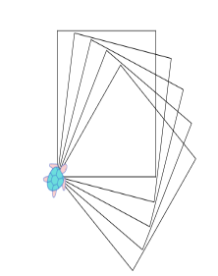
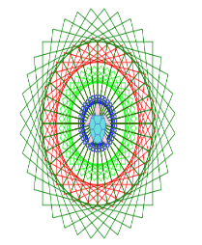
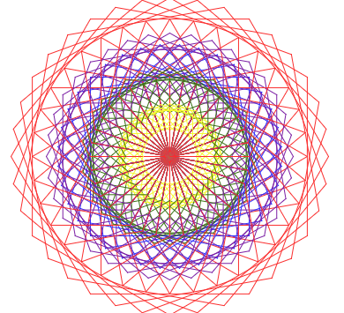
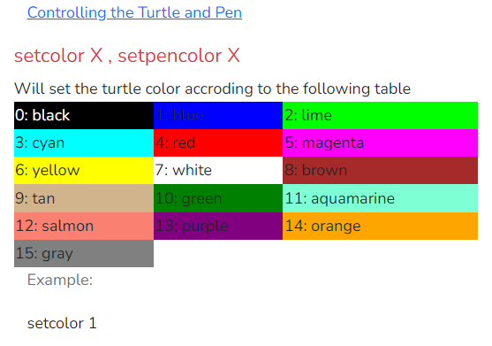
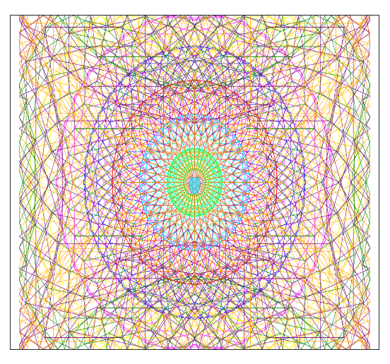
Workshop: Pattern making from Turtle Academy into Scratch 3

Slide 2
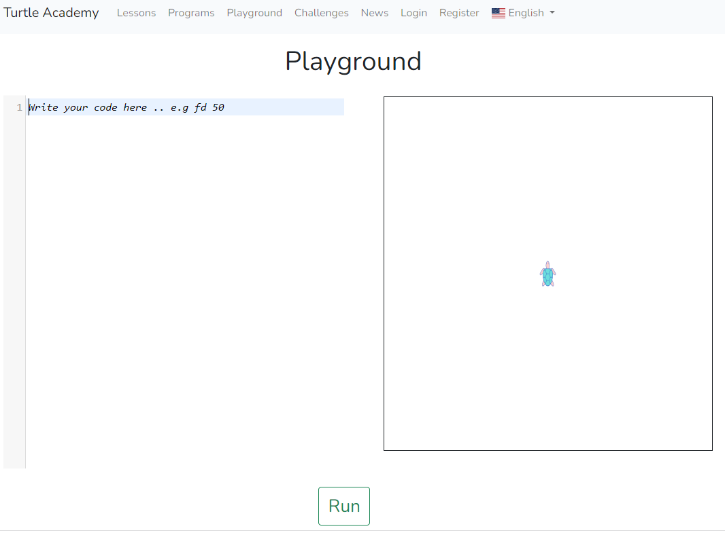
Turtle Academy
Search for Turtle Academy Playground
https://turtleacademy.com/playground

Slide 3
Turtle Academy –angles of a 2d shape
First discuss what are the angles needed to draw a square.
This website is very good at explaining why the calculation is as it is
https://mammothmemory.net/maths/geometry/angles-of-polygons/external-angles-of-a-regular-polygon.html
In other words 360/ number of sides for regular shapes from a square onwards.
Triangles are different and need to be based on 180 / 3 sides i.e. 60 degrees.

Slide 4
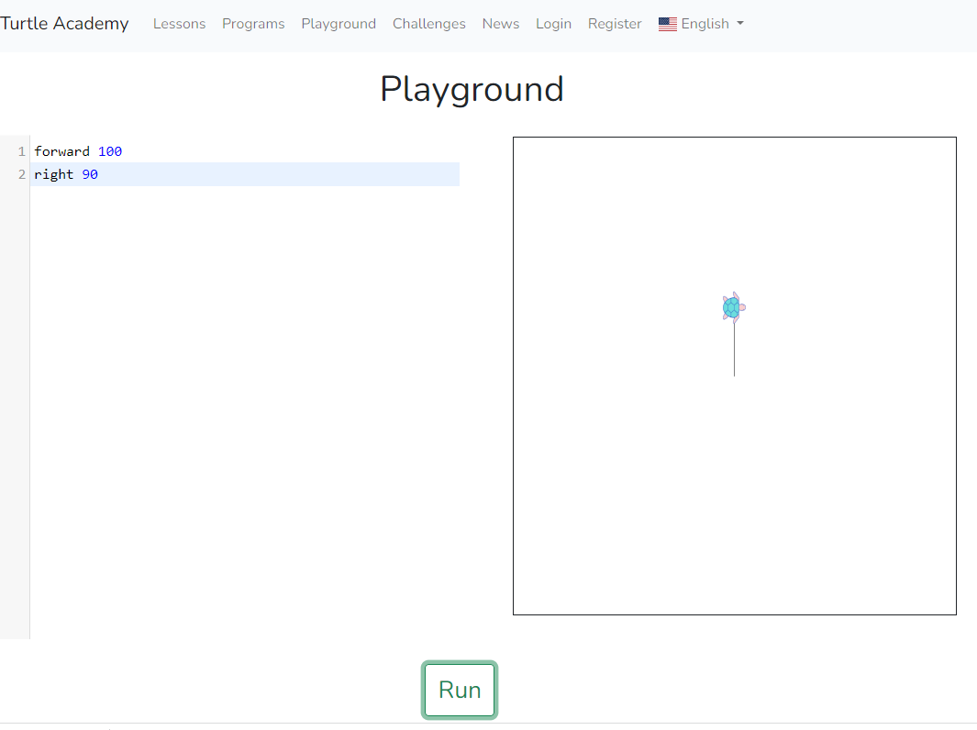
Turtle Academy – a square
Then try the following code forward 100 right 90
There needs to be space between the letters and numbers.
The turtle moves up and then turns at right angles.

Slide 5
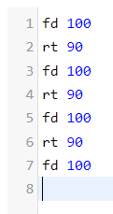
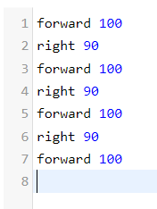
Turtle Academy – a square
To complete the square
This is a good point to show how the text programming
It can be abbreviated to fd instead of forward & rt instead of right.
Put on one line saving even more time.

Slide 6
Turtle Academy – making a pattern 1
To create the repeating pattern add a small turn (e.g. rt 10) at the end of your code.
The turtle turns 10 degrees after drawing each square. The next square is offset from the previous one making the pattern.
In this example the repeat was just 5 squares.
The code is below
Bracket together the code for the square. The repeat 5 in front is for 5 squares.

Slide 7
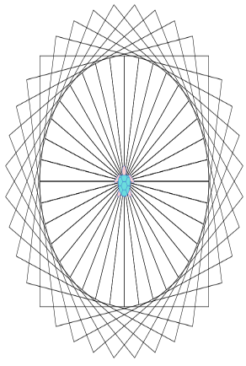
Turtle Academy – making a pattern 2
To create a full circle of squares add a repeat of 36. The maths is as follows.
360 / the turn e.g. rt 10
360/ 10 = repeat 36

Slide 8
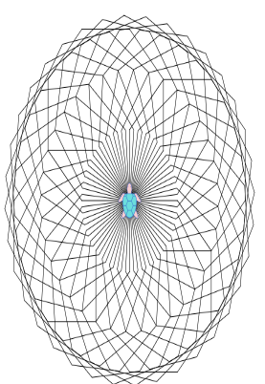
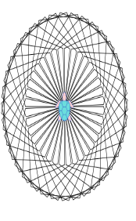
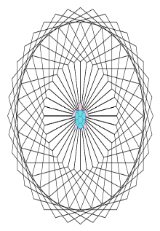
Turtle Academy – other shapes patterns
Pentagon 360/ 5 = 72 degrees
Hexagon 360/6 = 60 degrees
Octagon 360/8 = 45 degrees
Starting with sides of fd 100 allows a more detailed pattern to be created when colour is added.

Slide 9
Turtle Academy – adding colour
The information on colours is under the playground lower down the page.
The easiest way to see it is to duplicate the tab on the browser and scroll down to access the colours on a second tab.
N.B. the American spelling of color is needed for the code.

Slide 10
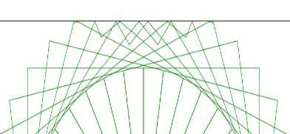
Turtle Academy – adding colour set color x
Here is a simple coloured pattern based on squares.
N.B. Once the line size goes over 275 (with a square) the shapes start to bounce off the playground sides.

Slide 11
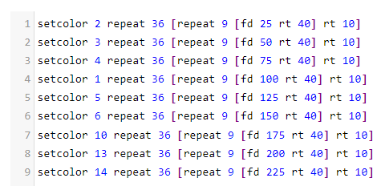
Code for a nonagon
The size of pattern is determined by the fd code –
fd 25,50,75,100,125,150,……….

Slide 12
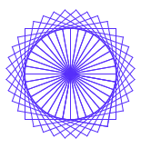
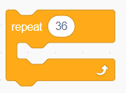
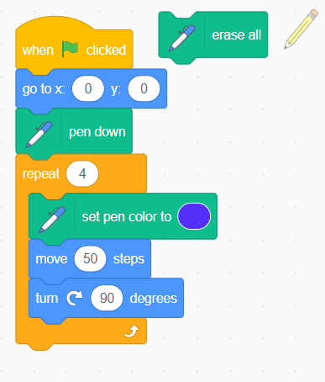
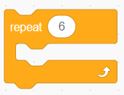
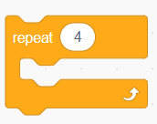
Scratch Pattern making

Slide 13
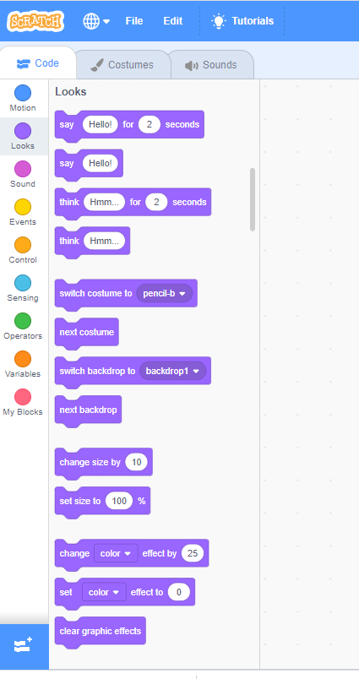
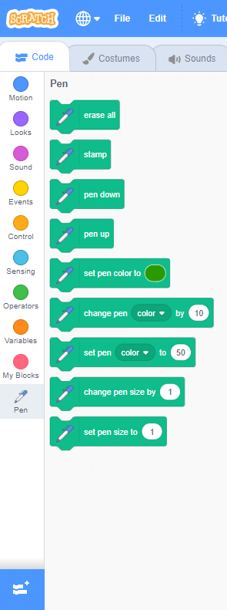
Scratch – add pen code extension

Slide 14
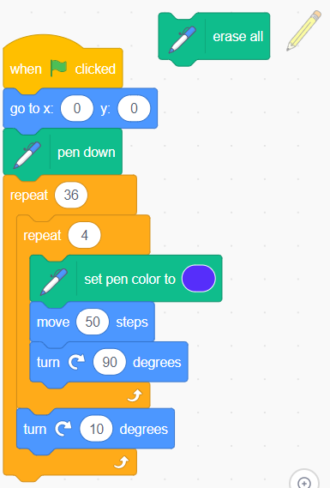
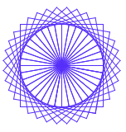
Scratch Pattern Making
The code below draws one square.
This code makes a pattern of 36.
The erase all clears the screen.

Slide 15
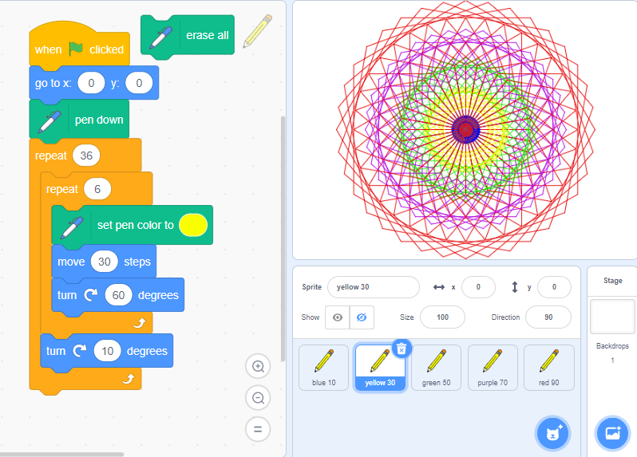
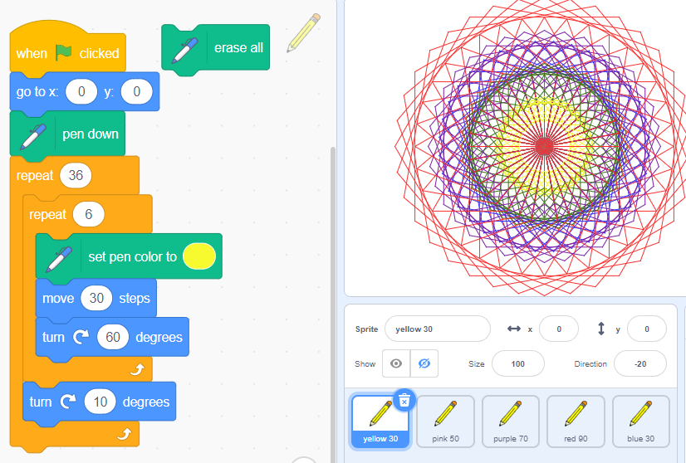
Scratch – making a hexagon pattern
The sprite costume is a pencil.
This code centres each shape repeat.
The pen colour is set inside the basic inner shape repeat loop.
The turn is 10 degrees.
The pencil costumes are not visible

Slide 16
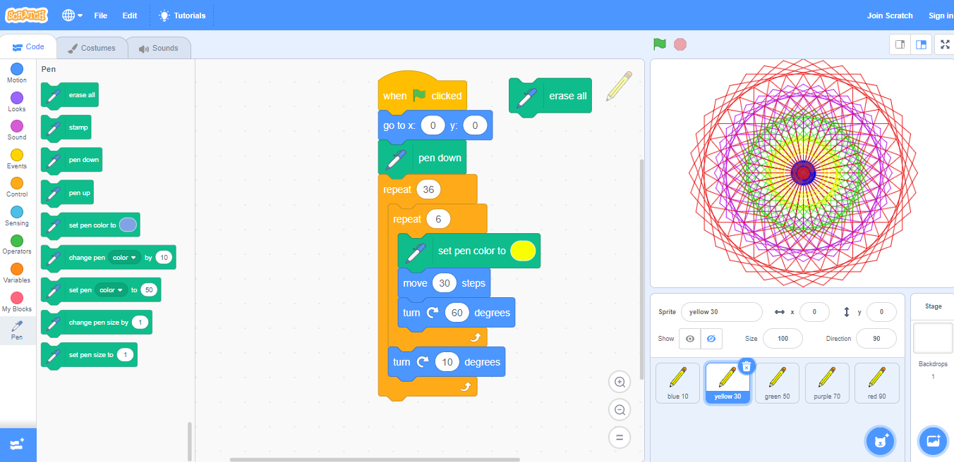
Scratch Patterns- Hexagon Pattern

Slide 17
Thank you for coming to my workshop
Claire Griffiths
Cross-Certified Teacher of Computing
Claire.Griffiths2@moray-edunet.gov.uk
Twitter @sassageek
Linkedin – Search by name and Computing

