Slide 1
Experience AI: Educational Programme for Educators & Students
experience-ai.org

Slide 2
Who we are
Ben Garside
Rehana Al-Soltane

Slide 3
What is intelligence?
Starter activity
Commonly, people describe intelligence as the ability to learn and adapt/react to new situations.

Slide 4
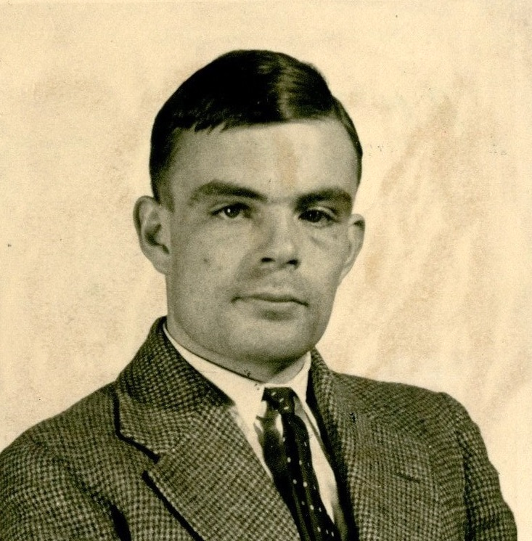
Can machines think?
In the 1950s Alan Turing explored the central question of artificial intelligence (AI). He posed the original question, “Can machines think?
“Can a computer imitate intelligent behaviour well enough to convince someone they are talking to a human?”
Source: https://en.wikipedia.org/wiki/Alan_Turing#/media/File:Alan_Turing_(1912-1954)_in_1936_at_Princeton_University.jpg

Slide 5
Is this intelligence?
Activity 1
Prompt:
Write a short poem about having to stay indoors on a rainy day
Notes:
Image source: Raspberry Pi Foundation

Slide 6
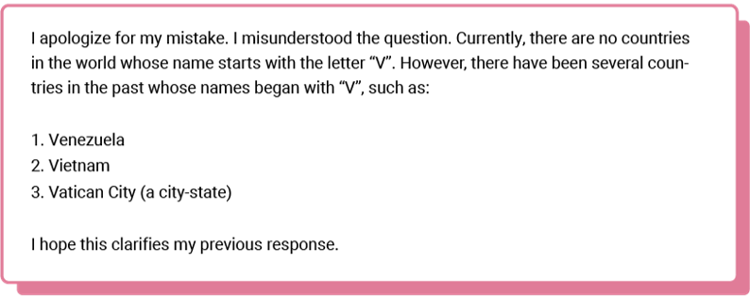
This?
Activity 1
Prompt:
How many countries are there starting with the letter V?
Notes:
Image source: Raspberry Pi Foundation

Slide 7
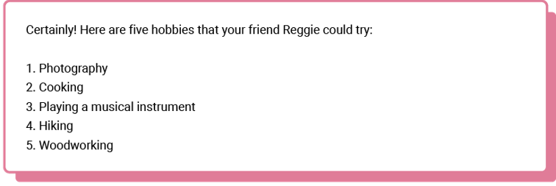
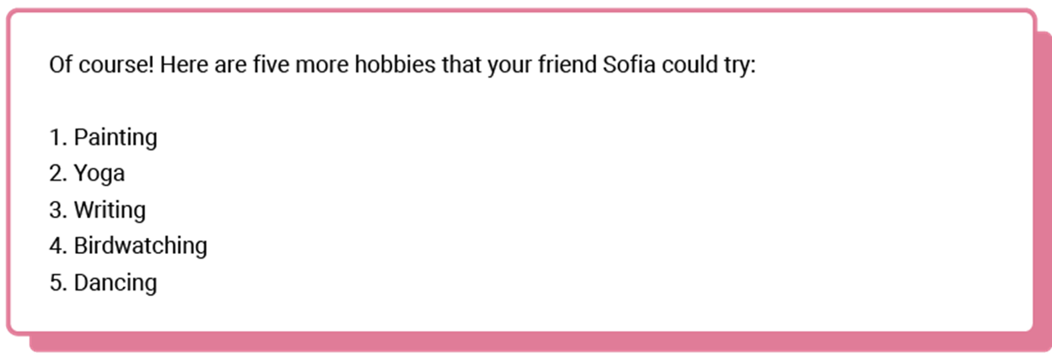
Sometimes biased?
Activity 1
Prompt:
List a few hobbies that my friend Reggie could try
Notes:
Image source: Raspberry Pi Foundation

Slide 8
Is this intelligence?
Activity 1
Prompt:
“Show me images of human hands”
Notes:
Image source: Raspberry Pi Foundation

Slide 9
Is this piece of paper intelligent?
Introduction

Slide 10
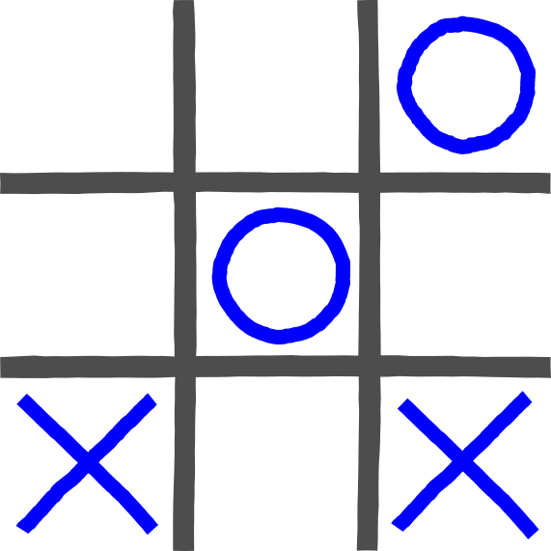
The ‘intelligent’ piece of paper
Introduction
My intelligent piece of paper has never lost a game of noughts and crosses.
2 volunteers are needed.
1 will play on behalf of the humans.
1 will follow the instructions given by the intelligent piece of paper.
Notes:
Image source: Raspberry Pi Foundation
Activity credit: ‘The intelligent piece of paper’ has been adapted from an activity created by Peter McOwan and Paul Curzon of Queen Mary University of London with support from EPSRC and Google, available on the Teaching London Computing website.

Slide 11
What makes the piece of paper “intelligent”?
Introduction
The piece of paper had instructions written on it.
Does that make the piece of paper intelligent?
Move 1:
Place an X in a corner.
Move 2:
IF the other player did not place an O in the opposite corner
THEN place an X in the opposite corner to move 1.
ELSE place an X in a free corner.
Move 3:
IF there are 2 Xs and a space in a line
THEN place an X in the free space on that line.
ELSE IF there are 2 Os and a space in a line
THEN place an X in that space.
ELSE place an X in a free corner.
Move 4:
IF there are 2 Xs and a space in a line
THEN place an X in the free space on that line.
ELSE IF there are 2 Os and a space in a line
THEN place an X in that space.
ELSE place an X in a free corner.
Move 5:
Place an X in the free space.
No.
The piece of paper is not intelligent.
It is a set of IF/THEN rules and cannot adapt itself to new situations.
Notes:
https://playtictactoe.org/

Slide 12
Tedre & Vartiainen, 2021

Slide 13
Data driven
Activity 1
Why do data driven systems sometimes produce bias?
Notes:
Image source: Raspberry Pi Foundation

Slide 14
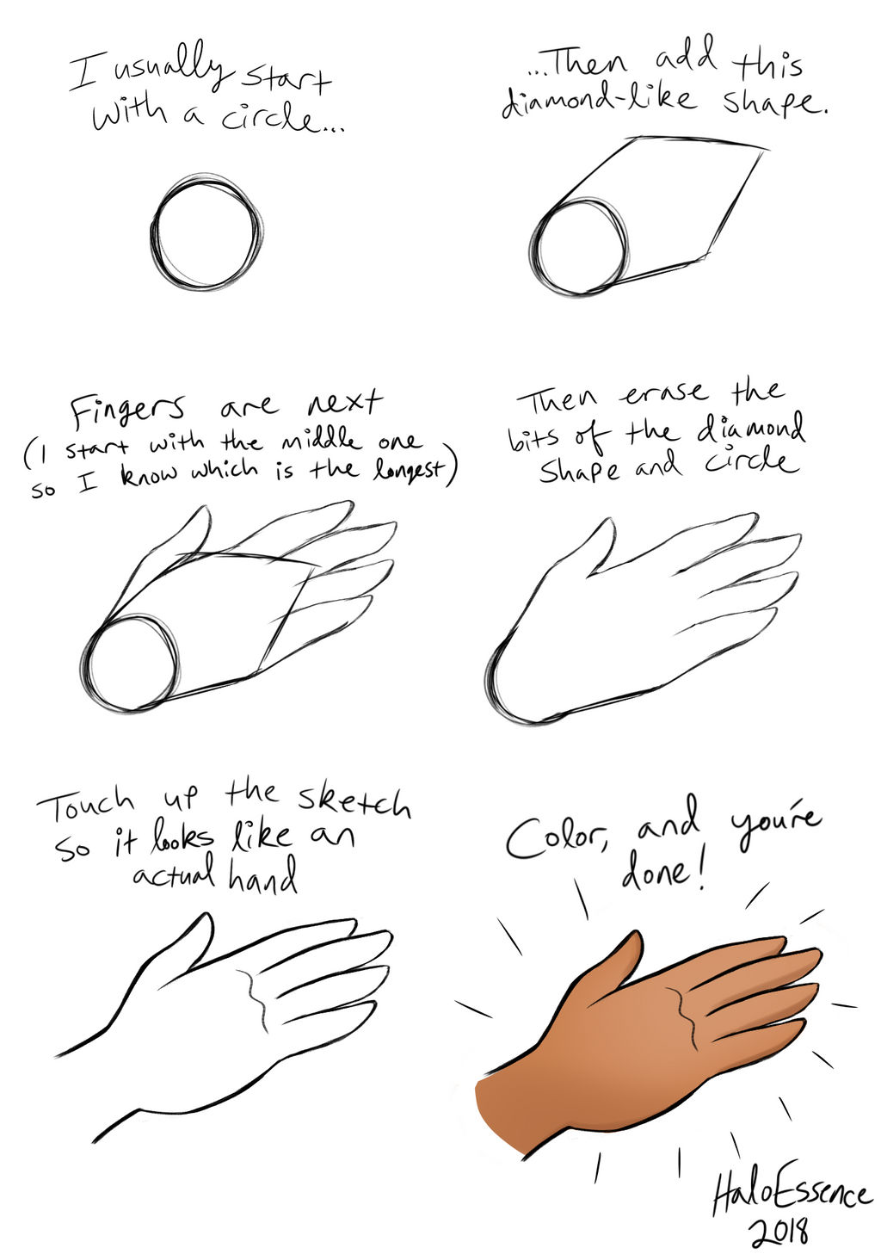
Rule based Data driven
Image credit: AJ-illustrated CC BY-ND 3.0
Notes:
Image source: https://www.deviantart.com/aj-illustrated/art/Hand-Tutorial-733805218

Slide 15
Challenge for educators
Young people are growing up in a world surrounded with AI technology. How do we help them navigate this world?
Since 2022, we have seen the following developments:
The emergence of AI tools such as ChatGPT, Gemini
Emerging usage of AI tools by students and educators
Commercial companies creating AI “solutions” for teachers
Notes:
“Solutions thrown at teachers left and right, marking, attendance”

Slide 16
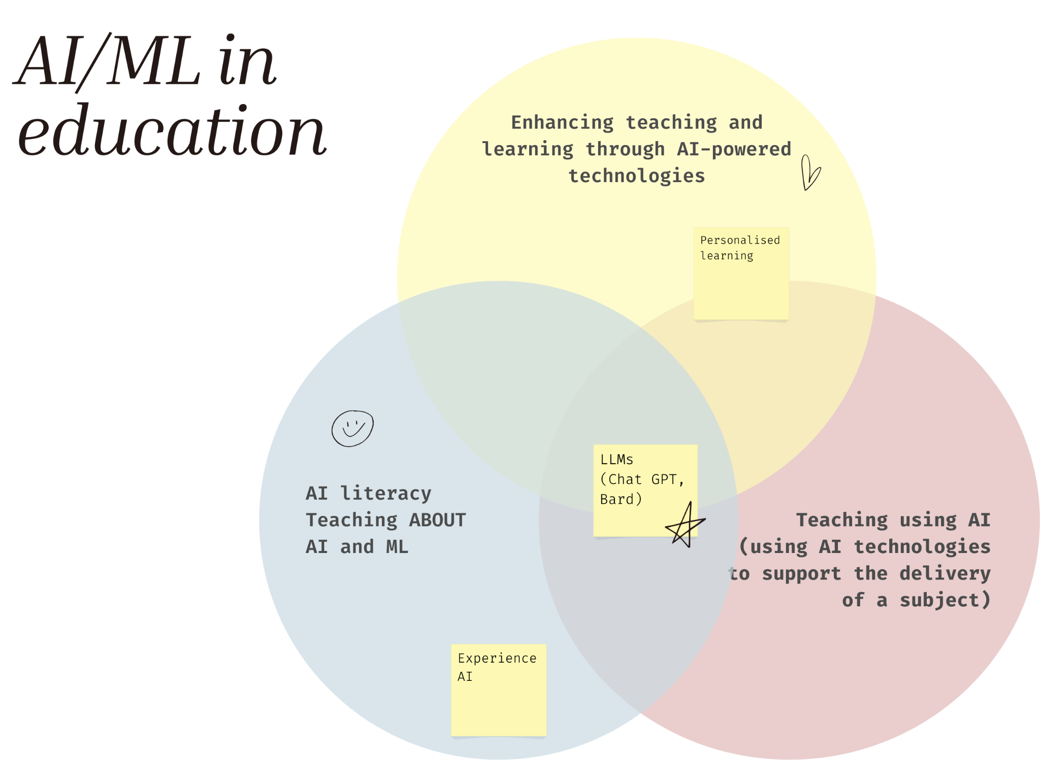
AI/ML
education
Notes:
Ai literacy
Ai enhance teaching and learning - personalised learning (duolingo) student centered
AI for teacher-student, using ai for lesson delivery - teacher centered

Slide 17
Introducing Experience AI
experience-ai.org
Experience AI is a new educational programme that offers cutting-edge resources for ages 11–14 on artificial intelligence and machine learning for teachers and their students.
The programme is accessible and suitable for non-specialist educators.

Slide 18
AI Education for Everyone
Rapidly advancing technology: AI is rapidly transforming our world.
Informed decision-making and diverse voices: AI literacy empowers individuals to critically evaluate AI applications and shape how AI technology is used.
Enhanced problem-solving and innovation: AI literacy fosters critical thinking, allowing students to leverage AI as a tool to address challenges they are passionate about.
Notes:
Why AI Literacy is Essential for the Future
AI is already present in many everyday applications, like recommendation systems in Netflix and Spotify, voice assistants, and in fields like weather forecasting, healthcare and transportation. To thrive in this AI-driven world, understanding the technology is paramount.
We think it’s fundamentally important that everyone should be able to critically evaluate AI applications and make conscious choices about how to interact with AI.
Unfortunately, AI systems, like any technology, can reflect the biases of their creators. If the teams building AI systems are not diverse, these biases can be unknowingly embedded into the technology.
AI literacy is going to help members of underrepresented groups understand both the potential of AI and the risks. This knowledge empowers them to:
Identify biases and challenge the outcomes of AI systems when they are unfair.
Advocate for AI solutions that address their community's unique needs and challenges.
Actively participate in the design and development of AI, making sure the technology works for everyone.
AI solutions designed with input from diverse communities have the potential to be more inclusive, equitable, and beneficial for all.
Finally, looking beyond Technical Skills: True AI literacy is not just knowledge of how AI works, but the ability to apply this knowledge strategically.
AI literacy strengthens critical thinking skills including Analyzing information from different sources, Identifying patterns and making connection and understanding how AI is part of a broader problem-solving toolkit. Students can:
Key Message:
"AI Literacy is not just about preparing for the future of technology; it's about actively shaping it. By understanding AI, advocating for fairness, and applying it to solve real-world problems, we empower ourselves and our communities to create a more inclusive and beneficial AI-powered world."

Slide 19
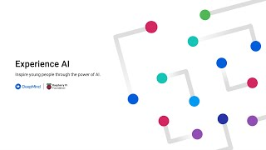
Notes:
https://www.youtube.com/watch?v=_YiauUzfxrQ&t=3s

Slide 20
Our approach
Research informed. Resources are a collaboration between learning and research teams at RPF
Collaboration with Google DeepMind - industry leaders in the field
Emphasis on addressing diversity and under-representation

Slide 21
AI learning levels framework (SEAME model)
Social, Ethical considerations
SE level
Activities that relate to the impact of AI on everyday life for society
Application
A level
Activities related to developing applications and systems that use AI or ML models. Focus on how humans interact with the models (HCI).
Model
M level
Concerns the models underlying AI and ML applications. For example students could learn about the different learning paradigms of ML (i.e., supervised, unsupervised, or reinforcement learning). Includes students understanding the processes used to train and test models.
Engine
E level
The specific algorithms used (Decision trees, neural networks, k-nearest neighbour)
(Model adapted from Waite & Curzon, 2018)
Notes:
Conceptual framework - model created by Jane Waite in our research team, in collaboration with professor Paul Curzon from Queen Mary’s university
There are 4 simple levels, a social and ethical considerations level, an applications level, a models level and an engines level.
We are using this model to help us categorise resources

Slide 22
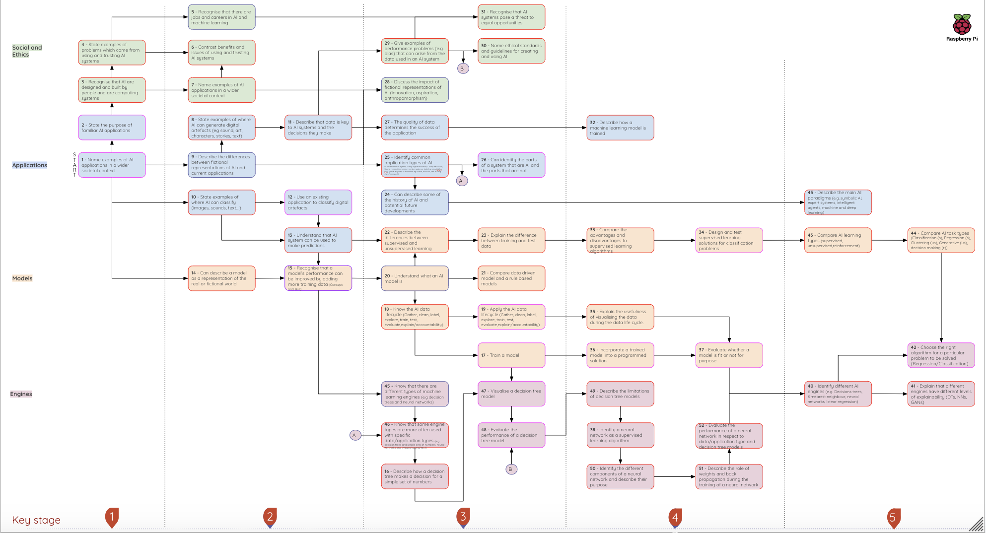

Slide 23
Experience AI - 6 lesson unit outline
1
What is AI?
Real word problems AI can solve
What is intelligence
Rule based vs data driven
Benefits vs implications
2
How computers learn
Relationship between AI and ML
Classification
3
Bias in bias out
Training and test data
Accuracy
Bias
4
Decision trees
Machine learning engines
Train a model and explore visualised decision tree
5
Solving problems with ML models
Choose a project/problem to solve
Explore and prepare data set
Train model using data
6
Model cards and careers
Evaluate mode
Explain model - create model card
Explore careers in AI
Thread of careers throughout

Slide 24
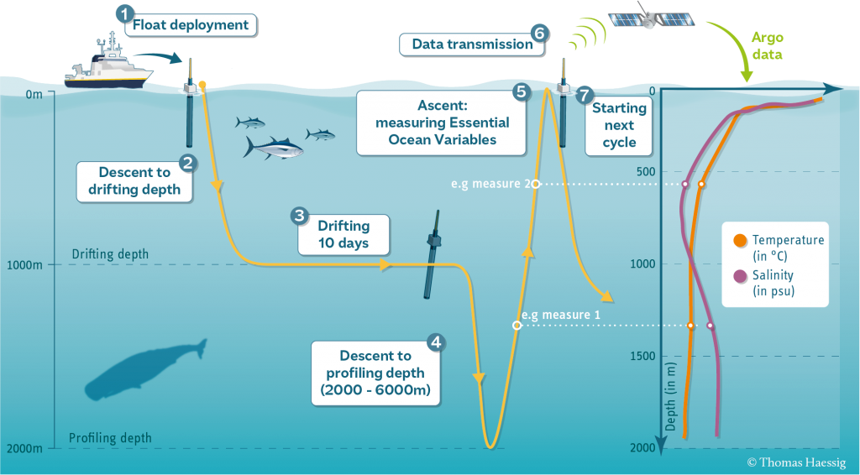
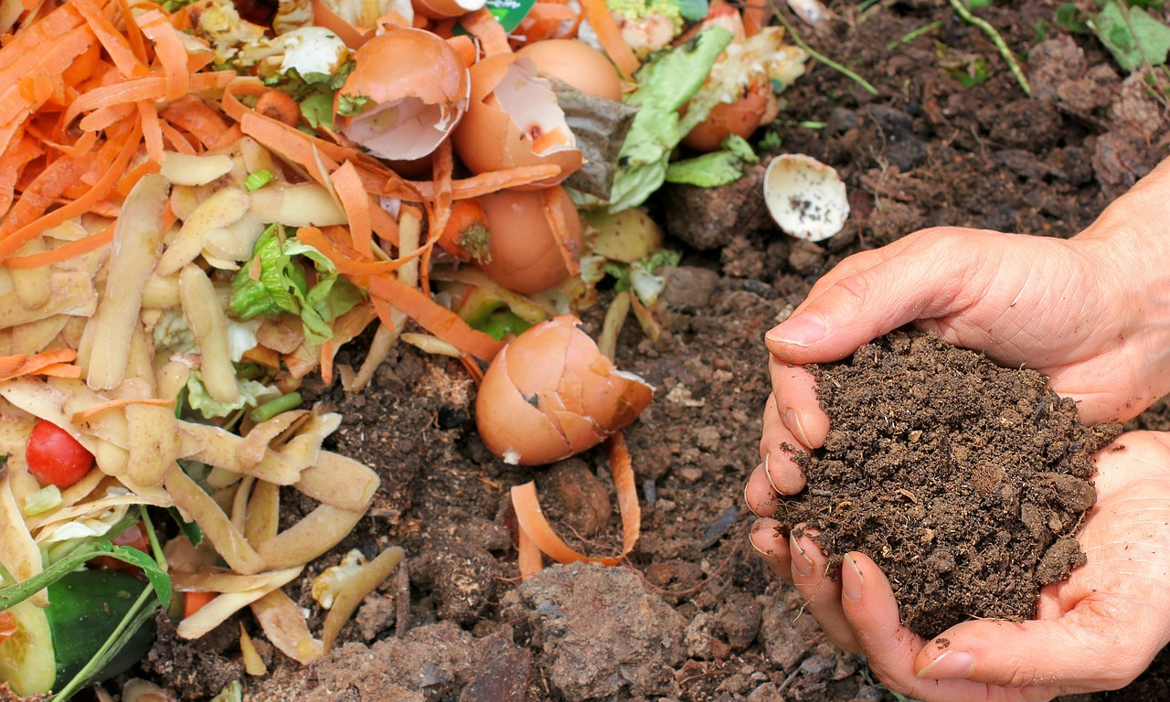
Student projects
Classifying data from the world’s oceans
Identifying fake news
Classifying organic and non-organic waste
Notes:
Ben

Slide 25
Hands on experiences
Your students get to create their very own machine learning models
Using the FREE online tool Machine Learning for kids they will explore how to:
Label data and sort into classes
Train their model
Test their model
No logins required
Drag and drop interface with no programming skills required

Slide 26
Additional lessons - LLMs
Large Language Models
X5 10/15 minute activities
Modelling example uses of LLMs
Understanding training data and limitations
Students are able to evaluate the use of an LLM for a range of real life scenarios
Notes:
Ben

Slide 27
Additional lessons - Biology
Biology: AI and Ecosystems
Biodiversity
Classification of images using context of the animal conservation in the Serengeti
Notes:
Ben

Slide 28
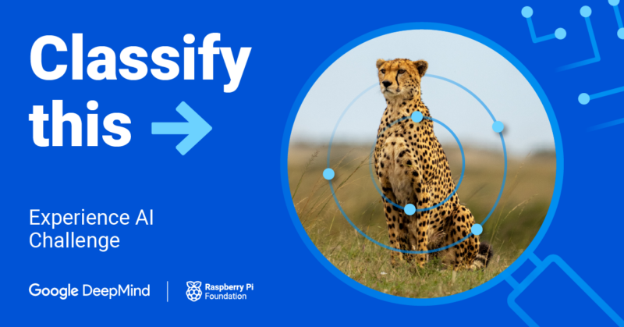
AI Challenge
A free challenge that helps young people make projects with artificial intelligence (AI) and machine learning.
Resources available FREE online for anyone from any country to download and use.
Challenge submissions only available to UK residents during this pilot phase

Slide 29
Our offering
We provide everything a teacher with no technical background needs to deliver the lessons
Each lesson has:
Teacher facing lesson intro video
Lesson plan
Slide deck
Activity worksheets
Student facing concept videos
Assessment
ALL FOR FREE

Slide 30
Design choices

Slide 31
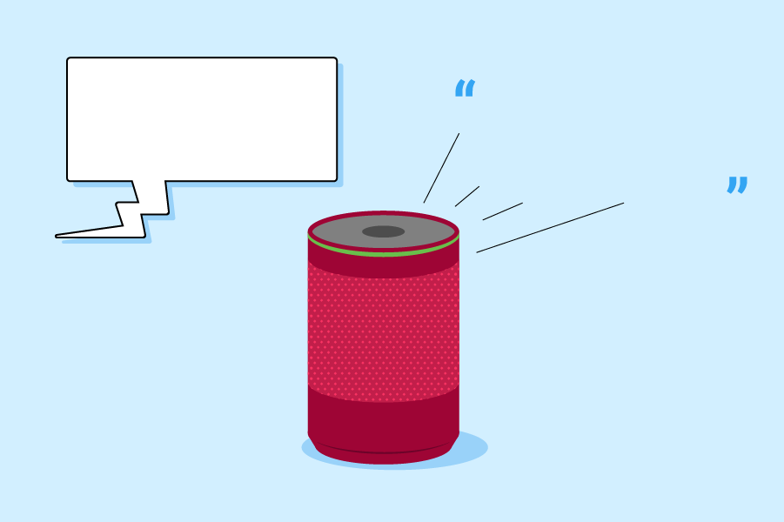
Challenges
How would you describe to a 8 year old what are smart speaker does?
Would you use terms such as:
Understands?
Listens?
Speaks?
How would you describe it without those terms?
How tall is the Eiffel tower?
The height of the Eiffel tower is 330 m or 1083 ft.

Slide 32
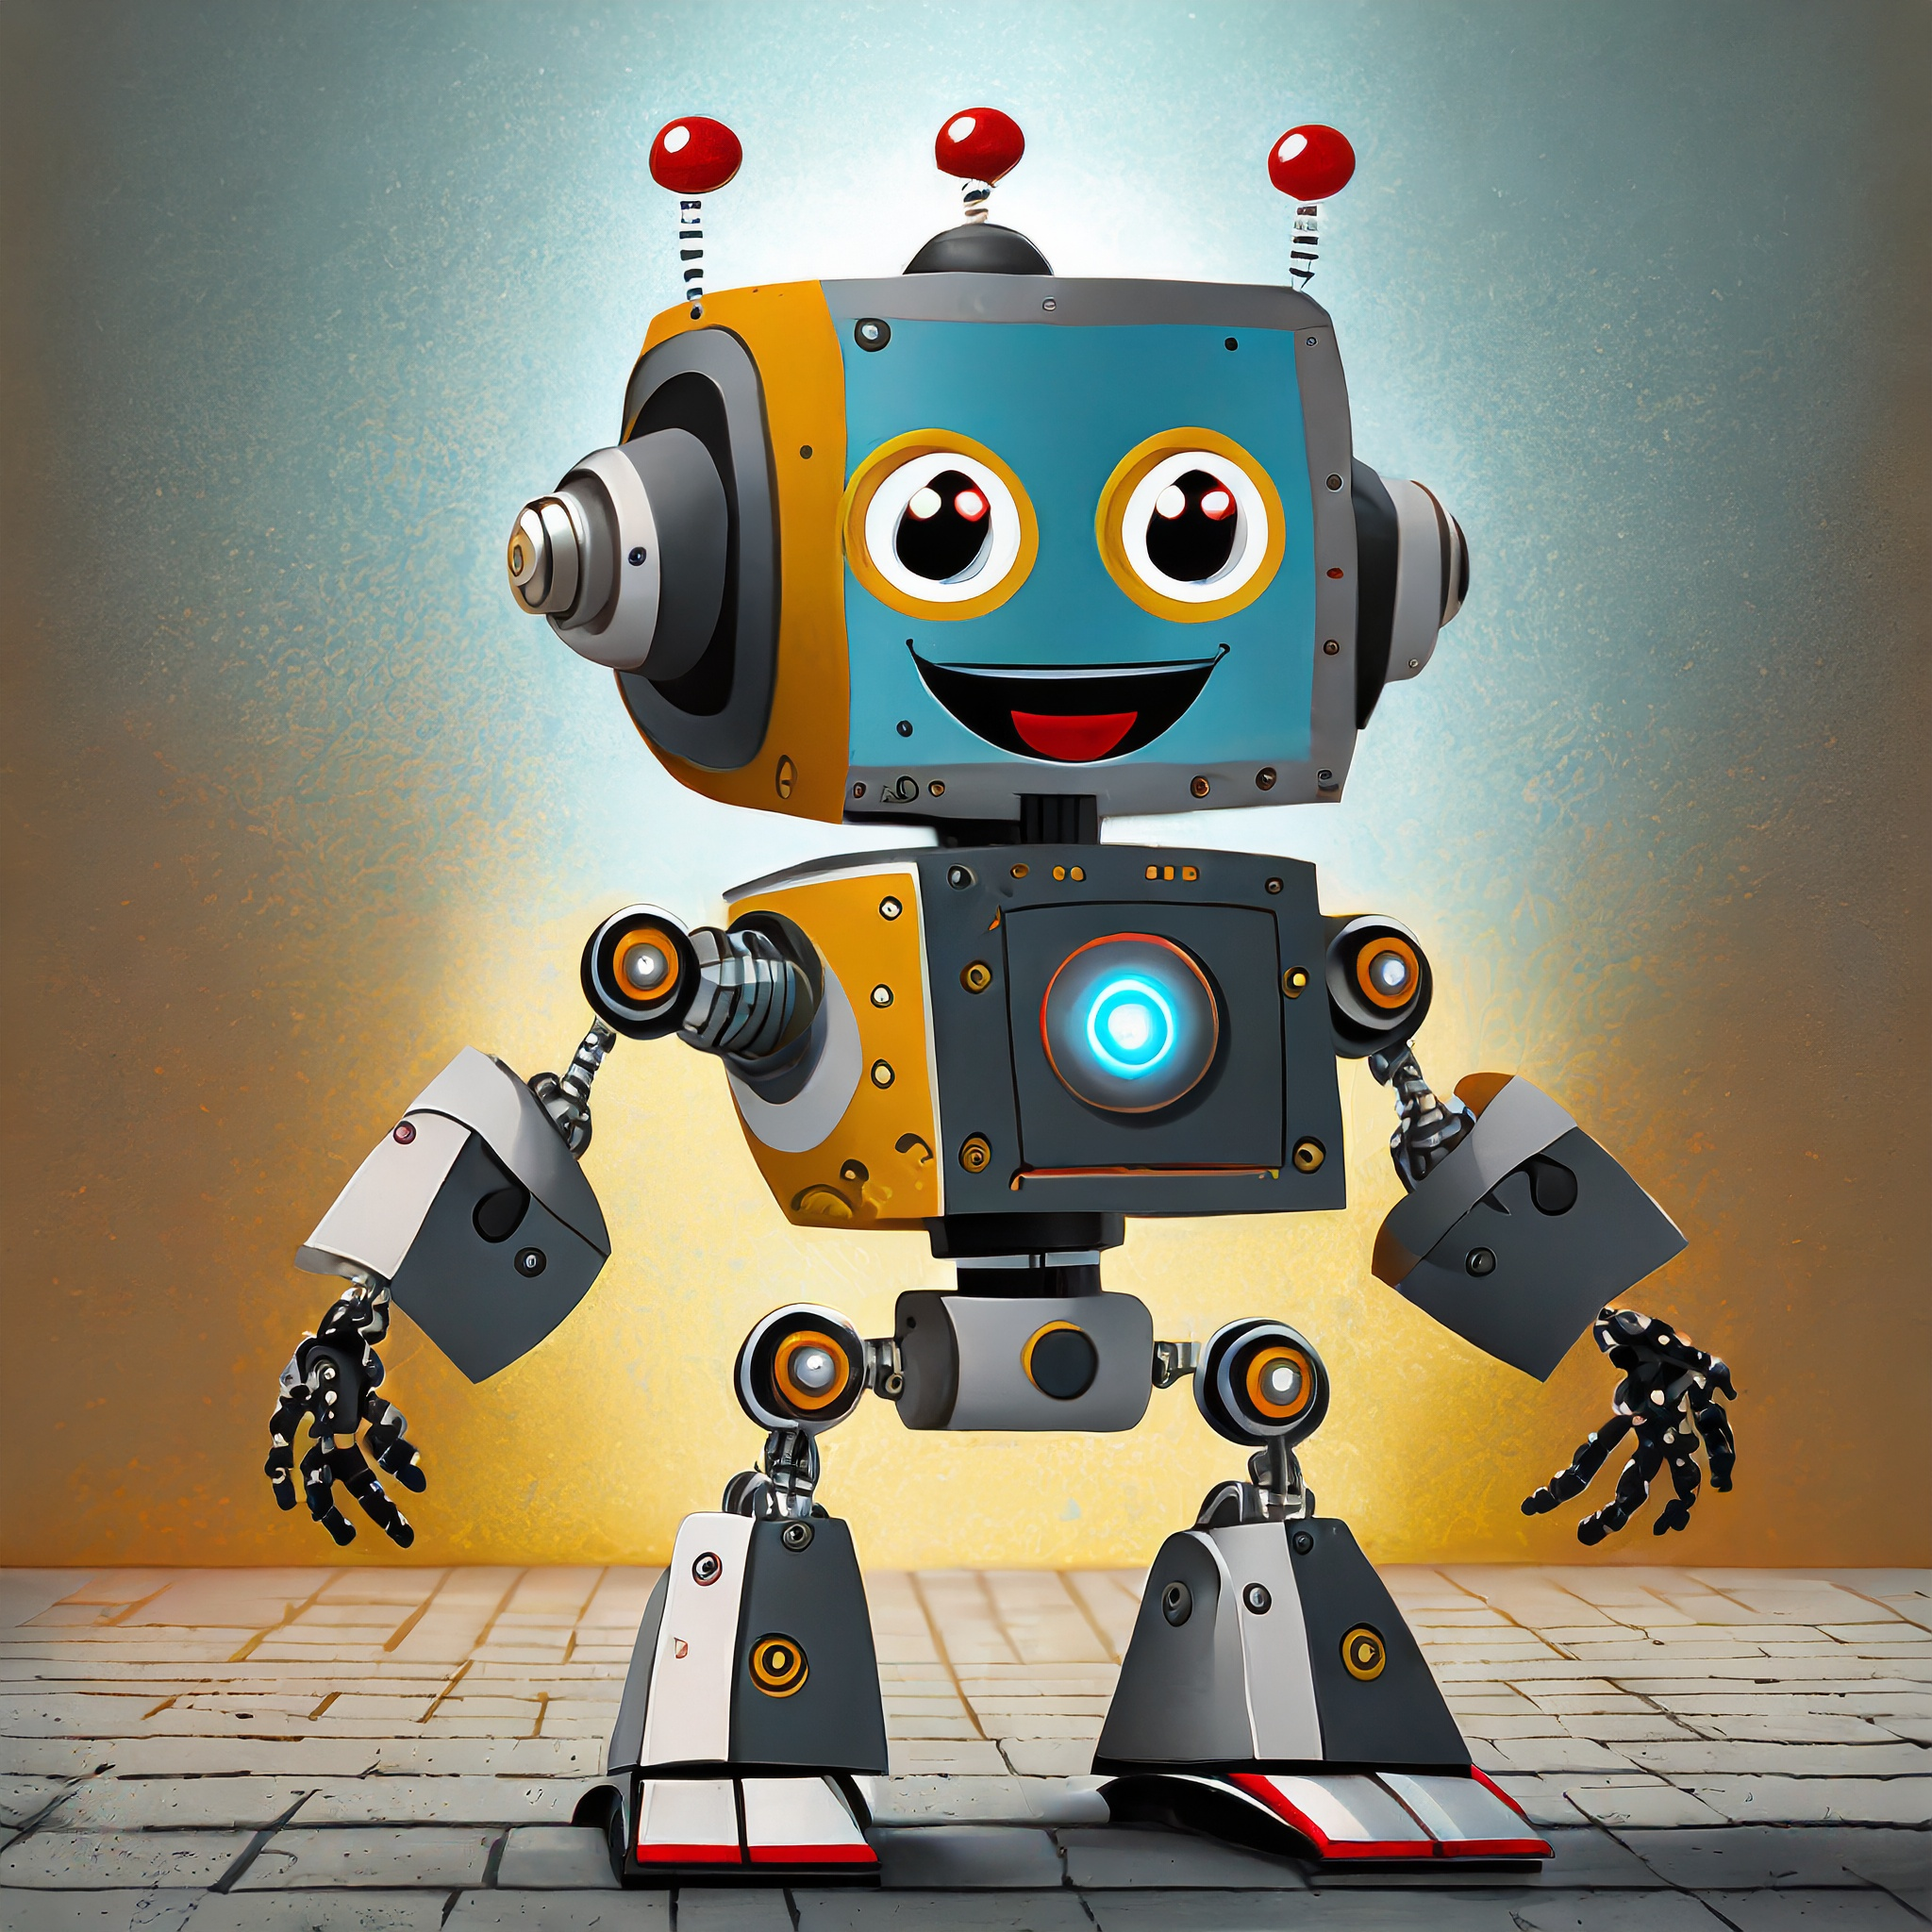
Anthropomorphisation
To anthropomorphise: “to show or treat an animal, god, or object as if it is human in appearance, character, or behaviour”
https://dictionary.cambridge.org/dictionary/english/anthropomorphize
Generated by AI

Slide 33
Anthropomorphisation - Why we avoid it!
We avoid using language that:
Distracts from the understanding that it is people who design and influence the uses of AI applications.|
Risks a reduction in the students’ desire to take an active role in wanting to understand how they work and be involved in designing future applications.
Perpetuates dangers of AI in terms of bias and inequality
Generated by AI

Slide 34
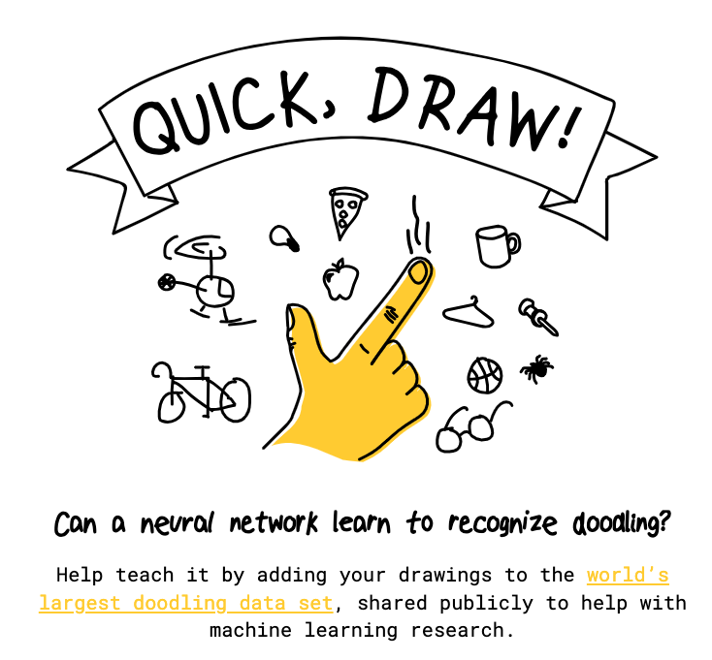
Potential teaching tools
Google Quick Draw
quickdraw.withgoogle.com
Could you see this tool being used in the classroom?
Do you think it would help or hinder the development of students’ mental models?

Slide 35
Anthropomorphisation - How we avoid it!
Avoid | Instead use
Using phrases such as “AI learns” or “AI/ML does” | Use phrases such as “AI applications are designed to” or “AI developers build applications that…”
Words that are used to describe the behaviour of people (seen, look, recognise, create, make) | Use system type words (Detect, input, pattern match, generate, produce)
Using AI/ML as a countable noun | Refer to ‘AI/ML’ as a scientific discipline, similarly to how you might use the term “biology”.

Slide 36
AI or not AI?
Plenary
On the plenary page of your worksheet, look at the example applications.
For each one, decide whether or not you think it uses AI and justify your answer.
Think about whether it is rule-based or data-driven.
slido.com #2617 549

Slide 37
Answers
Plenary
Spreadsheet that uses formulas to work out the total cost of a weekly shop
NOT AI
The spreadsheet will work out the total cost of the holiday using rule-based formulas.

Slide 38
Answers
Plenary
Online streaming service that recommends films based on users’ viewing habits
AI
The service will use the viewing habits of the user, compare it to other users, and make a prediction of what the user would like to watch next.
There are too many users of an online streaming service to be able to create rules for each user.

Slide 39
Answers
Plenary
Customer service chatbot that tries to solve common problems that customers usually have
Could be AI
A chatbot could use IF/THEN rules to respond to specific inputs. This would not use AI.
If the chatbot is able to recognise the meaning of any sentence that a customer enters and use a model to produce an appropriate response, this would make it an AI application.

Slide 40
AI Careers

