Slide 1
The future for teaching programming - at secondary level
Richard Pawson

Slide 3
Code with
‘Elan is the first new educational programming language designed specifically for British secondary schools since BBC Basic in 1981’

Slide 4
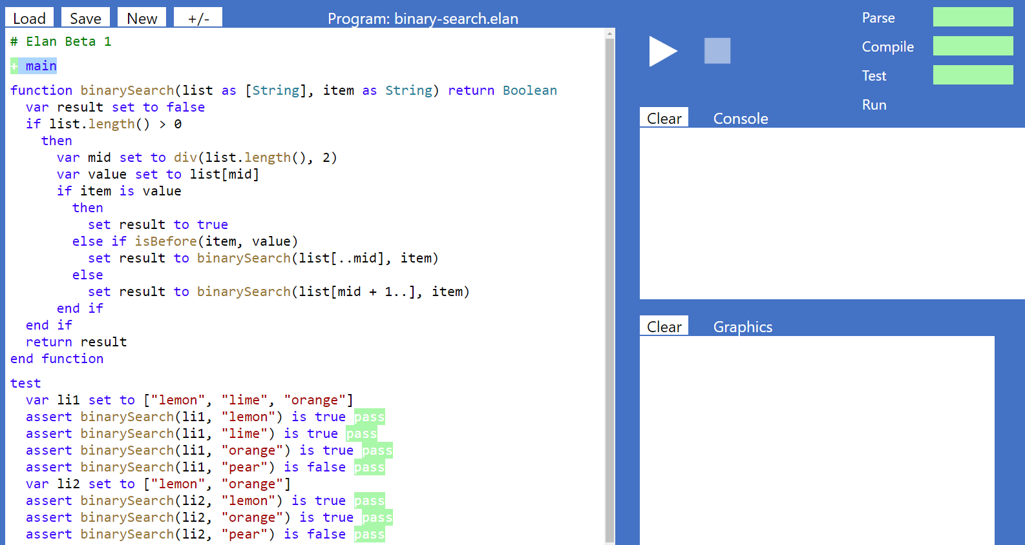
Unit testing is a first-class feature of Elan

Slide 5
Interlude

Slide 6
Practice question: What will this code produce?
Python 3
VB.NET
C#
x = "Hello"
x.upper()
print(x)
Dim x = "Hello"
x.ToUpper()
Console.Write(x)
var x = "Hello";
x.ToUpper();
Console.Write(x);
A)
hello
B)
HELLO
C)
Hello
D)
hELLO

Slide 7
Q1. Describe the similarities between a function and a procedure ( 3 marks)
They are both forms of subroutine. 1 mark
They both have a name. 1 mark
They both have the option to define parameters. 1 mark

Slide 8
Q2. Describe the differences between a function and a procedure (3 marks)
A function returns a value, and a procedure doesn't. 1 mark
Er, that's it.

Slide 9
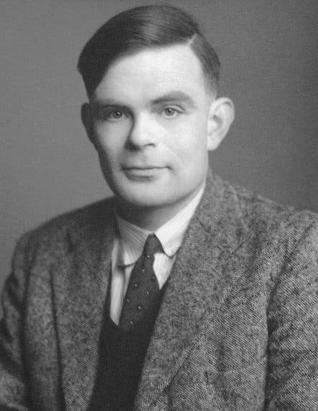
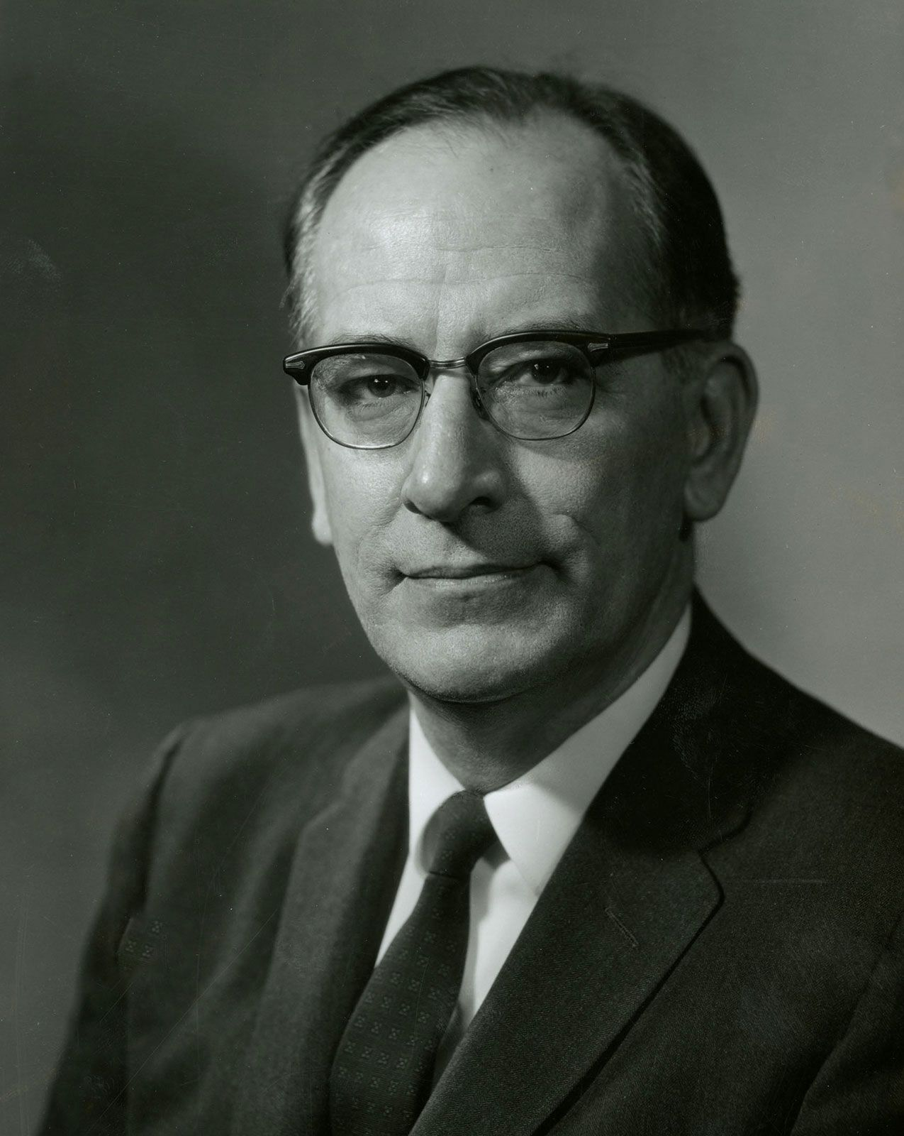
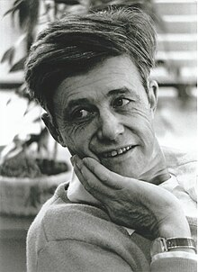
A bit of history…
'Subroutines' are almost as old as programming itself
Functions didn't appear until much later

Slide 10
Most programming languages now have 'cargo cult' functions

Slide 11
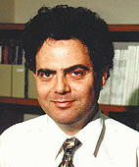
Bertrand Meyer: 'Command / Query Separation'
Every method should either…
Make a change to the system (a 'command')
Answer a question (a 'query')
… but never both, because...
'Asking a question should not change the answer!'

Slide 12
A procedure is a command A function is a query
A procedure…
can make changes to the inputs, or to the wider 'system'
indeed, it must
A function…
may not make changes to its inputs, nor to the wider system
may have no observable effect except the returned result
The result must depend on nothing except the details of the question

Slide 13
Functions are more restrictive than procedures - but offer far more benefits
Functions can:
be fully unit tested
be used in expressions
be reasoned about
be safely combined
be transparently parallelised
cache their results

Slide 14
Immutability changes everything
Immutable type doesn't mean you can't change contents
Just that when you do, you get back a new instance
You've already been using immutable data structures – where?
Why is this important?
Immutable data structures are seen as the future of programming
Fewer errors
Easier to parallelise
Immutable types in Elan
ArrayList v. ImmutableList
Both mutable and immutable versions of Set, Dictionary, Stack, Queue, Tree, & Graph
User-defined classes may be specified as immutable
Incentive1 : functions will accept only immutable types as parameters
Incentive2: You can't have a 'hanging function' as you can in most languages

Slide 15
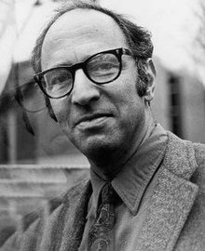
Programming paradigms What is a paradigm

Slide 16
Programming paradigm shifts
Procedural programming
Structured (procedural) programming
Object-oriented programming
Functional programming

Slide 17
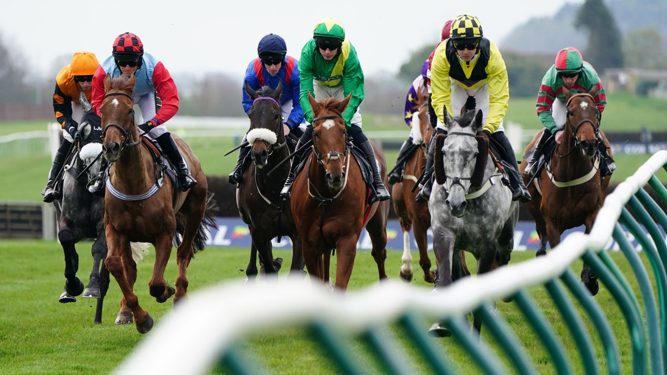
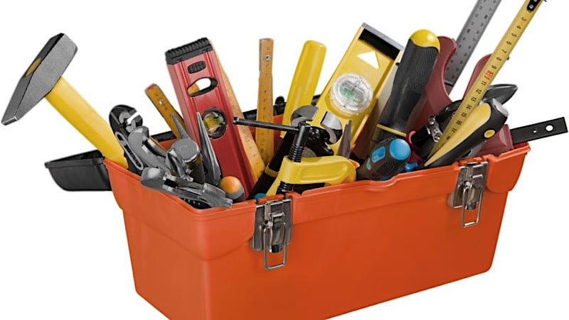
The future for teaching programming: Single-paradigm (which?) or Multi-paradigm ? (how?)
Single Paradigm
Multi Paradigm
'One True Way'
'Specific roles'
Prescriptive
'Choose the horse for the course'
'The toolbox'
Liberal

Slide 18
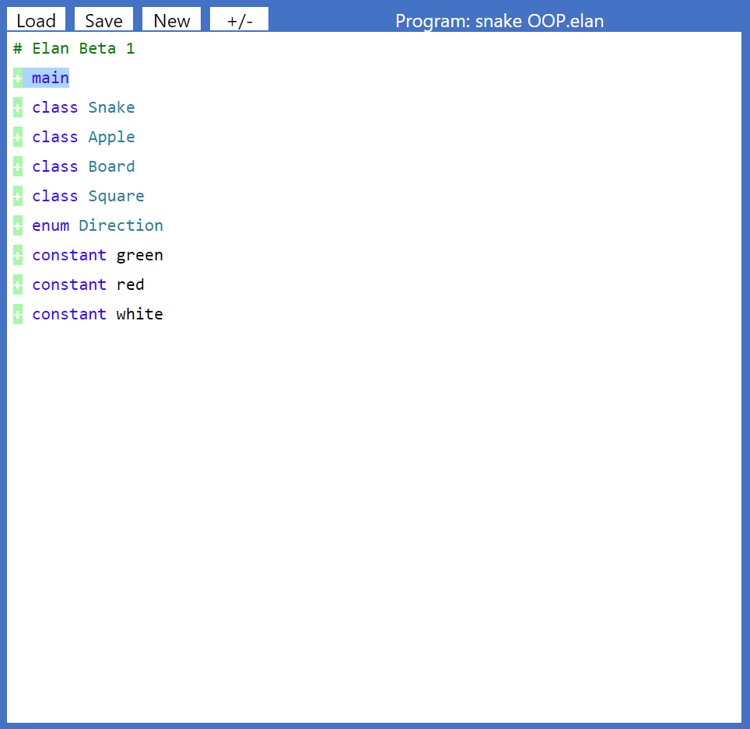
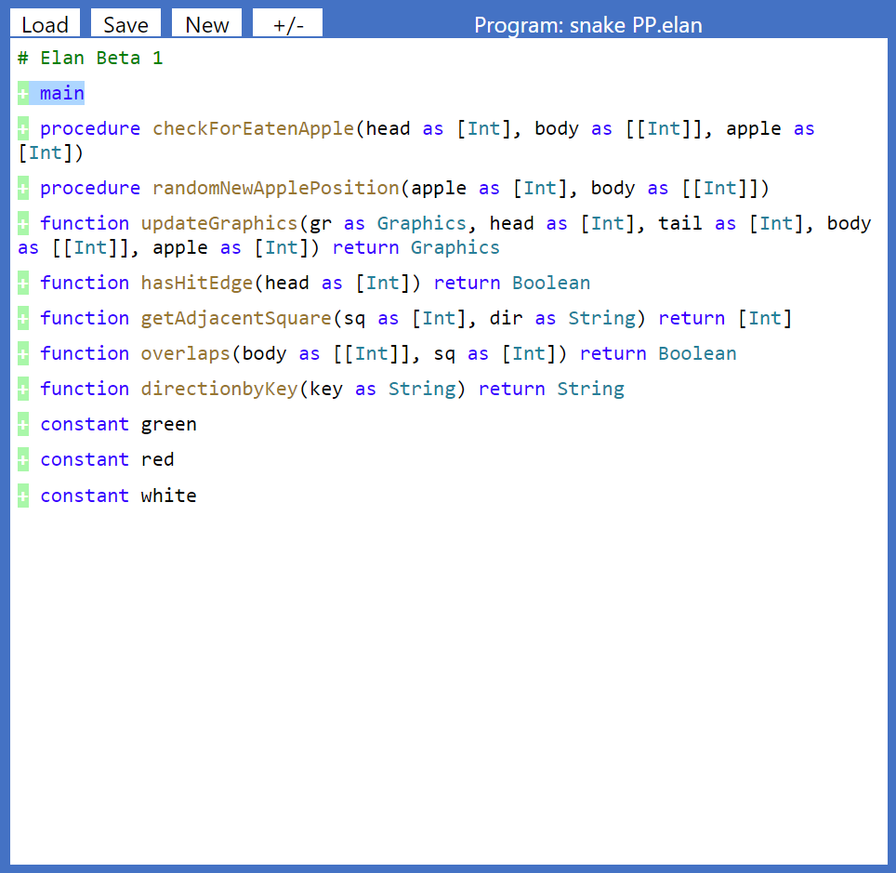
Comparing programs side by side

Slide 19
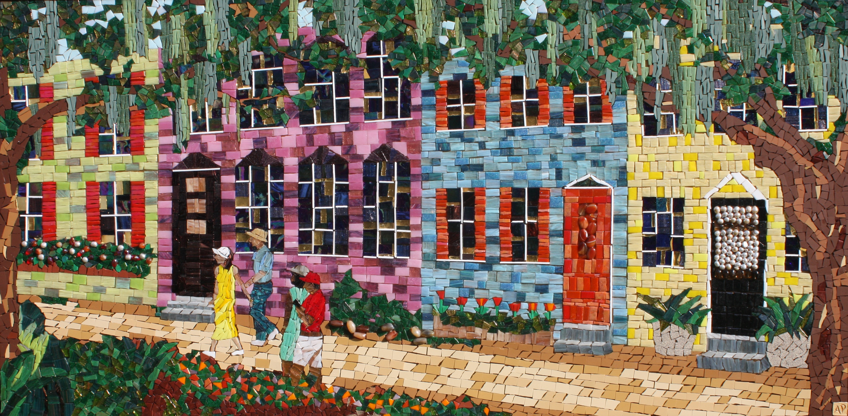
'Wiggle from a straight line, not from a wiggly line'

Slide 20
So what are these specific roles?
Freestanding functions
Define all the app 'domain logic': data transformations, queries, rules
So: start programming with functions (all with tests!)
Objects
Defining the nouns of the app domain as custom data structures
Sounds like 'records'? Yes
So: Introduce them right after array/lists
Apart from 'type substitutability' – all the rest is gloss
Procedures
Define all Input/Output
So: make this your very first use of procedures – (including 'main')
This is one of the reasons why Elan has 'Character Mapped Graphics'

Slide 21
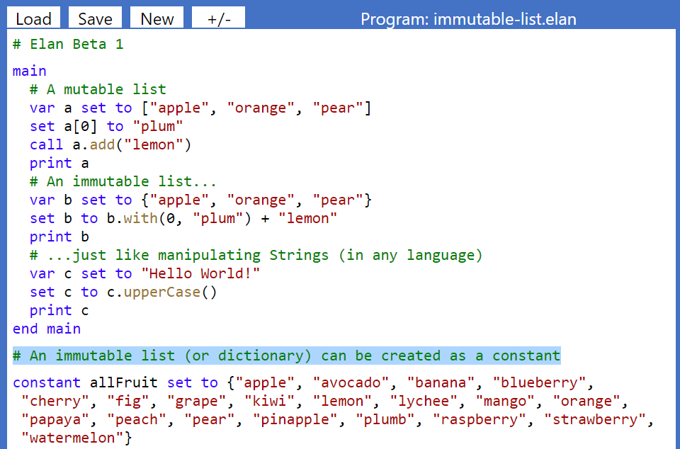

Slide 22
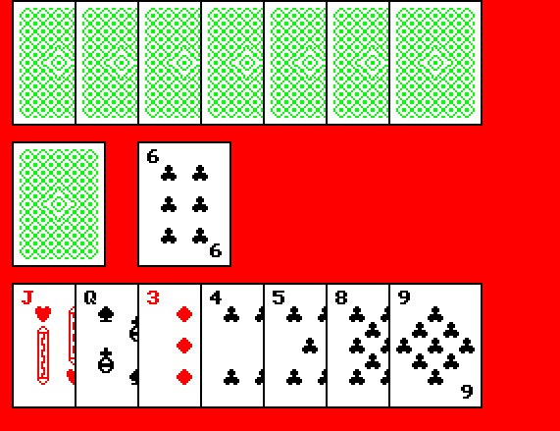
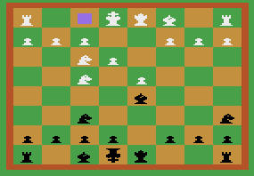
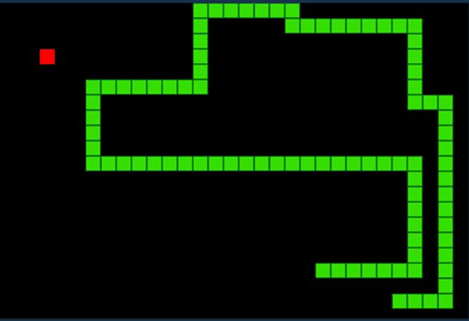
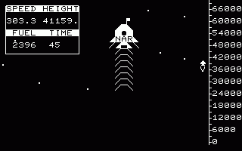
1980s – Character mapped displays
Simple but engaging games
Feasible to write complete app from scratch
You learned lots of programming from it
Modern GUIs & game frameworks
Richer, more complex games
Stunning imagery and sound
Great for learning game design – but not for learning programming

Slide 23
Preventing common 'anti-patterns'
Global variables
Breaking out of a loop
Exiting a procedure or function before the end
Creating a function with side-effects, or external dependencies
Null reference
Inheriting from a concrete class
Hanging function call
Formatting code inconsistently

Slide 24
Encouraging good patterns
Separation of concerns
Lightweight objects
Type substitutability rather than inheritance
Using immutable types as much as possible
Expression functions

Slide 25
Who is 'we'?
Architect & lobbyist: Richard Pawson
Implementation: Stef Cascarini & Richard Pawson
Informal advisors & consultees:
Simon Peyton Jones
Michael Kölling, Neil Brown at King's College, London
Ada Computer Science: Alastair Beresford & co. at Cambridge University + RPF
Education team at BCS: Julia, Neil, Becci, Peter M
John Stout
Miles Berry
Pete Dring
Nela Brockington
A formal governance board will be appointed before Release 1.0

Slide 26
Early reaction from the community
'CAS will be creating resources to support the teaching of programming with ELAN…'
'BBC Basic had a positive impact on the introduction of computing into schools in the early 1980s. I'm encouraged to see this new initiative, Elan, with the potential to make another significant contribution to British schools.
My team and I were given the opportunity to see an early demonstration of Elan, and it was clear that a great deal of thinking about the future for teaching programming had gone into its design and implementation…'
Becci Peters CAS Computing Subject Lead
Samina Kiddier Assistant Director, STEM Education

Slide 27
'I think we all see the merit in this approach and I am certainly in awe of your ambition - I hope it gains traction. Any programming language that helps build good habits would be a vehicle we would consider moving forward.'
ELAN offers a great approach to the teaching of programming - it's a schools-focussed language.
It can be used as a transition from block-based to text-based languages, with features that will help students at all abilities learn to program and bringing in an early focus on functions, which students enjoy because they can immediately see more potential in their code.
We think teachers will be interested in the possibilities this language can offer their students.
Tim Brady Subject Advisor
'We are excited to explore how this language/IDE will be adopted by students and schools. We will engage with schools and students to discover the potential opportunities that Elan could offer in any new qualification developments.'
Emma Armitage Product Development Lead
?
?
Gareth Gillard Subject Officer

Slide 28
Next steps
Email me: rpawson@nakedobjects.org
Try out the Beta at: elan-lang.org
Try out the demo programs - modify them, or build your own
Watch the explanatory videos
Download the (incomplete) manual
Participate in Elan discussions on CAS
With your help, v1.0 will be released in April 2025
Ready for teaching in Sept 2025

