Slide 1
Creativity and Curiosity
CAS Conference 2024
Prof Miles Berry FBCS
These slides: bit.ly/caskeynote
13 July 2024

Slide 3
Coding in an AI age…

Slide 4
What was your first computer?

Slide 5
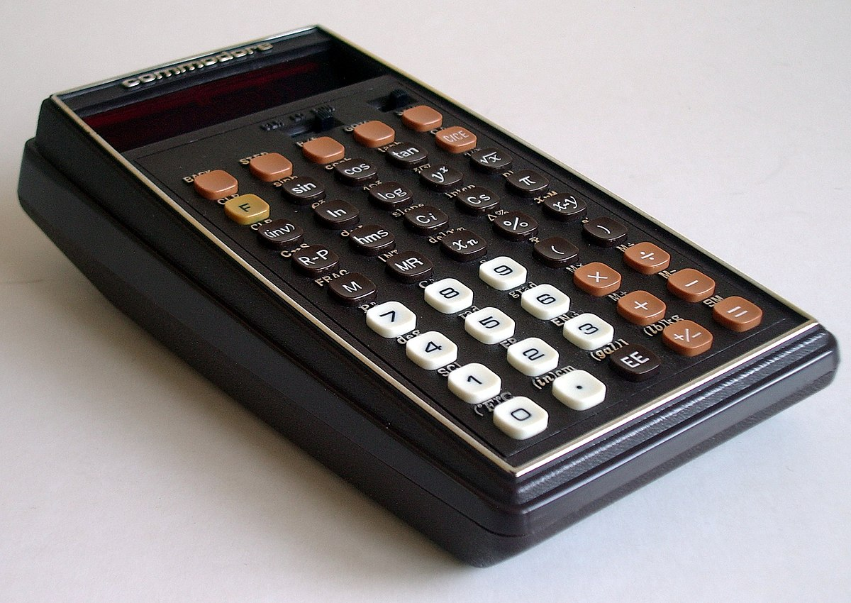
What was your first computer?

Slide 6
So why teach arithmetic?

Slide 7
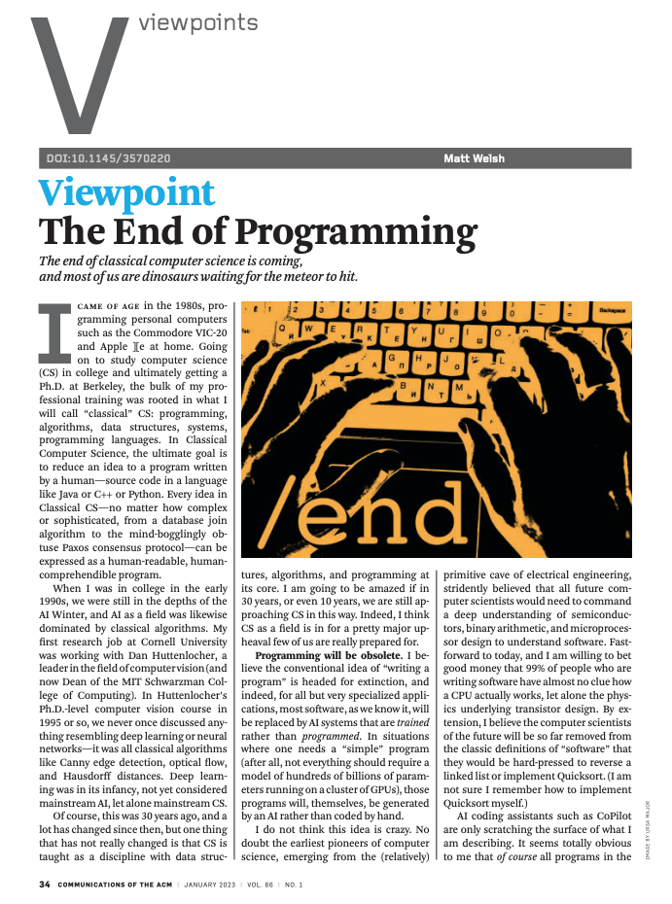
Programming is obsolete?
Programming will be obsolete. I believe the conventional idea of "writing a program" is headed for extinction, and indeed, for all but very specialized applications, most software, as we know it, will be replaced by AI systems that are trained rather than programmed. In situations where one needs a "simple" program (after all, not everything should require a model of hundreds of billions of parameters running on a cluster of GPUs), those programs will, themselves, be generated by an AI rather than coded by hand.
Welsh, 2023

Slide 8
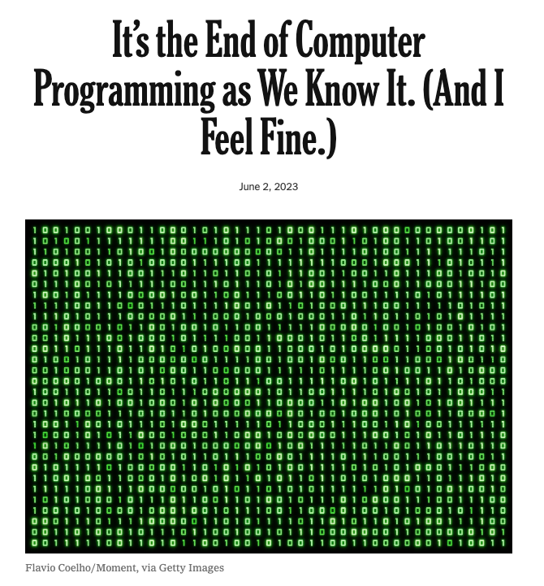
The end of programming?
A.I. could transform computer programming from a rarefied, highly compensated occupation into a widely accessible skill that people can easily pick up and use as part of their jobs across a wide variety of fields. This won’t necessarily be terrible for computer programmers — the world will still need people with advanced coding skills — but it will be great for the rest of us.
Manjoo, 2023

Slide 9
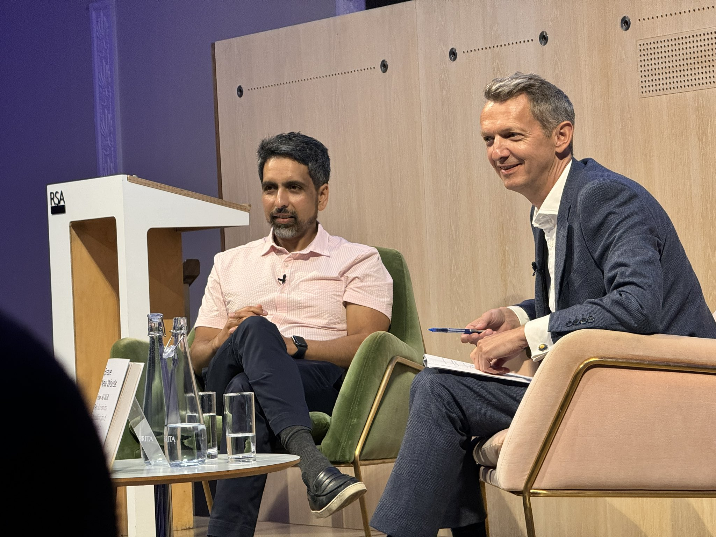
Post-scarcity jobs?
We are entering a post-scarcity world in some areas.
You have to be able to read and / or code well enough to put the AI generated pieces together.
There are likely to be other jobs that are very human focused.
Khan, 24/6/24

Slide 10
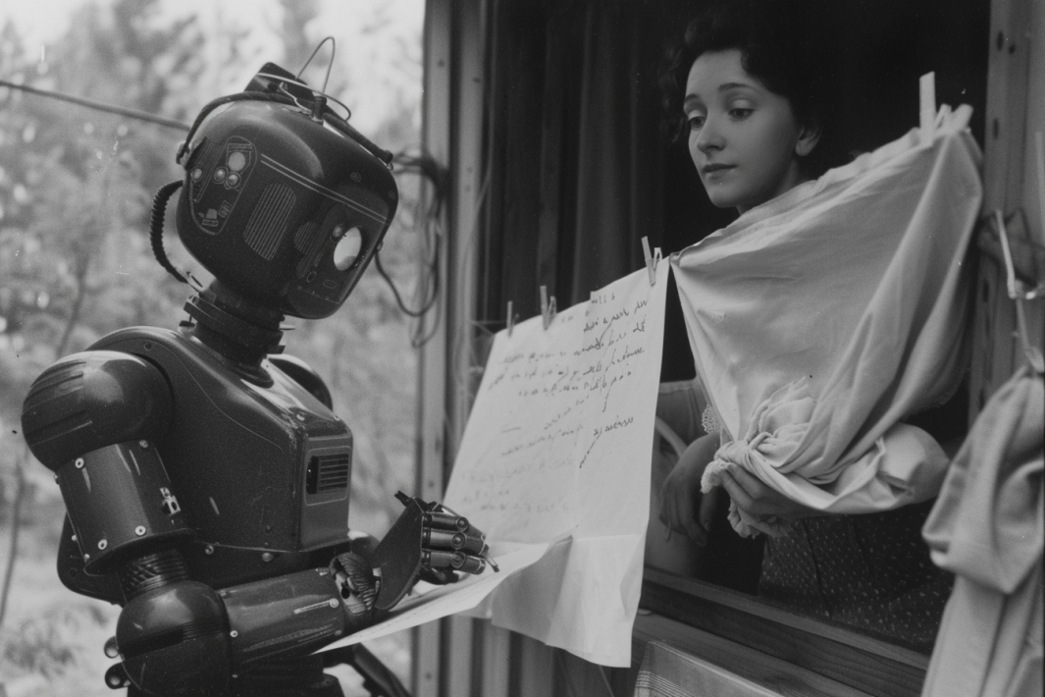
Humans doing the hard jobs on minimum wage while the robots write poetry and paint is not the future I wanted
Sharro, 2023

Slide 11
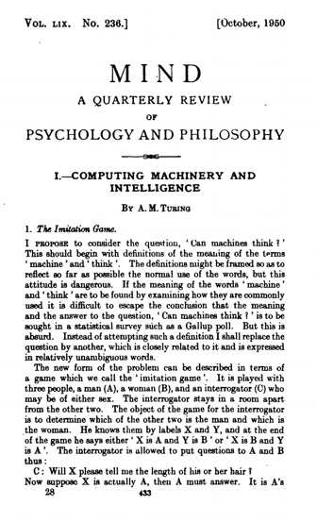
The Imitation Game
I believe that in about fifty years’ time it will be possible to programme computers, with a storage capacity of about 10⁹, to make them play the imitation game so well that an average interrogator will not have more than 70 per cent, chance of making the right identification after five minutes of questioning.
Turing, 1950

Slide 12
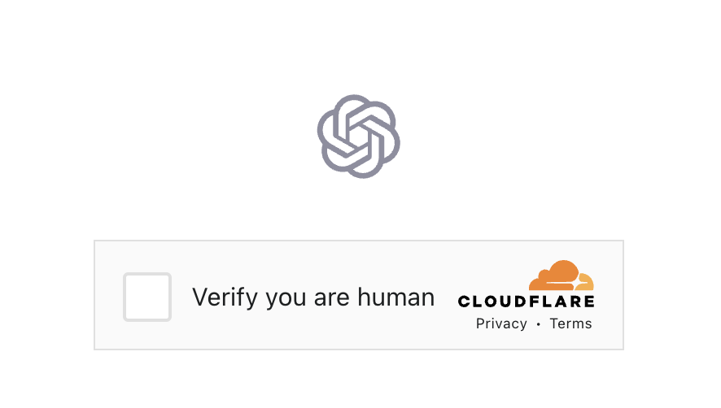

Slide 13
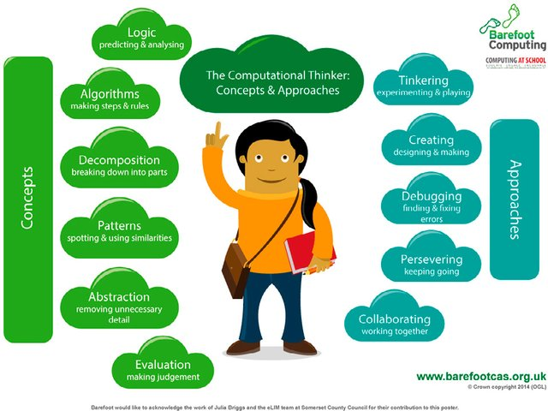

Slide 14
Computing
A high-quality computing education equips pupils to use computational thinking and creativity to understand and change the world.
DfE, 2013 cf Marx, 1845

Slide 15
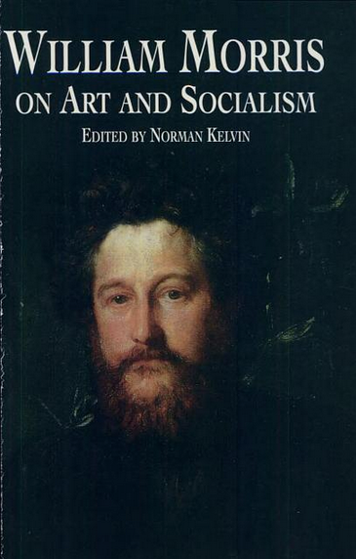
Beauty or utility?
If you want a golden rule that will fit everybody, this is it:
Have nothing in your houses that you do not know to be useful, or believe to be beautiful.
Morris, 1880
Morris, 1880

Slide 16
The best bits…

Slide 17
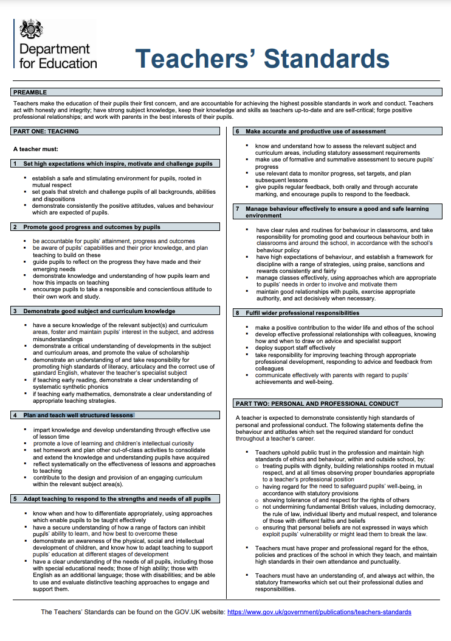
TS4 Plan and teach well structured lessons
“promote a love of learning and children’s intellectual curiosity”

Slide 18
Child centred?
“At the heart of the educational process lies the child.”
“One of the main educational tasks of the primary school is to build on and strengthen children's intrinsic interest in learning and lead them to learn for themselves.”
Plowden, 1967
Plowden, 1967

Slide 19
What questions have your pupils asked you?

Slide 20
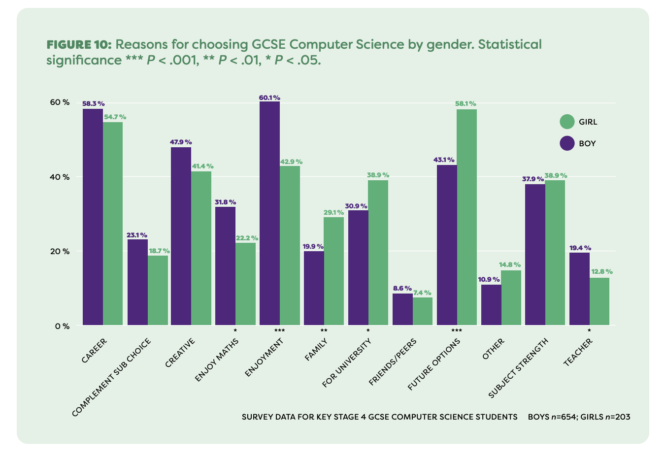

Slide 21
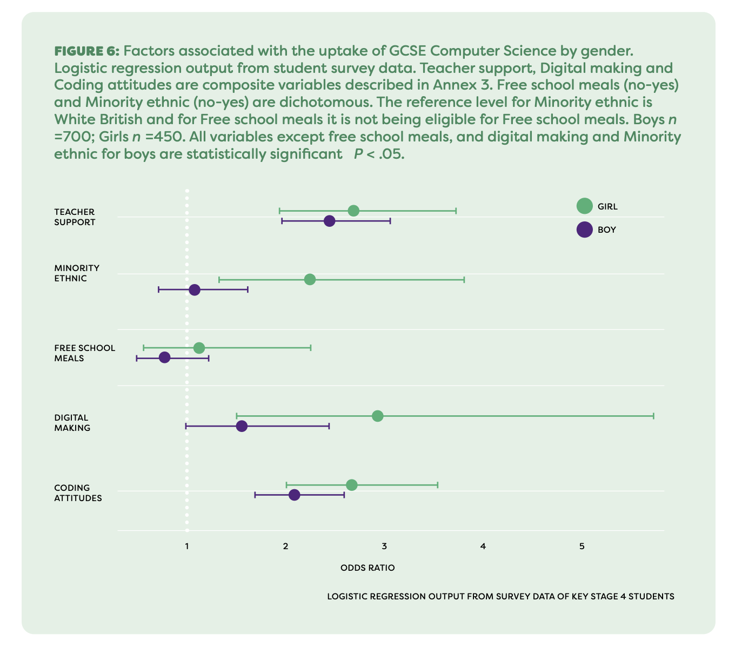

Slide 22
My daughter’s view…
“We’re interested in what we can do with computers.
The boys are interested in what computers can do.”
Berry, S. (2024)

Slide 23
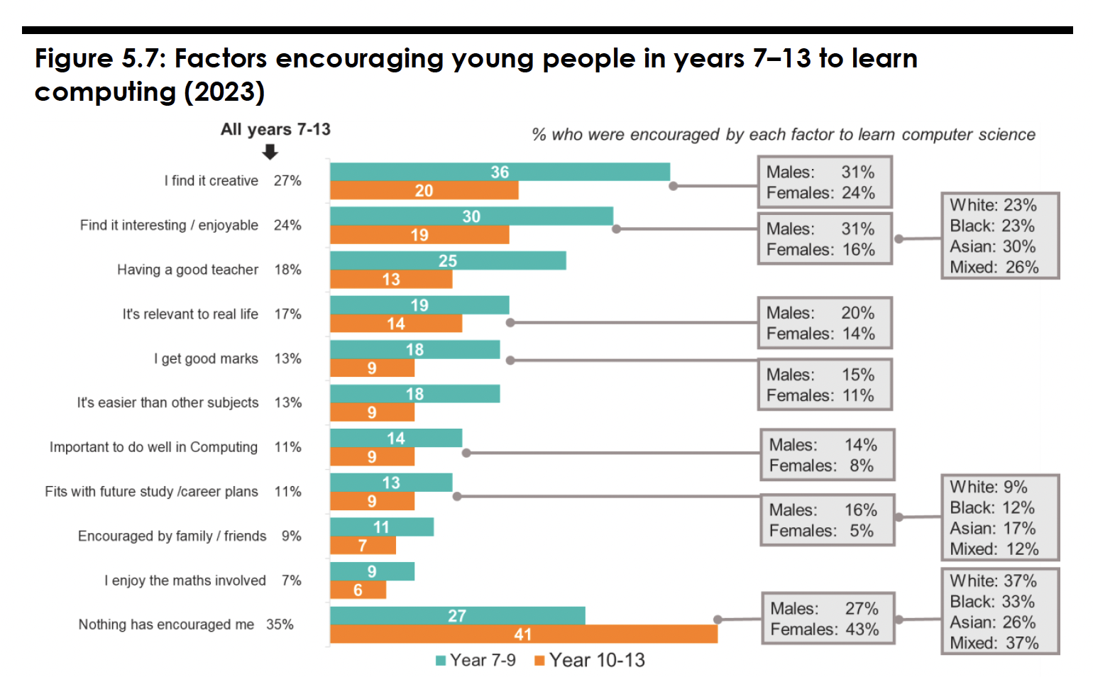

Slide 24
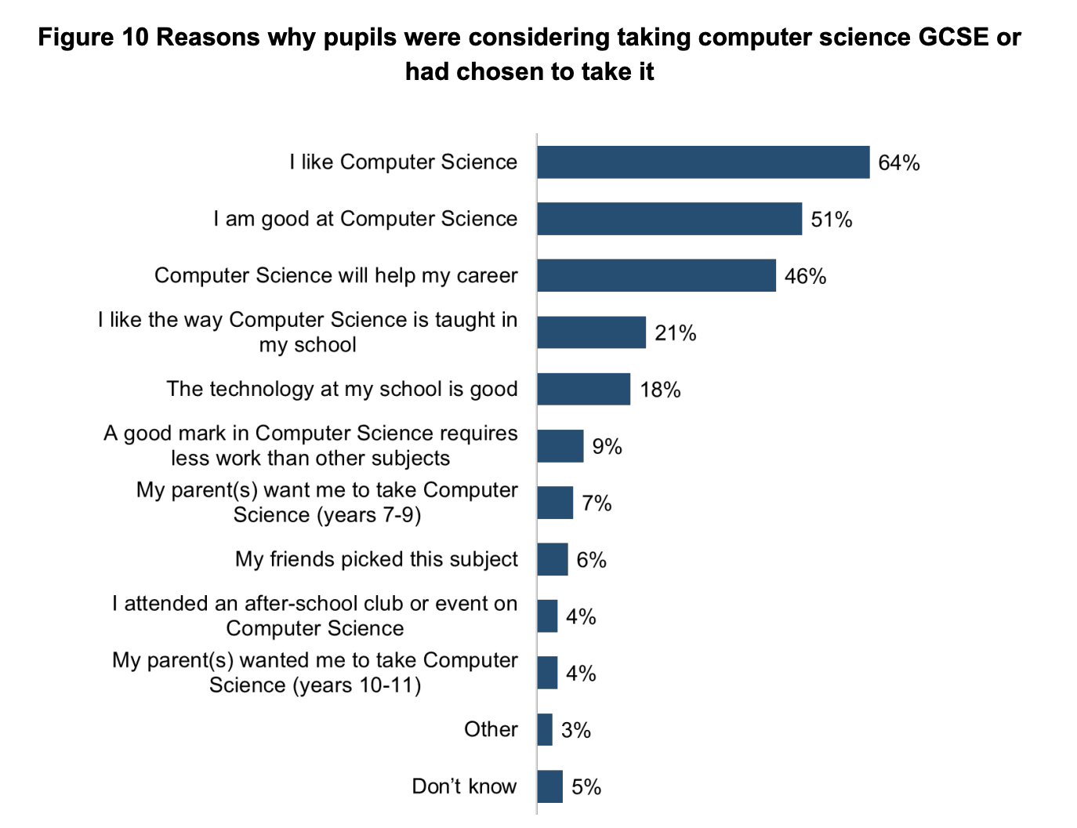

Slide 25
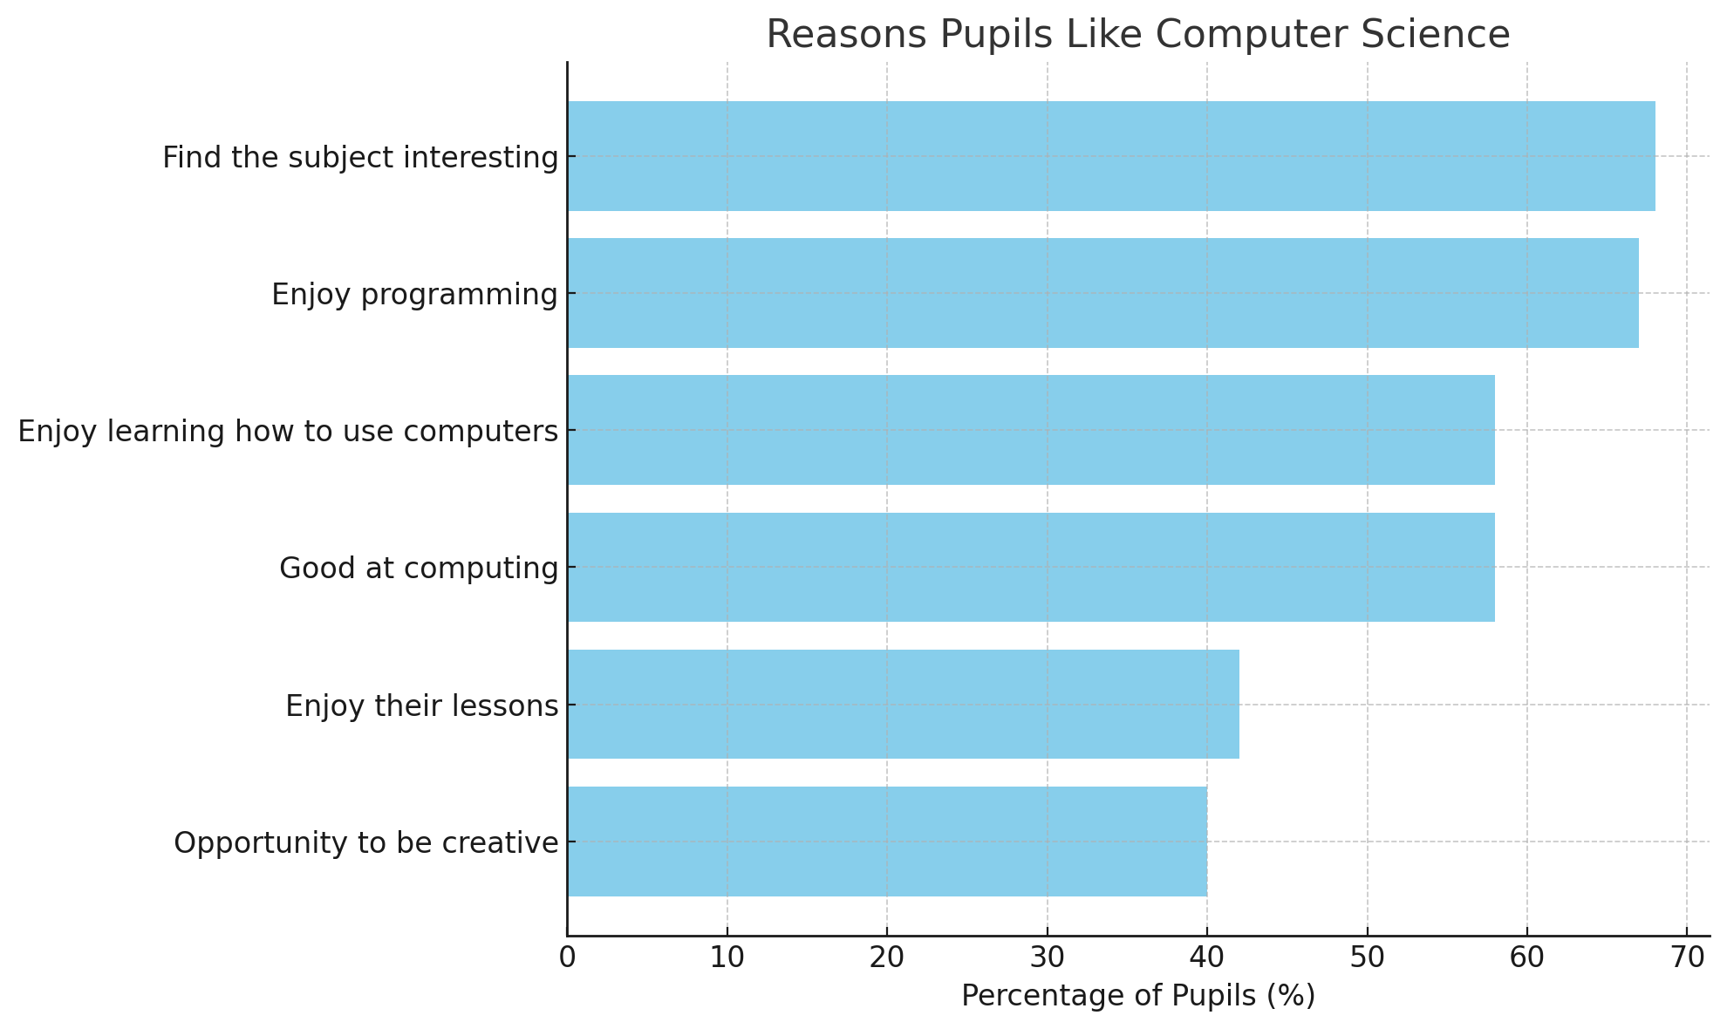

Slide 26
Gove at BETT
Instead of children bored out of their minds being taught how to use Word and Excel by bored teachers, we could have 11 year-olds able to write simple 2D computer animations using an MIT tool called Scratch. By 16, they could have an understanding of formal logic previously covered only in University courses and be writing their own Apps for smartphones.
Gove, 2012

Slide 27
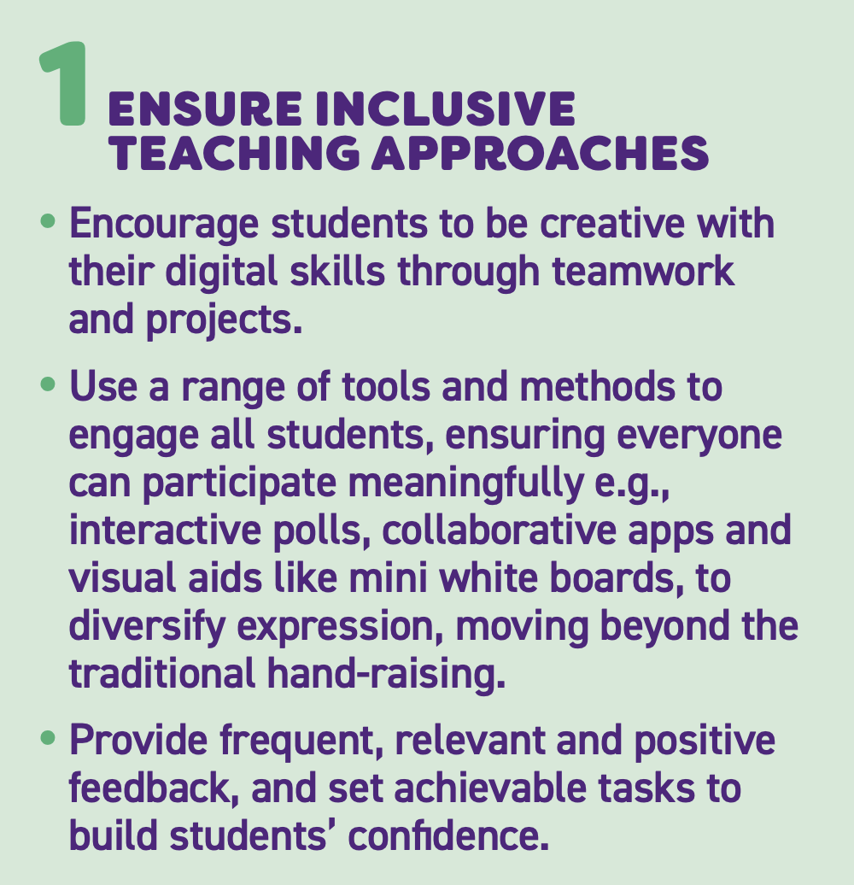
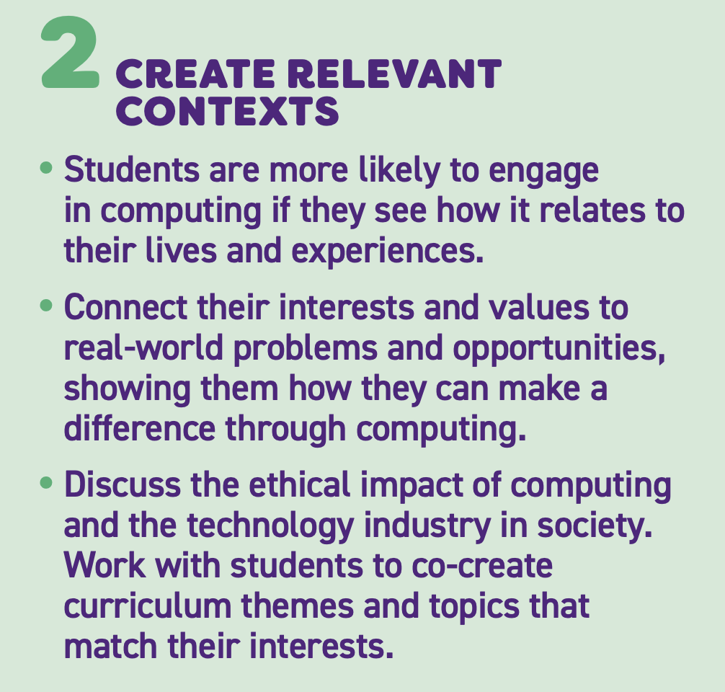

Slide 28
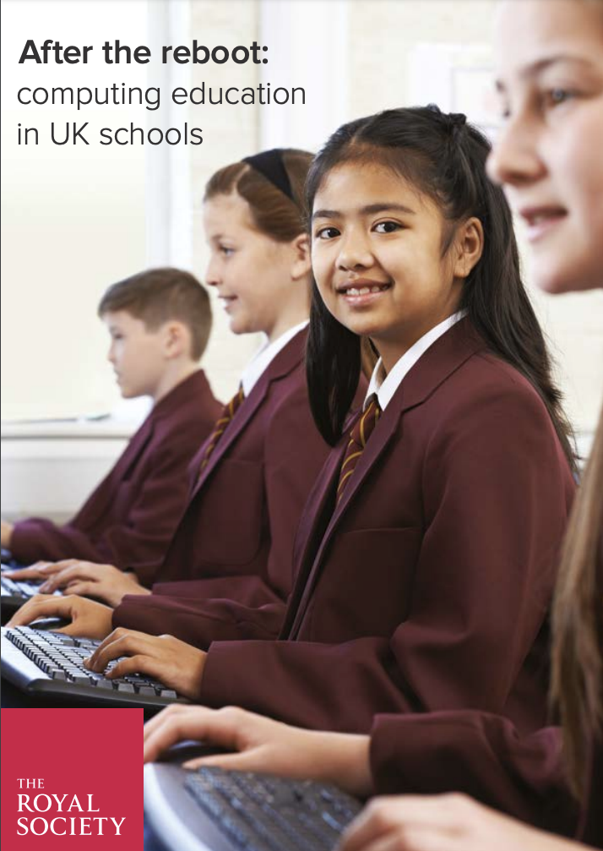
Active learning
Evidence indicates that learning computing in an active environment benefits pupils beyond the impact on their formal attainment; for example, it can help create an inclusive learning environment that encourages the participation of a more diverse group of pupils in computing.
Royal Society, 2017

Slide 29
Why coding matters
Coding is not the message of the new computing curriculum: it is its medium. Coding is the labwork of computer science: it motivates, illuminates, and brings to life the dry bones of theory. Without programming, computer science would be a dry, theoretical husk of a subject.
Peyton Jones 2019
Notes:
Coding is not the message of the new computing curriculum: it is its medium. Coding is the labwork of computer science: it motivates, illuminates, and brings to life the dry bones of theory. Without programming, computer science would be a dry, theoretical husk of a subject.

Slide 30
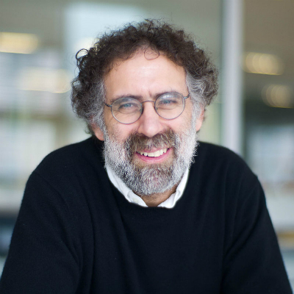
Make something in the world to make something in your head
When you make something in the world, it becomes an external representation of ideas in your head. It enables you to play with your ideas and to gain a better understanding of the possibilities and limitations of your ideas. By giving an external form and shape to your ideas, you also provide opportunities for other people to play with your ideas and give suggestions on your ideas.
Resnick

Slide 31
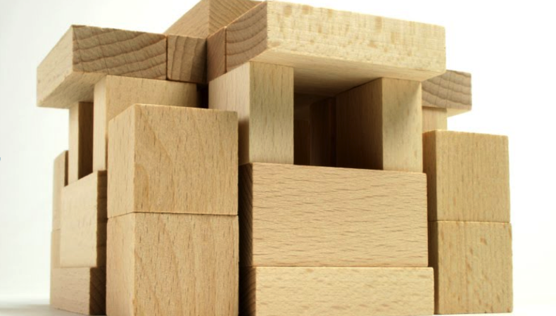
Computing
A high-quality computing education equips pupils to use computational thinking and creativity to understand and change the world.
DfE, 2013

Slide 32
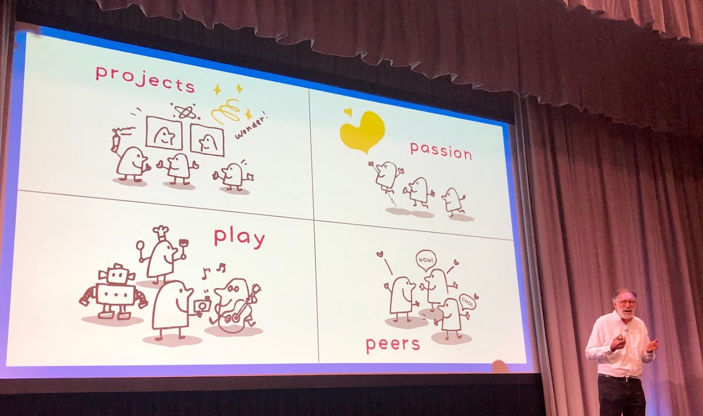

Slide 33
Embroidery…

Slide 34
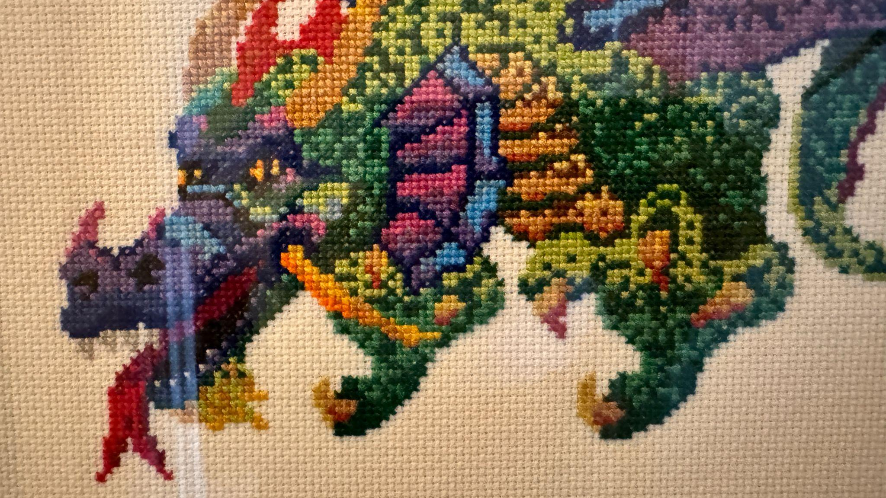
Embroidery

Slide 35
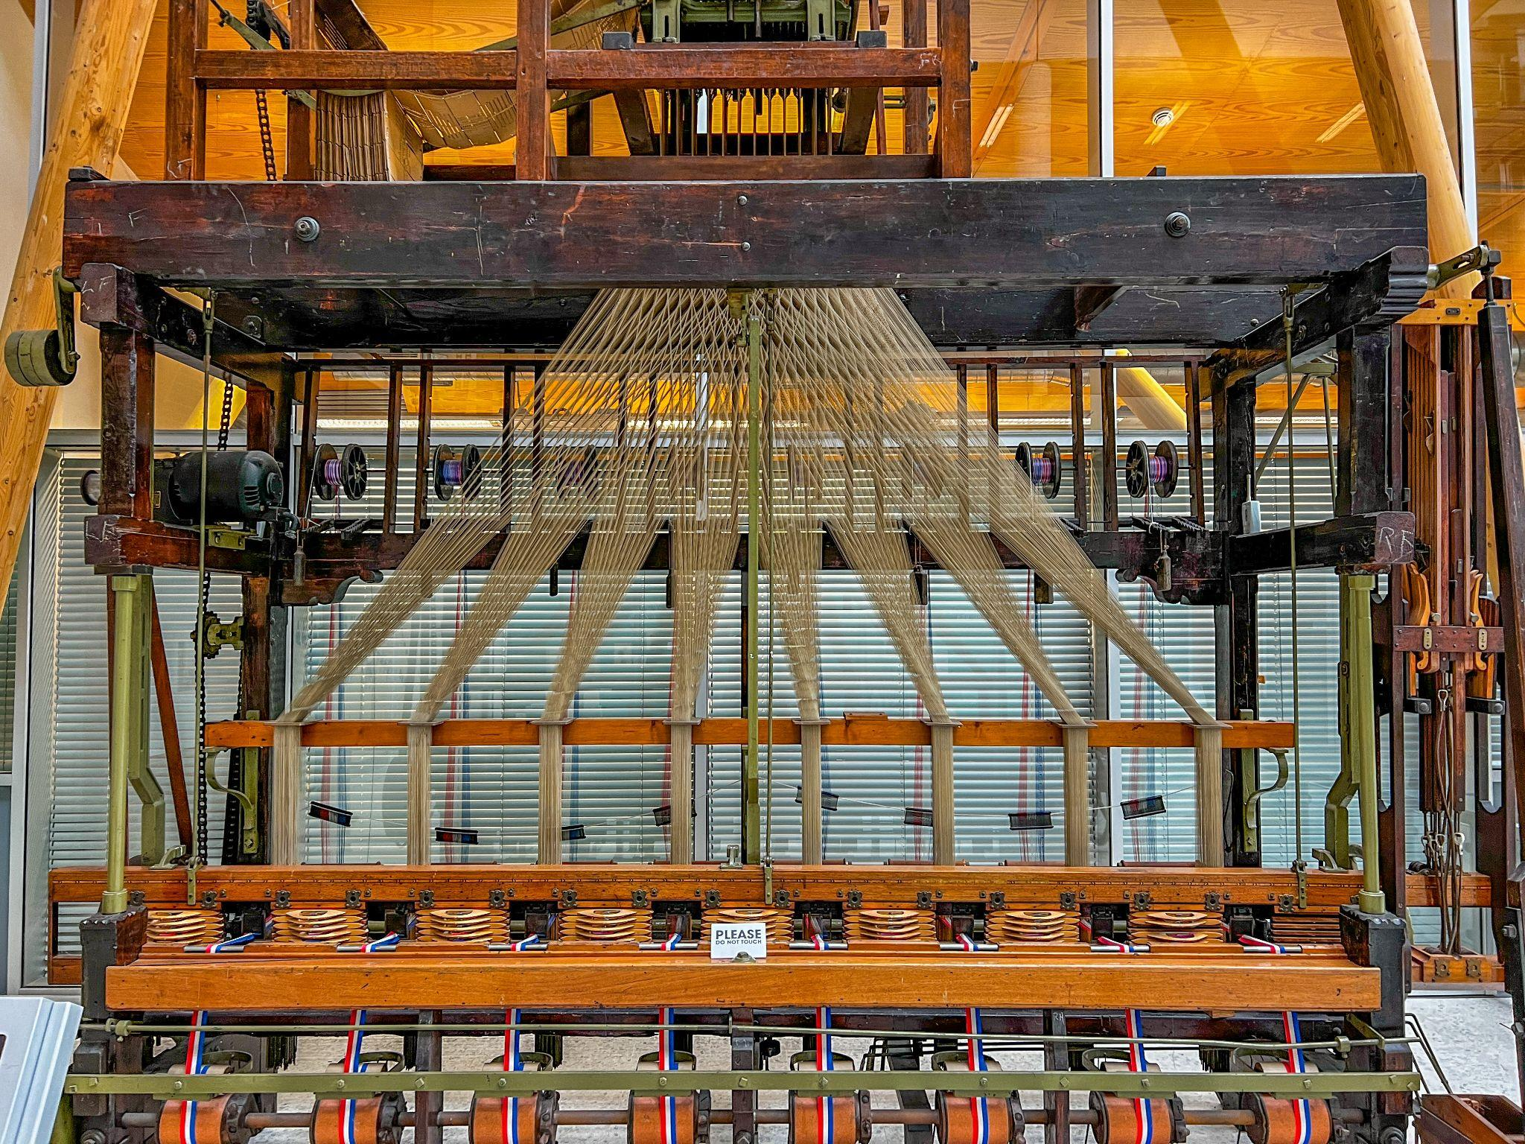
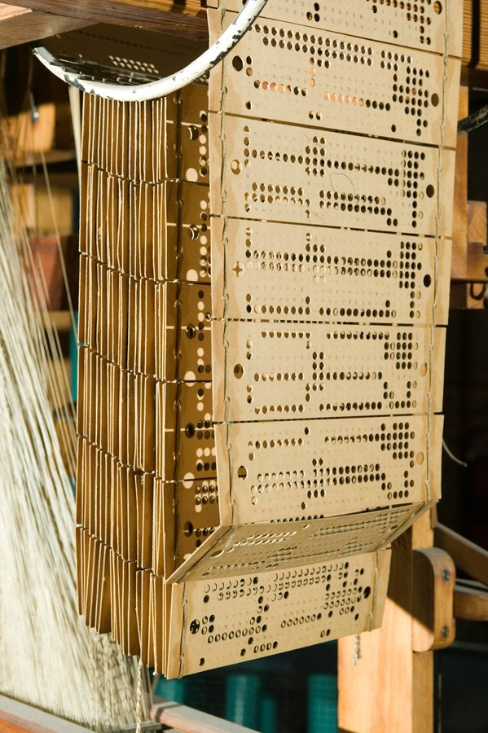

Slide 37
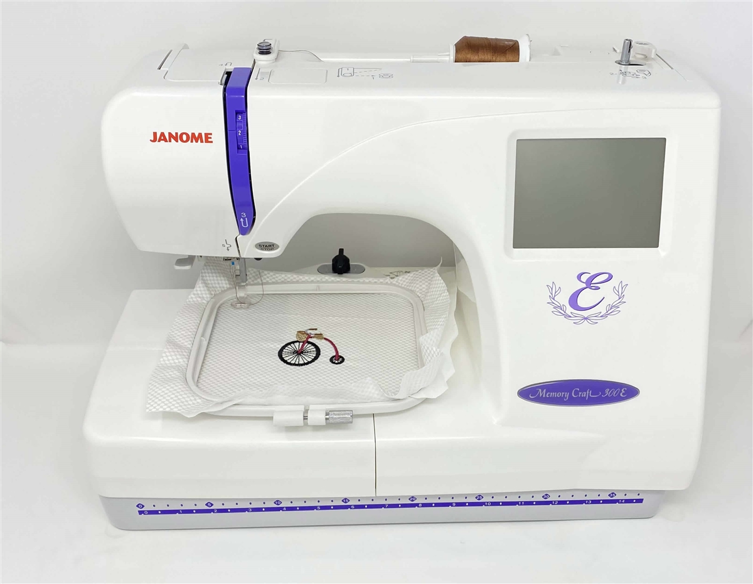

Slide 38
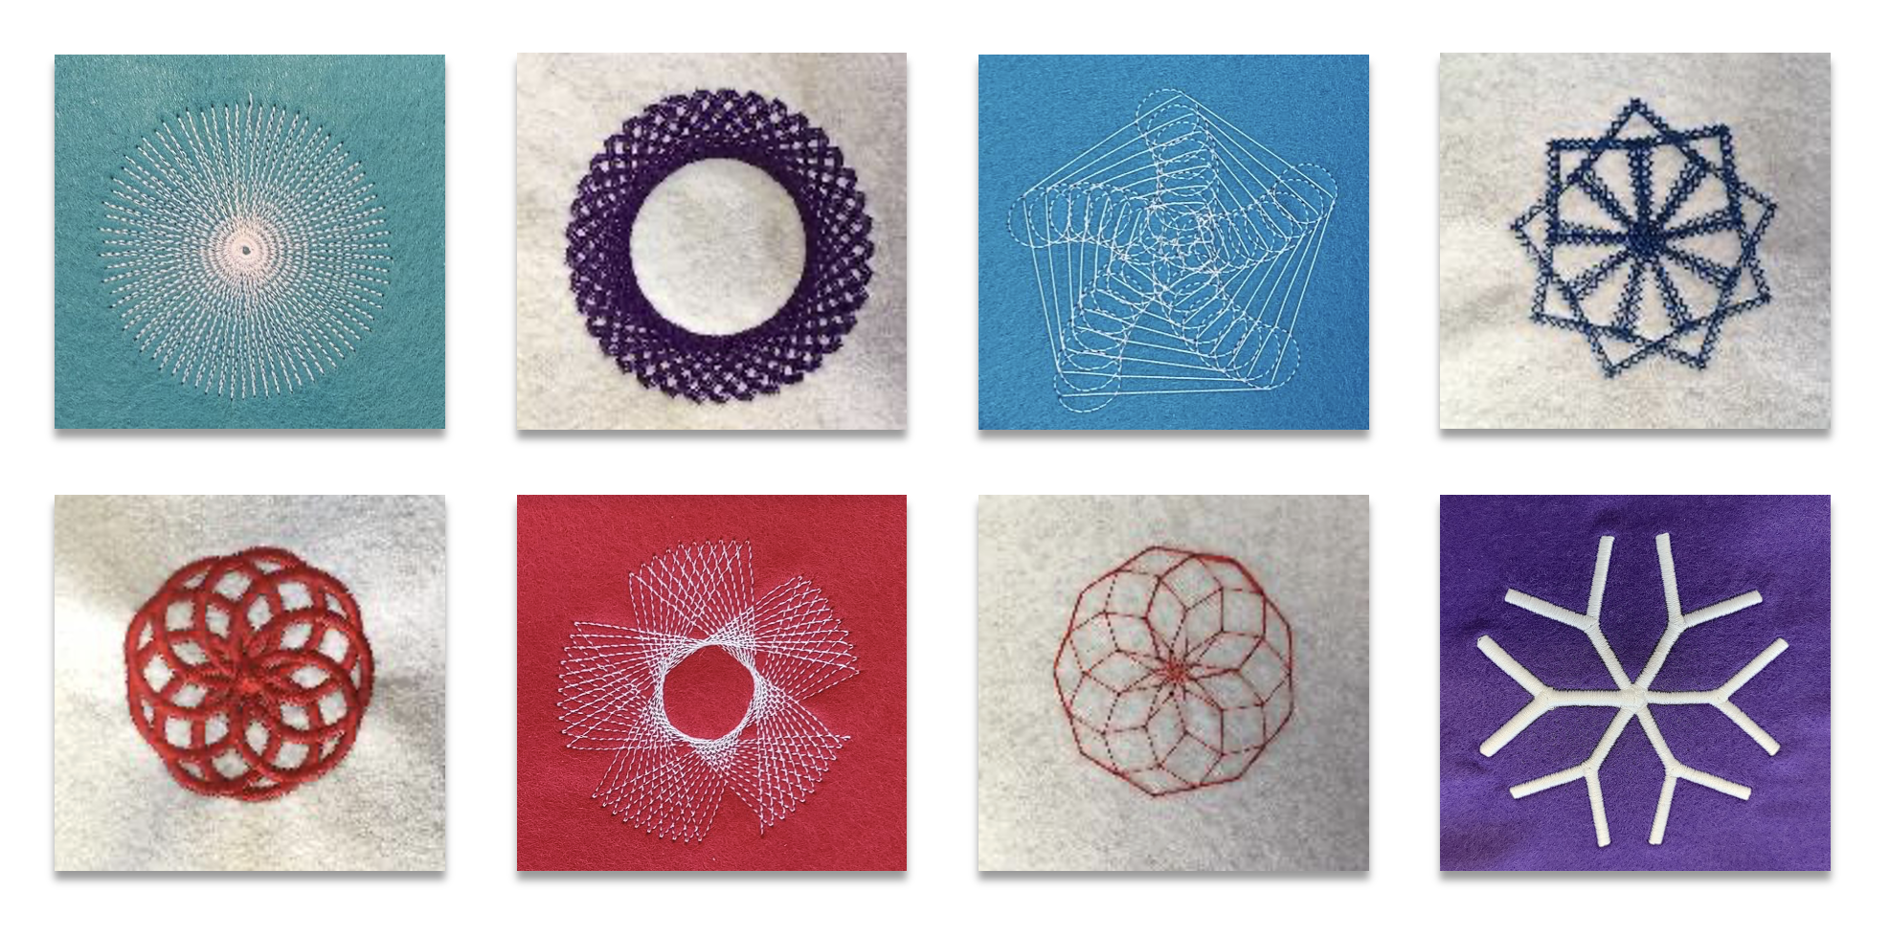
University of Warwick

Slide 39
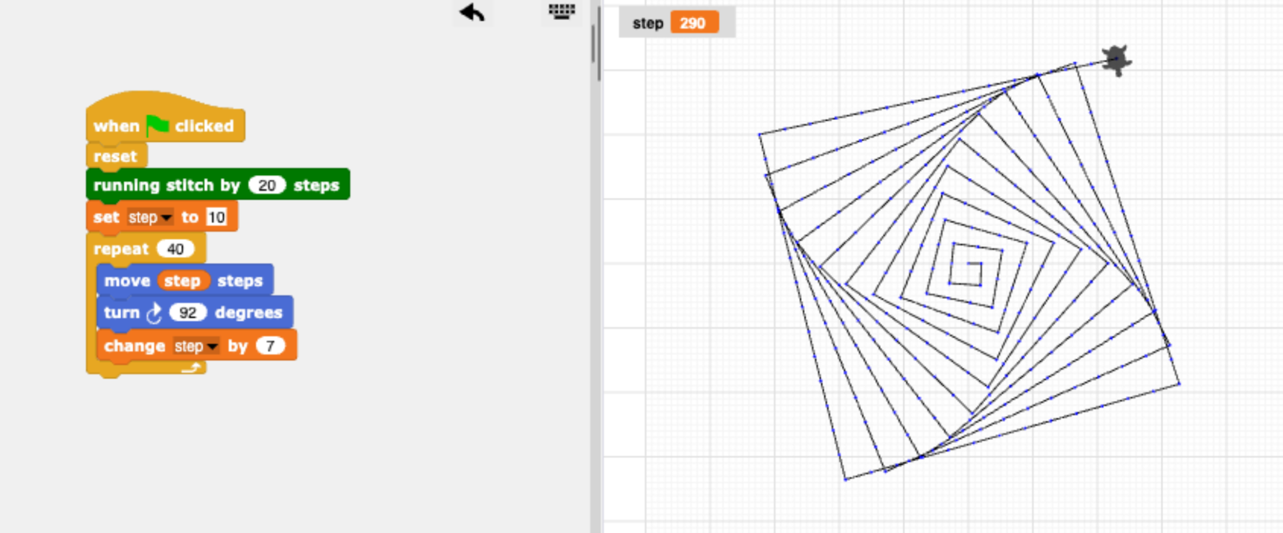

Slide 40
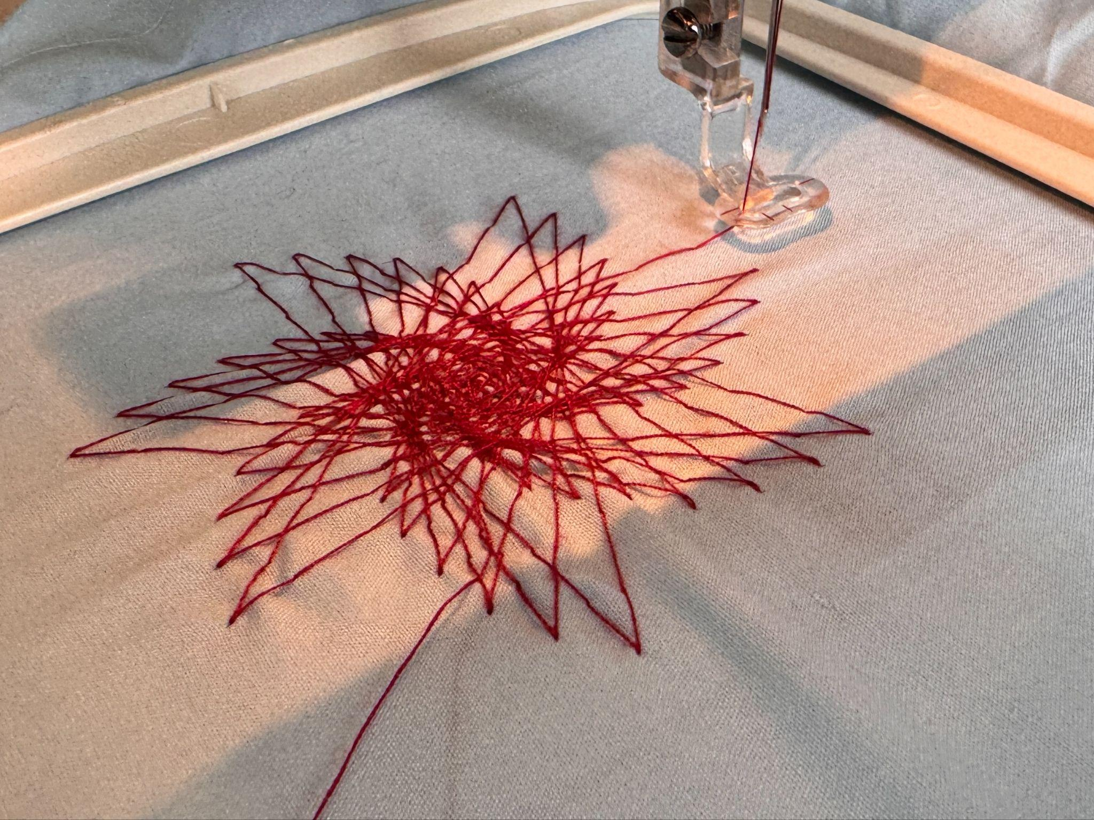

Slide 41
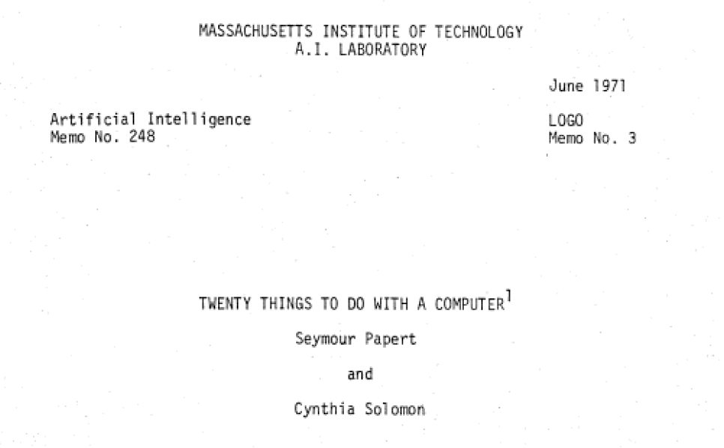
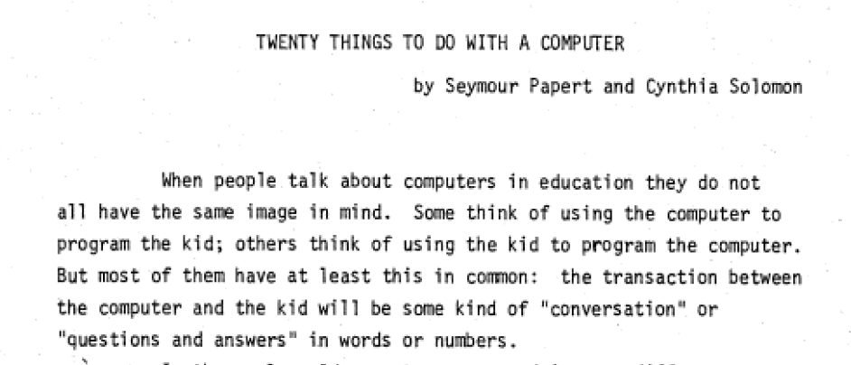

Slide 42
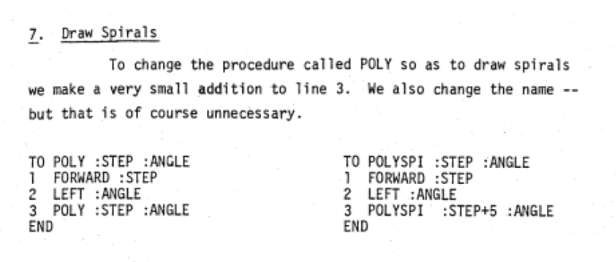
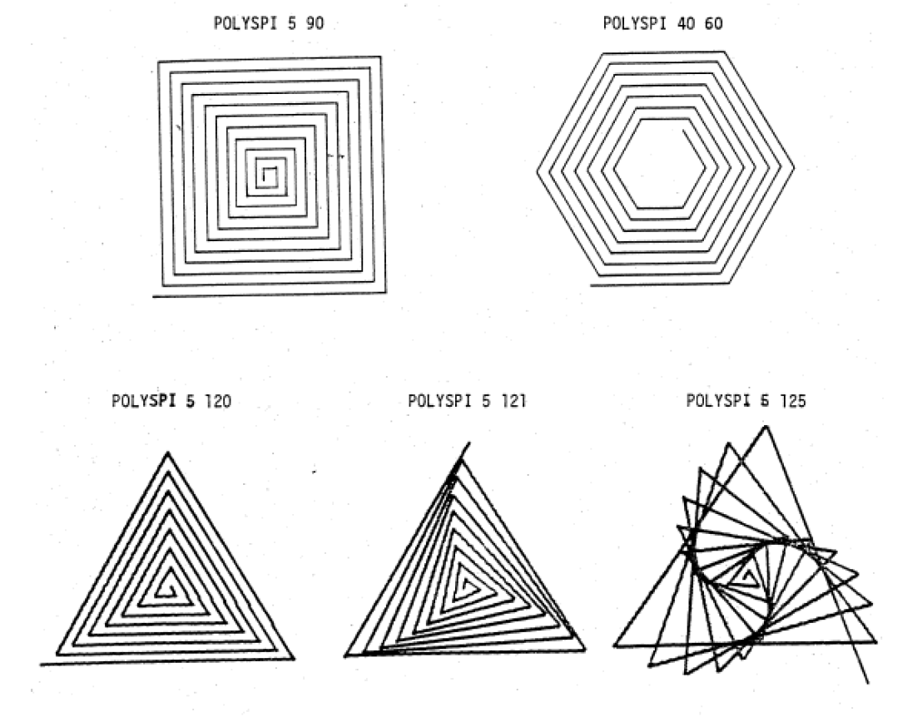

Slide 43
What’s worked for you?
TS4b
“promote a love of learning and children’s intellectual curiosity”

Slide 44
Any questions?
These slides: bit.ly/caskeynote
m.berry@roehampton.ac.uk

