Slide 1

Computer Science Curriculum Briefing
From Plymouth to Roehampton
8th July 2014

Slide 2
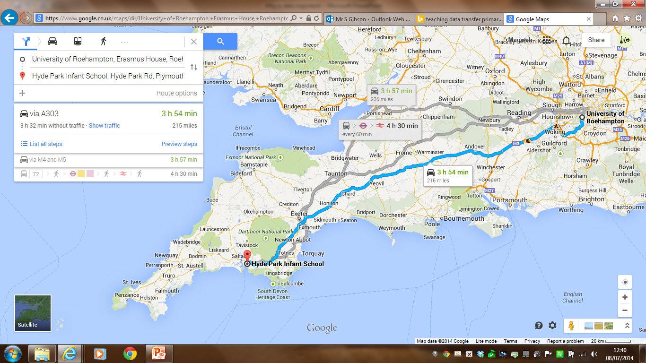
Travel light…
Notes:
Despite the distance, I am still able to talk to you because of the way we can share and transport data.

Slide 3
Tech takes over
Notes:
Head teachers conference and impact of technology on the presentation.

Slide 4
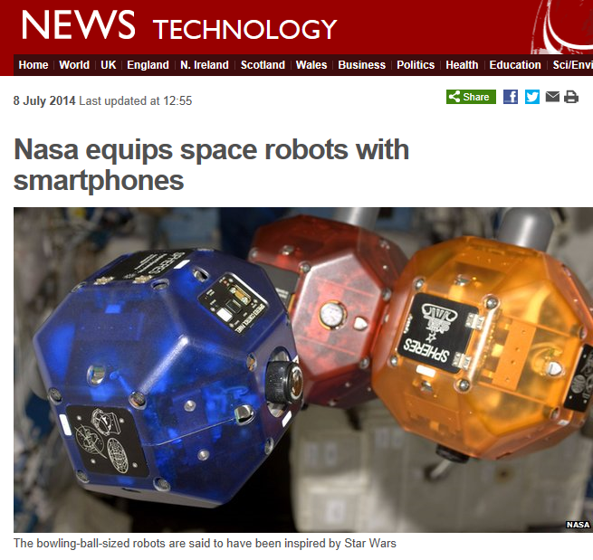

Hot off the press…
“Looking to further improve the robots, Nasa turned to Google's Project Tango.”
Notes:
Google is now turned to by NASA – they have conquered the earth, and now they set their eyes on space.

Slide 5
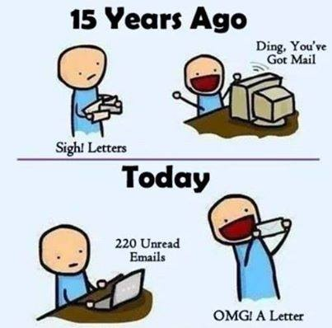
The world has changed!
Notes:
The way we communicate will never be the same again, so long as we continue to fuel the energy required to power!

Slide 6
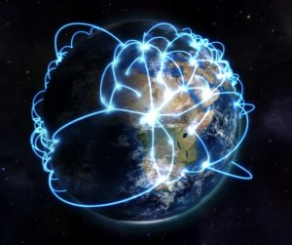
The conference call
Notes:
Data is universal – how many people are watching this right now?

Slide 7
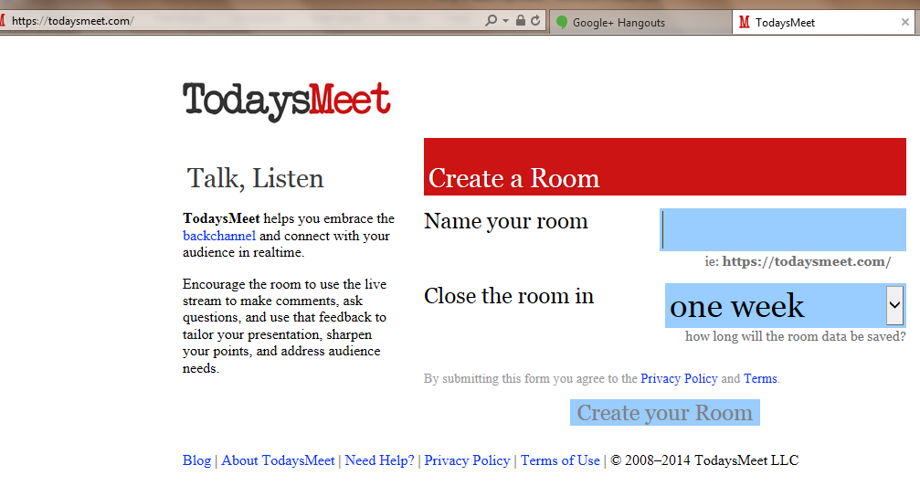
Classroom Twitter
Notes:
A classroom friendly tool equivalent to twitter, but more ‘e-safe’.

Slide 8
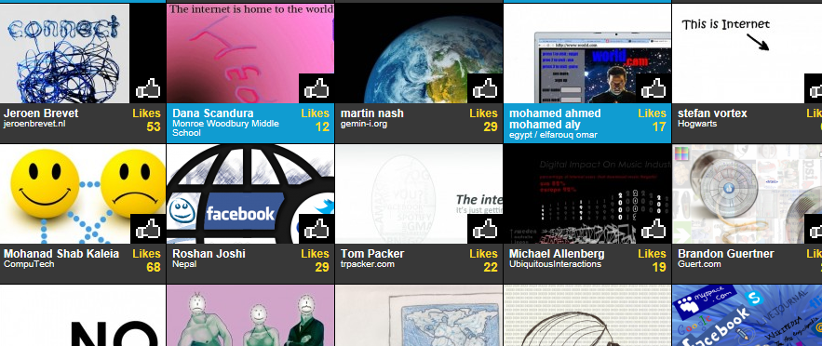
Draw the Internet
Notes:
Draw the internet at home and at school. Is there a difference?

Slide 9
Travel light…
Device
Network connection
Server
External connection
Global connection
Notes:
This is the journey of data…

Slide 10

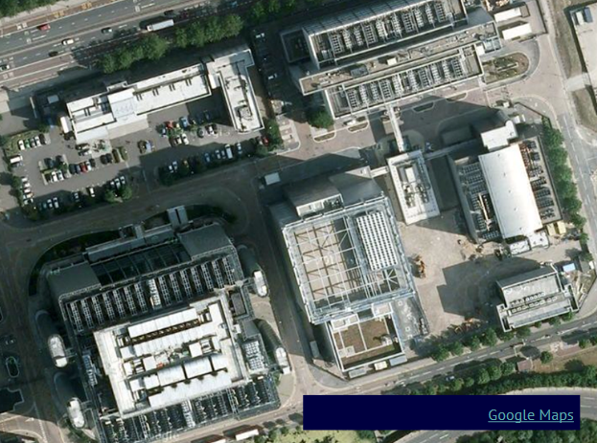

Messy maps…
Notes:
Doodle the journey of data, then add information on the arrows. Code the arrows – wireless / wired / cable, etc…

Slide 11
How is it travelling?
Write the number 8.
Halve it, write it (repeat x3)
Underneath each number, write either a tick or a cross.
Now, add together the numbers with ticks underneath.
What’s the answer?
Notes:
Show 7 year olds this algorithm. They corrected it (no instruction to write on same line). They were enabled to invent binary…

Slide 12
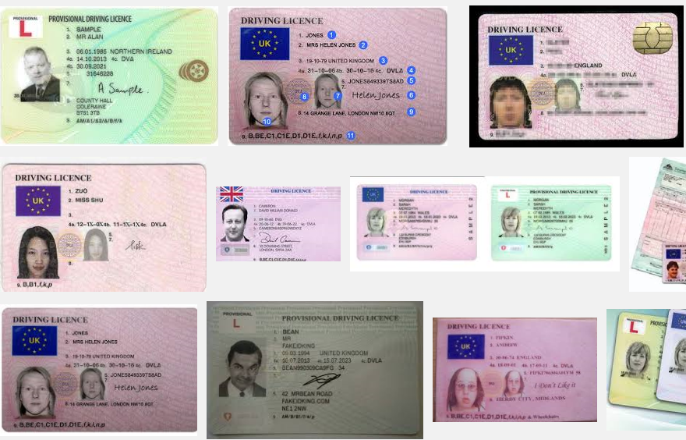
Share and share alike
Notes:
Story about head teachers daughter posting driving licence online…

Slide 13
Secure your data
Notes:
E-Safety Assembly – wool passed out representing picture being shared. Hard to wind back in…

