Slide 1
IT Professional Skills and Careers
Andrew Tuson
Department of Computing/Centre for Information Leadership

Slide 2

Conditions of Use
We are happy for you to use and adapt these slides.
Please acknowledge City University as the author – so keep this slide.
We acknowledge copyright of our sources.
We’d also like to have the City logo on this slide at least – thank you!
Licensed under: http://creativecommons.org/licenses/by-nc-sa/2.0/uk/

Slide 3
Session Aims
To get an insight into
The economics of the IT industry.
The kind of roles in the IT profession
The current employment prospects…
…and what employers are looking for…
…so you can take action!

Slide 4
Consider the Fundamentals…
Digital Economy comprises ~8% of GDP
  Larger than agriculture and transport combined
  It is where growth is expected, and makes other industries effective.
  E.g. by 2012, 20% of all new commerce will be online.
Over half of UK GVA in in IT-intensive industries
  E.g. finance, creative industries, high-value manufacturing…
Effective IT key to UK competitiveness
  8% of UK-US productivity gap due to IT use.
Notes:
This slide highlights the importance of the UK IT industry to the economy.
GDP = Gross Domestic Product – think of ‘turnover’ in a business.
GVA = Gross Value Added – think of ‘profit’ in a business.

Slide 5
IT in the Knowledge Economy
Modern organisations depend on IT to be effective
  Computer technology, principles and application.
  Skilled professionals are needed that can both understand and solve problems with IT.
IT market is vast and diverse, but changing
  IT organizations shape business demand, designing and managing business processes (Gartner)
  “The key to success for prospective IT students lies in choosing courses where the content is relevant to industry and key business skills are nurtured alongside technical excellence. An industrial placement can also be a distinct advantage.” (prospects.ac.uk)
Notes:
Key point: IT professionals are more than just technologists – they also are problem solvers that use technology to increase the effectiveness of organisations.

Slide 6










Who Employs IT Professionals?
Manufacturers who design, build and support the products.
Software houses which supply solutions to customers with IT requirements.
Users e.g. banks, hospitals, universities, retailers and other businesses.
Over half of the UK’s 1 million IT professionals employed in IT functions of non-IT organisations.
Creative Industries, e.g. games.

Slide 7

IT Roles…
Software Development Centred Roles
  Software Engineer/Designer
  Applications/Systems Programmer
Client/Business Centred Roles
  Systems Analyst/Consultant
  IT/Project Manager
Technology Centred Roles
  Technology Specialist
  Research and Development (requires an MSc, often a PhD).
Some IT-related roles (e.g. web designer, technical author) draw more from a design/arts background.

Slide 8
East Coast vs West Coast IT
Corporate
Business IT
Well paid
Highly-structured
Tend to recruit ‘talent’ to develop…
SMEs
Engineering/Media
More fun?
Informal
Tend to recruit to the here and now…
Notes:
Trying to contrast roles in SMEs and corporates with US Silicon Valley or corporates in NYC.

Slide 9
What Employers Want
Technical Knowledge
Motivation
Enthusiasm
Team Working
Communication Skills
Flexibility
Adaptability
Initiative
Interpersonal skills
Business Awareness
Problem Solving
Numeracy
Time Management
Self development
Creativity
Decision making
Leadership
Trainability
Notes:
IT is unusual for STEM in that technical and ‘soft’ skills are equally important to employers.

Slide 10
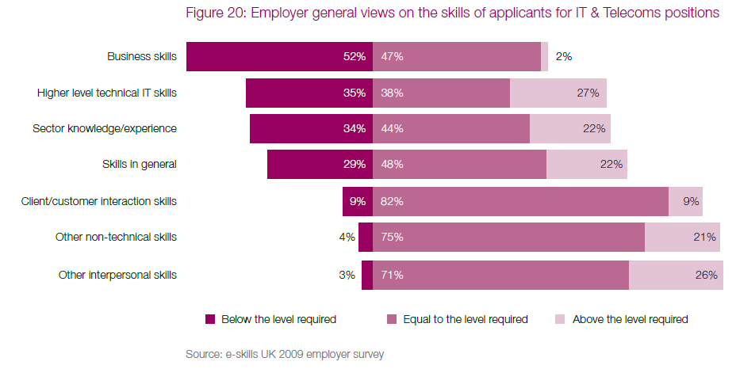
Put another way…
Notes:
Generally employers are happy with the tech skills of graduates – though they want them to move to higher level quickly. Business awareness is a problem at all levels of the industry.

Slide 11
How to get those skills
Work experience (76% of employers say this can enhance employability).
Can be through one year placements, summer, part-time and temporary work.
Work should be ideally but not essentially in IT.
A good degree
    so study hard!
Voluntary Work
Extra curricular activities
    e.g. Student Union
Leisure activities
Travel

Slide 12
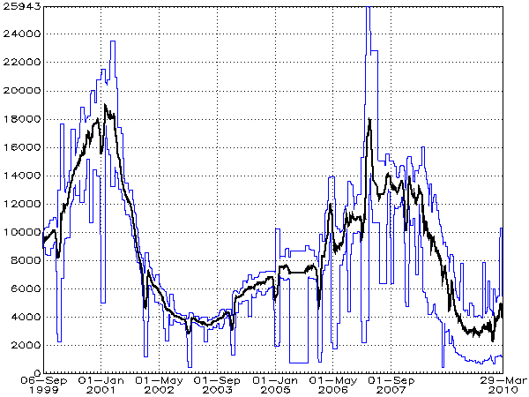
www.jobstats.co.uk
Over half of IT vacancies in London & SE England.
Inter-quartile range of advertised IT salaries is £32.8-61K per year, median is £42.7K.
Demand for specific skills fluctuates
Ability to learn new skills fast more useful to graduates
Notes:
Question to ask here – if vacancies have fallen, have there been job losses like in the dot-com crash?

Slide 13
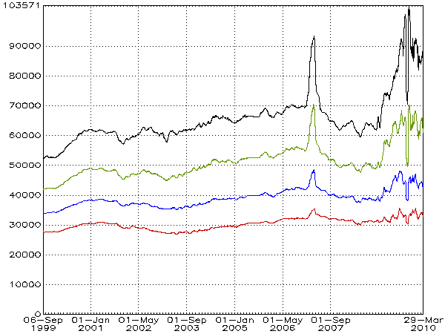
Follow the money…
How do we know this?
  What if the drop in vacancies also indicates large-scale job losses?
The key is to look at the advertised salaries
  If there were widespread job losses this would fall.
  Simple application of supply and demand (market clearing).
Notes:
Answer is not really – in fact demand of higher level skills (top 25% of profession) is in fact rising. Job losses are side effect of recession but skilled IT professional finding new work as business use IT to reduce costs.

Slide 14
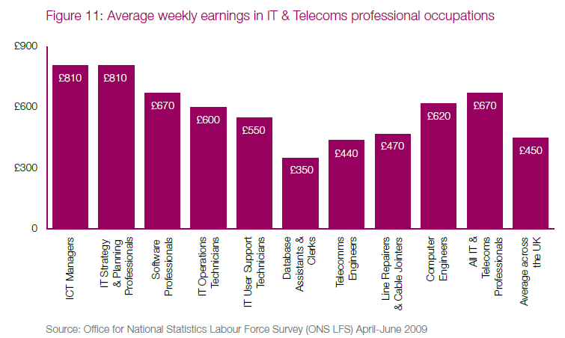
Salaries by Role….
Notes:
In summary business facing and/or high tech skill roles pay the most.

Slide 15
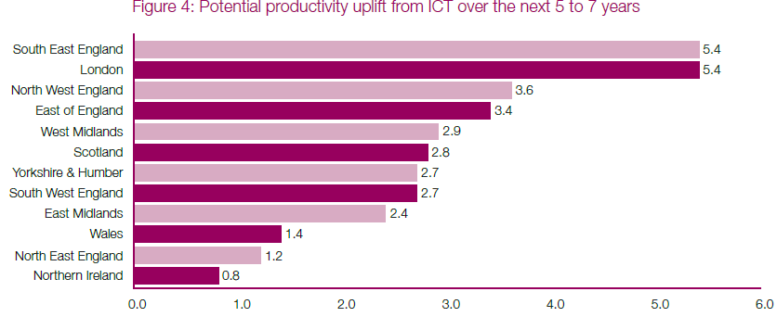
Geographic Issues (1)
Notes:
IT is more valuable in London/SE because the financial services industry is so dependent on it.
High-value manufacturing/public sector is the driver of the rest.

Slide 16
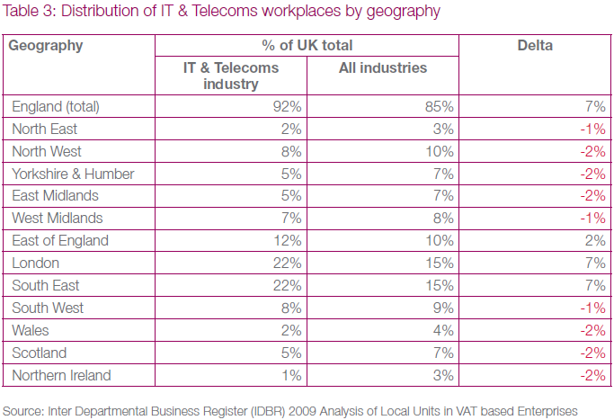
Geographic Issues (2)
Notes:
This is reflected in where the workplaces and jobs are: the impact of the financial services sector can be felt here.

Slide 17
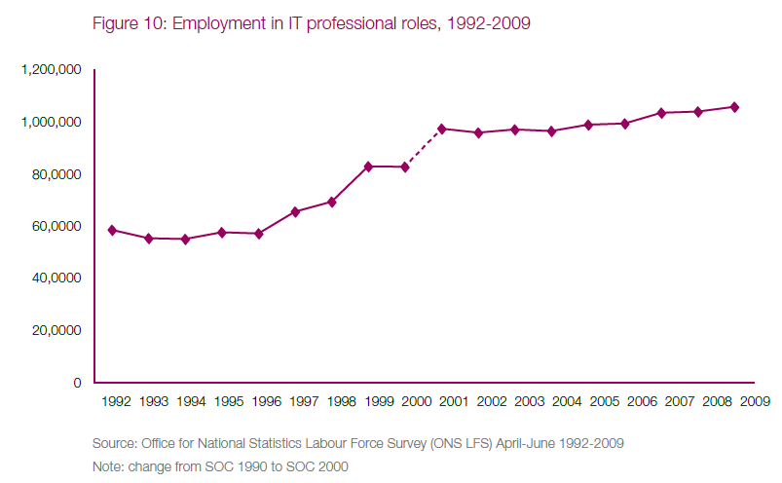
There are more of us…
Notes:
Contrary to reports of off-shoring and the dot-com crash the number of IT professionals is on the rise
As we’ll see later this hides a movement over the last 10 years that has seen a loss of low-end IT roles to be replaced with higher-value IT roles.

Slide 18
But lots of you (Gen Y)
Notes:
So why is there reports of very high graduate unemployment? Because we are moving through a demographic peak at the same time as a recession. The pink line is a better line for graduate demographics as its weighted by participation by social class.
Source: HEPI
You may wish to talk about Gen Y (though they have problems too) – see Marc Prensky.

Slide 19
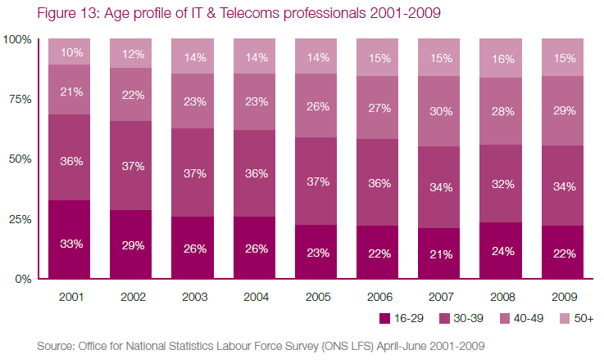
The industry is getting old…
Notes:
The good news is that once graduates are in, there should be scope for progression as a larger part of the profession in moving towards retirement.

Slide 20
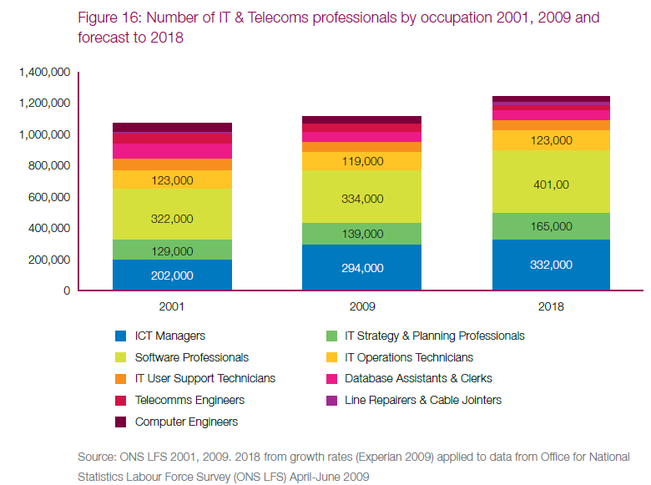
Where is the growth…?
Notes:
This graph indicated that growth is in the higher-value roles - a trend that has been happening for the last 10 years

Slide 21
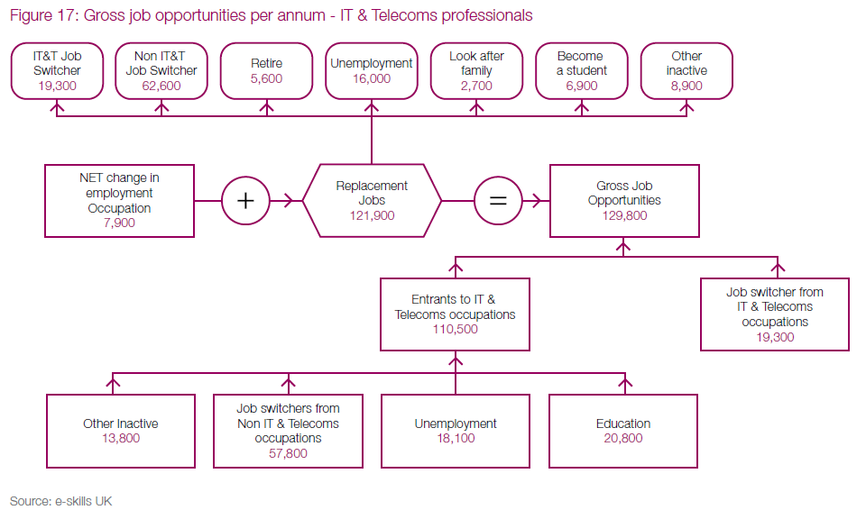
The flow of jobs…
Notes:
The take-home of this graph is that there is growth in IT jobs, some will be from degrees a lot from those in other roles retraining into IT professional roles (this is quite common).

Slide 22
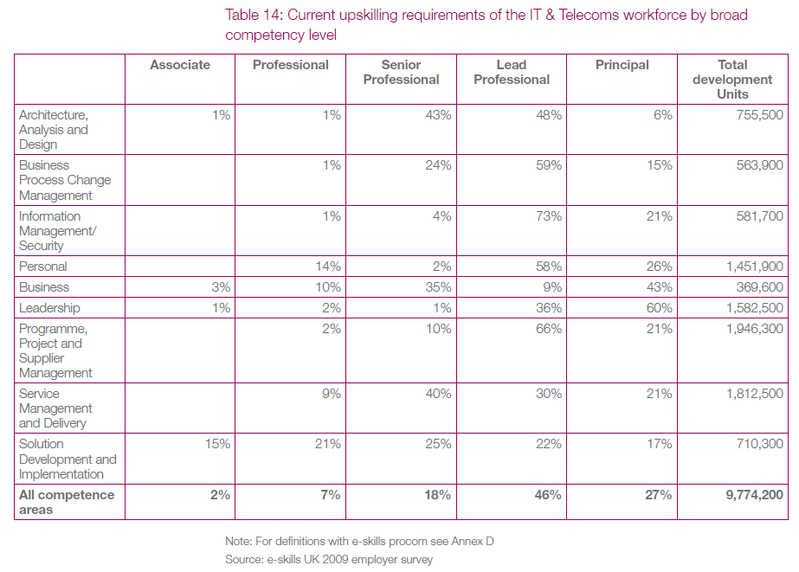
Notes:
Take-home message is that the higher-skill/business-focused the role the more the training and demand needs are. This confirms the trend to higher value roles in the industry.

Slide 23
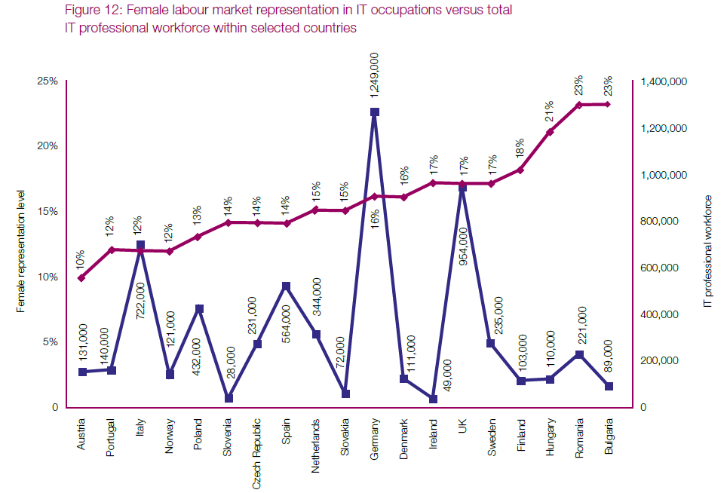
Gender Issues
Notes:
This shows that there is a gender gap in IT. Why this may be is another presentation in of itself, but its widely seen as a concern.
That said the IT industry does well on other diversity measures – e.g. http://www-03.ibm.com/press/uk/en/pressrelease/29176.wss

Slide 24
prospects.ac.uk (1)
In UK employment | 62.3%
In overseas employment | 1.3%
Working and studying | 4.6%
Studying in the UK for a higher degree | 6.0%
Studying in the UK for a teaching qualification | 1.3%
Undertaking other further study or training in the UK | 2.4%
Undertaking other further study or training overseas | 0.1%
Believed to be unemployed | 13.7%
Not available for employment, study or training | 2.7%
Other | 5.6%
Prospects is the careers site for graduates.
Employability for CS/IT graduates (after six months) is worse than national average (7.9%)
What about those employed?
Source: Prospects/HESA
Notes:
Now for the bad news. [Should say that City does well here..;-)]

Slide 25
prospects.ac.uk
Arts, design, culture and sports professionals | 5.2%
Business and financial professionals and associate professionals | 5.1%
Commercial, industrial and public sector managers | 9.1%
Education professionals | 3.0%
Engineering professionals | 1.9%
Health professionals and associate professionals | 0.2%
Information technology professionals | 43.7%
Legal professionals | 0.1%
Marketing, sales and advertising professionals | 2.4%
Scientific research, analysis and development professionals | 0.1%
Social and welfare professionals | 0.6%
Other professional and technical occupations | 2.6%
Numerical clerks and cashiers | 1.3%
Other clerical and secretarial occupations | 5.9%
Retail, catering, waiting and bar staff | 10.4%
Other occupations | 8.4%
Unknown occupations | 0.2%
Less than half enter the profession!
  Though some may be hidden in other categories…
Appears that a proportion are not employed in ‘graduate’ positions!
  Over 10% in retail, catering, waiting and bar staff.
High demand/importance of IT in the UK economy – mismatch a problem.
Note this is six months after graduation – it improves over time…
  But students’ expectations are within that timeframe.
Source: Prospects/HESA
Notes:
The above says it all – it would appear that some graduates are not being snapped up for graduate level positions.
[Again, I should add that City’s numbers are far better than the national picture…]

Slide 26
Are CS Departments Different?
Source: HESA/Independent
Notes:
I’ve removed names to protect the guilty…☺
This is a rough and ready analysis – I took the online independent league table in Jan 2011 and plotted employabilty against Tariff points on entry for CS/IT degrees.
Note there are quite a few unis that manage to increase employability a lot compared to what their intake would imply (City is one of these).
There are also quite a few that don’t…

Slide 27
Why the variation…
  A-level/BTEC grades of students accounts for 59% of variation. The rest?
No-one’s sure but some suggestions…
  Placements help – strong evidence for this!
  Links with industry
  Differences in academic standards
  Differences in relevance in coverage
  Local IT employment markets
  Social capital – what’s that?
Notes:
Let the debate begin… Except for industry placements – there’s 30 years of evidence that helps and not only for STEM subjects.

Slide 28
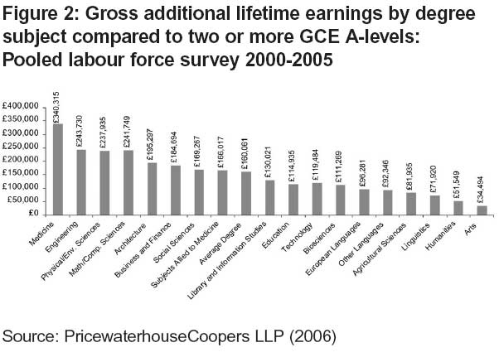
Return on Investment?
Notes:
On the other hand, computer science graduates seem to do well over the long term. On par with other STEM subjects…

Slide 29
What this means for you…
If you have the high-level technical skills and business awareness the IT industry needs, then…
  Your skills will be wanted more than ever.
  The jobs will be more interesting and challenging.
  The pay will be good - simple supply and demand.
If you don’t then the low-end IT jobs won’t be there
  Those jobs have (largely) been off-shored!
The IT industry only employ staff who make money
  What you learn in the coming years is critical…
  The degree certificate itself is not enough…
Notes:
The key message here is that mediocre won’t cut it. The entry level of the IT profession has increased over the last 10-20 years. Those who respond will do well, those who don’t will be out of the game.
So if anyone thinks that pushing less than strong students towards IT in the expectation that it’s a ticket to a professional career because they can get the PC working better than the baby boomers is not giving good advice. The ability needed to get in the game is going up…
Learning spreadsheets won’t help. The intellectual challenge of proper computing can. So why are we teaching the former in schools? We should be giving them the good stuff – so thank you CAS!..☺

Slide 30
Key Sources
Much of the data was taken from the e-Skills ‘Technology Insights’ report series.
  www.e-skills.com
Other useful sources are:
  www.prospects.ac.uk
  www. jobstats.co.uk
  www.uvac.ac.uk
  www.bcs.org/careers/
Any questions?...☺

Slide 31
Further Reading
Wolf, A. (2002). Does Education Matter? Myths About Education And Economic Growth, London: Penguin Press.
Wolf, A. (2009). An Adult Approach to Further Education, London: IEA.
Leitch, S. (2006). Prosperity for all in the global economy - world class skills: Final Report of the Leitch Review of Skills. London: HM Treasury.
Brown, P. and Hesketh, A. (2004). The Mismanagement of Talent: Employability and Jobs in the Knowledge Economy. Oxford: OUP.
Knight, P., and Yorke, M. (2004). Learning, Curriculum and Employability in Higher Education, London: Routledge Falmer.
Morley, L., Eraut, M., Aynsley, S., McDonald, D., and Shepard, J. (2006). Needs of employers and related organisations for information about quality and standards of higher education. Bristol: Higher Education Funding Council for England.

