Slide 1
Using a LLM to mark free text questions on Ada

Slide 2
What is Ada Computer Science?
Free online platform built and maintained by the Raspberry Pi Foundation and the University of Cambridge
Designed for teachers and learners (aged 14+)
Written by computer science subject experts; based on extensive research and evidence about pedagogy
Integrates:
comprehensive instructional materials introducing concepts
self-marking questions to reinforce and assess learning
automated high-quality formative feedback

Slide 3
More than just Ada!
The Ada team delivers the computer science strand of the STEM SMART programme alongside our colleagues at the University of Cambridge. This is aimed at supporting able but disadvantaged students apply to top universities.
We also deliver the Bebras Challenge and OUCC in the UK. The former is the world’s largest computational thinking competition; this year over 400,000 students took part in the UK. Soon you will discover Bebras style questions on Ada and links to Ada learning material on the Bebras site.
We offer Teacher mentoring to teachers with weekly online mentoring sessions with members of our team.
We have a number of Student Challenges throughout the year. Currently we have the Encryption Challenge for students to take part and earn rewards!

Slide 4
How is Ada different from Isaac CS?
The teams at the Raspberry Pi Foundation and the University of Cambridge are no longer involved in Isaac CS
Since we launched Ada Computer Science we have:
Written over 150 new questions and re-titled all questions so they are easier to find
Added exemplar code in Java and Visual Basic (VB)
Reviewed and updated several topics
Improved the UI for teacher features
Introduced an embedded SQL editor
Published a new AI and Machine Learning topic
Published a database project to support with the NEA

Slide 5
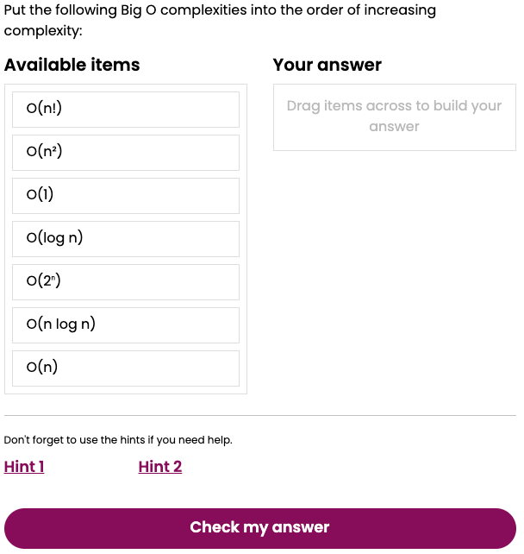
Questions on Ada
Ada CS has over 1000 self-marking questions. Eleven question types. Designed to help learners self-assess and reinforce learning.

Slide 6
The problem!
Despite all these different question types, we struggle to mark the main type of question that students get in real exams.
Something like this:
1.a)
Explain the difference between a compiler and an interpreter.
[2 marks]

Slide 7
Pilot study - LLM tool to mark questions on Ada
Overview of the study:
16 questions (from a past OCR exam paper)
100 students (with necessary permissions)
1543 usable student responses
7 teachers marking
Each response was marked by 3 teachers (including their own)
Students received marks from their teacher only

Slide 8
Pilot study - preparation
OCR Agreement
Ethics Approval
Teacher sign up
Consent
Permission
We signed a contractual agreement with OCR to use a few questions from past exam papers
We received ethics approval from University of Cambridge for the study
We signed up teachers at our teachers event
We created consent forms for teachers and students for them to take part and for us to use their data
We also created permission forms for parents to be used when needed

Slide 9
Pilot study - carrying out the test
Invite to Group
Teacher marking
Testing Window
LLM tool marking
Once the students (and their teacher) had signed the consent form they were given the code to join the group and take the test
After the two week testing window, the teachers were sent a link to the marking tool
Each student response was sent to three teachers, so each teacher marked around 48 papers
Each student response was also marked by our LLM tool powered by GPT3 and GPT4

Slide 10
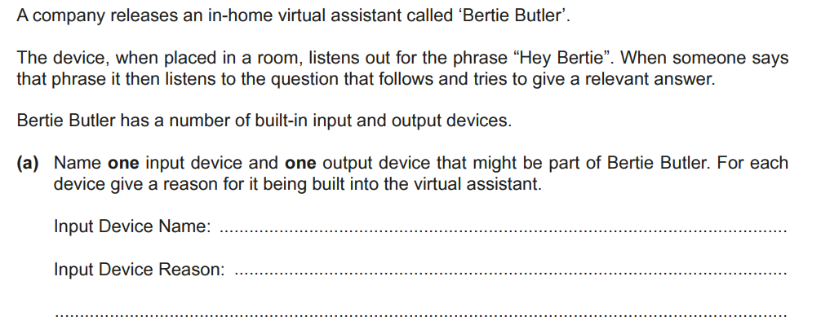
Exam paper question

Slide 11
Student example #1
What mark would you award out of a maximum of 2? (max 1 device name, max 1 reason)
Microphone, needed to listen out for the phrase “Hey Bertie” (so that it can then listen to the question asked and attempt to give a relevant answer)

Slide 12
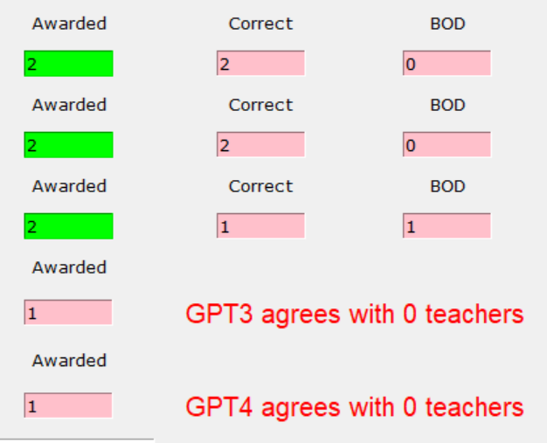
Student example #1
Microphone, needed to listen out for the phrase “Hey Bertie” (so that it can then listen to the question asked and attempt to give a relevant answer)
Issue: GPT-3.5 and GPT-4 may not have awarded the second mark because of the exact match in the “Do not award” comment.
Notes:
Possible solution: Clarify in the prompt to not allow the reasoning mark if only “...Hey Bertie” is given without any further explanation.

Slide 13
Student example #2
What mark would you award out of a maximum of 2? (max 1 device name, max 1 reason)
Bertie could have a microphone as an input device so that the user can use their voice to interact with bertie and have it translated to instructions for bertie.

Slide 14
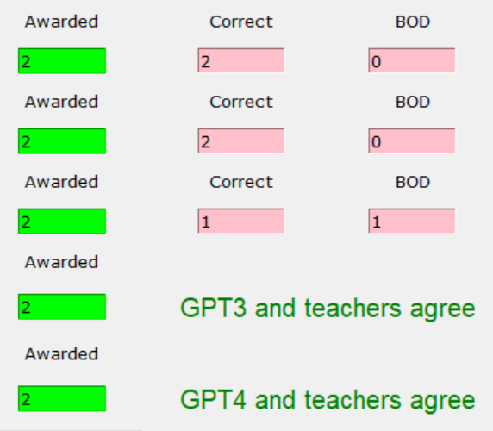
Student example #2
Bertie could have a microphone as an input device so that the user can use their voice to interact with bertie and have it translated to instructions for bertie.
Everyone agrees! Happy days :-)
Notes:
Note that in the platform version, the LLM questions will display the full mark scheme and which specific mark criteria have been awarded.

Slide 15
Student example #3
What mark would you award out of a maximum of 2? (max 1 device name, max 1 reason)
microphone to pick up sound

Slide 16
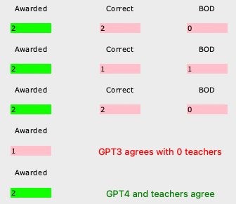
Student example #3
microphone to pick up sound
GPT-3.5 doesn’t agree :-(
Do you?!

Slide 17
Student example #4
What mark would you award out of a maximum of 2? (max 1 device name, max 1 reason)
Microphone to listen for commands

Slide 18
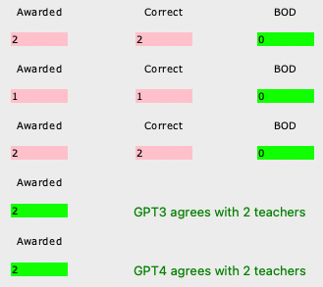
Student example #4
Microphone to listen for commands
A teacher doesn’t agree!
GPT-3.5 and GPT-4 agree with two out of three teachers.

Slide 19
Student example #5
What mark would you award out of a maximum of 2? (max 1 device name, max 1 reason)
Microphone so that it can listen when it has been activated by 'Hey Bertie'

Slide 20
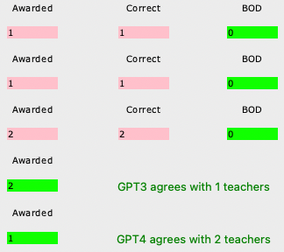
Student example #5
Microphone so that it can listen when it has been activated by 'Hey Bertie'
GPT-3.5 agrees with 1 teacher…
GPT-4 agrees with 2 teachers!

Slide 21
Question 1 - marking disparity
Out of 100 student responses:
There were 9 occasions when the LLM tool using GPT-3.5 did not agree with any of the teachers (but GPT-4 did agree with at least one teacher)
On 5 occasions it was was stricter than the teachers
On 4 occasions it failed to award a mark for the device “microphone” which should clearly have been awarded

Slide 22
Question 1 - marking disparity
Out of 100 student responses:
There were 9 occasions when the LLM tool using GPT-4 did not agree with any of the teachers (but GPT-3.5 did agree with at least one teacher)
On 2 occasions it was over generous (but on one of these it could be argued that the marking was correct)
On 7 occasions it was stricter than the teachers

Slide 23
Question 1 - marking disparity
Out of 100 student responses:
There were 7 occasions when GPT-3.5 and GPT-4 did not agree with any of the teachers
On all 7 occasions only 1 mark was awarded by GPT-3.5 and GPT-4 instead of 2 marks that all of the teachers had given

Slide 24
Pilot study - data analysis
 | Agreement with majority vote teacher mark |  | Agreement with any teacher
Max marks | GPT-3.5 | GPT-4 | GPT-3.5 | GPT-4
1 | 0.80 | 0.81 | 0.91 | 0.94
2 | 0.67 | 0.73 | 0.82 | 0.88
3 | 0.51 | 0.65 | 0.74 | 0.81
4 | 0.38 | 0.47 | 0.65 | 0.70
Average | 0.66 | 0.72 | 0.82 | 0.87
Average pairwise agreement of the seven participating teachers = 0.69 (0.70, 0.67, 0.67, 0.73, 0.66, 0.71, 0.71)
Notes:
Average pairwise agreement between teachers is where we measure agreement as "joint probability of agreement" https://en.wikipedia.org/wiki/Inter-rater_reliability

Slide 25
Pilot study - conclusions
Teachers do not always agree with teachers!
GPT-3.5 and GPT-4 do not always agree with teachers!
Agreements are more likely with questions which have lower marks
1 and 2 mark questions had much higher agreement compared to the 3 and 4 mark questions
Potential for the LLM marking to be further improved by tweaking the prompts
E.g. n-shot examples, chain-of-thought
Notes:
N- shot examples is the example answers provided. MS is used as chain of thought

Slide 26
🥁 LLM questions on Ada
Questions are tagged as LLM marked.
Banner with accuracy results from pilot study, link to FAQ, and how to withdraw consent.
Example question: Arithmetic logic unit (ALU) operations
Notes:
https://adacomputerscience.org/questions/alu_operation_example

Slide 27
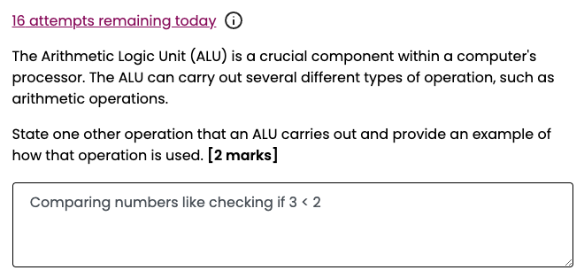
Daily cap per user to provide equal opportunity due to fixed monthly budget.

Slide 28
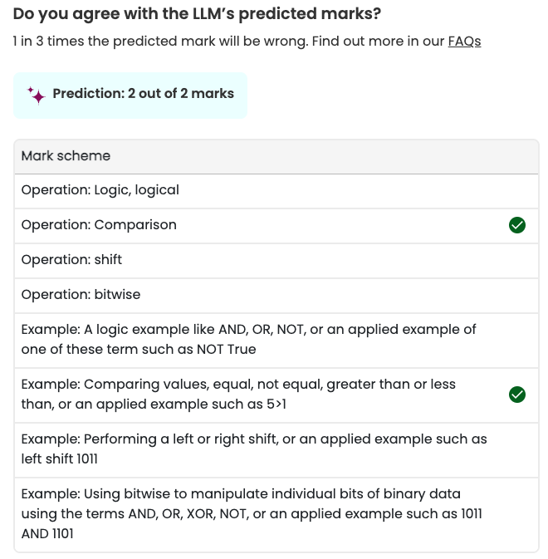
States marks are a prediction with purposeful, challenging language.
Provides link to FAQ and predicted marks.
Displays full mark scheme (used by the LLM) and highlights marks given.

Slide 29
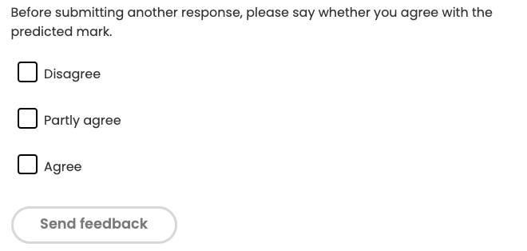
Users are encouraged to report on agreement of marks given.

Slide 30
How we try to ensure transparency
For each LLM question we:
Require people to log in and consent to sending answering to OpenAI
Include a banner highlighting the accuracy results from the pilot study, link to an FAQ, and how to withdraw consent
Provide the markscheme, marks given, and state this is a prediction
Allow users to report on the agreement of marks given
The report will be used to inform our monthly review of common wrong answers to improve performance of LLM tool

Slide 31
How we try to ensure reliability
To help us get good results we:
Provide example responses with a range of marks (n-shot examples)
Breakdown the markscheme into 1 mark options (chain-of-thought)
Test and refine the prompts to improve accuracy
If during a review we find a misclassified example we can:
Add it to the examples
Fine-tune the examples and prompts
Notes:
Chain-of-thought prompting is where the prompt says to consider step-by-step or, in this case, mark-by-mark.

Slide 32
Risks and mitigations
Received approval from the University of Cambridge ethics committee!!!
Privacy policy updates agreed by Raspberry Pi and UoC
Low-stakes (formative) questions only
Starting with 2 mark questions
Aim for false negatives over false positives
Awareness and increased testing of potential problems caused by tokenisation e.g. binary numbers
Notes:
Models tend to handle misspelling fairly well but it is something we will monitor.

Slide 33
Risks and mitigations
Commercial licence purchased from OpenAI - their policy is not to train models on any data that is submitted via their API
We only send the contents of the user’s answer to the LLM; we do not send any user account information or personal data
No text output from the LLM is returned to the user, only the human-written itemised mark scheme, checked marks and LLM prediction
Emphasis is not on the LLM marks but on the pedagogical activity of the learner self-marking and comparing their answer to the mark scheme
Notes:
Key point: LLMs are not really reliable enough to do marking blindly at this point. We are returning the mark scheme with the predicted marks to shift the emphasis of the task from the marking to the secondary pedagogical activity of self-marking their attempt against the mark scheme and comparing the predicted marks to what they would have awarded themselves. They can then alter their answer to try and get the full marks and this raises the awareness of the student of how their questions are going to be marked in an exam. This is likely to be the key differentiator between our offering and what other platforms will develop.

Slide 34
Let’s try the questions
LLM free-text questions:
Link: rpf.io/5o
Notes:
Quiz: https://adacomputerscience.org/quizzes/view?#llm_test_july2024

Slide 35
Next steps
There are currently 10 Live LLM questions.
We have developed 20 more GCSE/Core questions which will be live by end of October.
20 more for A-Level/Advanced students will be live by the end of the year.
Target of 50 LLM questions by the end of the year

Slide 36
Thank you!
Questions

